Slide 1



An Introduction to the Advanced Placement® Program
<Your School’s Name>

Slide 2
Introducing the AP Program to Your School Community
This presentation was created for counselors to help students and families familiarize themselves with the AP® Program throughout the course selection process.
We know that schools have various AP offerings, policies, and procedures. You can copy and paste and personalize the presentation for your school.
We recommend that you deliver this presentation as part of your course selection meetings, either in person or by sharing your screen during a virtual meeting.
Other ways to share this presentation:
First, be sure to customize the presentation to your school.
Record a voiceover to accompany the slides. Then share the slides with voiceover presentation with your school community through your school website, newsletter, email, or social media channel(s).
Post the slides with detailed notes (if not including a voiceover) on your school website and social media channel(s).

Slide 3
Welcome
Welcome
<Your School’s Name> is committed to every student’s success.
We believe access to college-level studies such as Advanced Placement® (AP®) plays an important role in that success.

Slide 4
What We’ll Cover
1
What Are Advanced Placement Courses?
4
AP Exams
2
Benefits of Taking AP
5
The Reality of AP
3
Resources and Supports for Student Learning
6
Questions and Answers

Slide 5
What Are Advanced Placement Courses?
What Are Advanced Placement
Courses?

Slide 6
The Basics
AP® courses are college-level courses offered in high school.
Courses reflect what’s taught in introductory college courses.
Students take AP Exams at the end of the course, measuring their mastery of college-level work.
Students can typically earn college credit and/or placement into honors or advanced courses when they score a 3 or higher on an AP Exam.

Slide 7
Our AP Courses
<This slide will list your school’s AP courses. Delete courses not offered at your school.>
AP Capstone™: AP Seminar, AP Research
Arts: 2-D Art and Design, 3-D Art and Design, Art History, Drawing, Music Theory
English: English Language and Composition, English Literature and Composition
History and Social Sciences: Comparative Government and Politics, European History, Human Geography, Macroeconomics, Microeconomics, Psychology, United States Government and Politics, United States History, World History: Modern
Mathematics and Computer Science: Calculus AB, Calculus BC, Computer Science A, Computer Science Principles, Precalculus, Statistics
Sciences: Biology, Chemistry, Environmental Science, Physics 1: Algebra-Based, Physics 2: Algebra-Based, Physics C: Electricity and Magnetism, Physics C: Mechanics
World Languages and Cultures: Chinese Language and Culture, French Language and Culture, German Language and Culture, Italian Language and Culture, Japanese Language and Culture, Latin, Spanish Language and Culture, Spanish Literature and Culture

Slide 8
AP at <School Name>
<Here you can list some interesting facts about AP in your school such as:>
Number of students enrolled in AP
Number of exams taken last year
Quotes from recent graduates about how taking AP courses and exams benefited them in college
Additional supports provided to students (e.g., summer ramp-up programs for incoming students, mentors, office hours, study groups)

Slide 9
Benefits of Taking AP
Benefits of Taking AP

Slide 10
About the AP Experience
“It’s a good learning experience, no matter
what the outcome is.”
— Ny’Asia, AP Student
Research shows that when students are given access to advanced coursework opportunities, they:
  Work harder.
  Engage more in school.
  Have fewer absences/suspensions.
  Graduate at higher rates.
(EdTrust, 2019)
“The AP credits I received allowed me to skip straight to higher-level, more demanding courses in my major.”
— Tyler V., University of Washington

Slide 11




A Head Start in High School
Research consistently shows that AP students are better prepared for college than students who don’t take AP. They’re more likely to enroll and stay in college, do well in their classes, and graduate in four years.
Get a Taste of College
Get familiar with college-level work—and boost your confidence by tackling it.
Develop College Skills
Time management, critical thinking, scholarly writing—AP courses help you hone the skills you’ll need in college and career.
Discover Your Passion
Studying a subject in depth could give you new insights and even put you on the path to a career.
Boost GPA <Include this bullet if applicable>
Our school offers a GPA boost to students who take AP courses and/or exams. This helps students stand out on college applications and stay motivated to take AP courses.

Slide 12




An Edge in College
Taking AP courses in high school could give you an advantage in college.
Earn College Credit
Your AP score could earn you college credits before you even set foot on campus.
Stand Out to Colleges
AP on your high school transcript shows colleges you’ve tackled college-level work.
Earn Placement in Advanced or Honors Courses
Your AP score can let you skip introductory courses in college.
Save Money and Time
Earning credit or placement can free up time on your schedule or even let you graduate early.

Slide 13
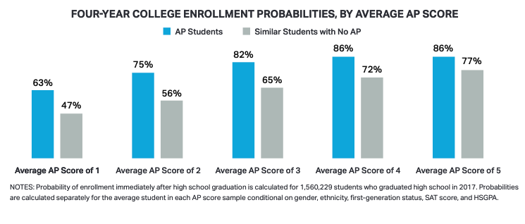
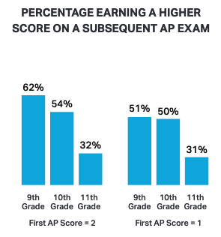
New Findings on the AP Experience
Regardless of the score, completing an AP Exam has benefits.
AP students, including those with average scores of 1 or 2, are more likely to enroll in a four-year college compared to academically similar students who did not take AP in high school.
Many students who first earn an AP Exam score of 1 or 2 will then earn
a higher score on the subsequent AP Exams they take.
Source: https://research.collegeboard.org/pdf/new-analyses-ap-scores-1-and-2.pdf

Slide 14
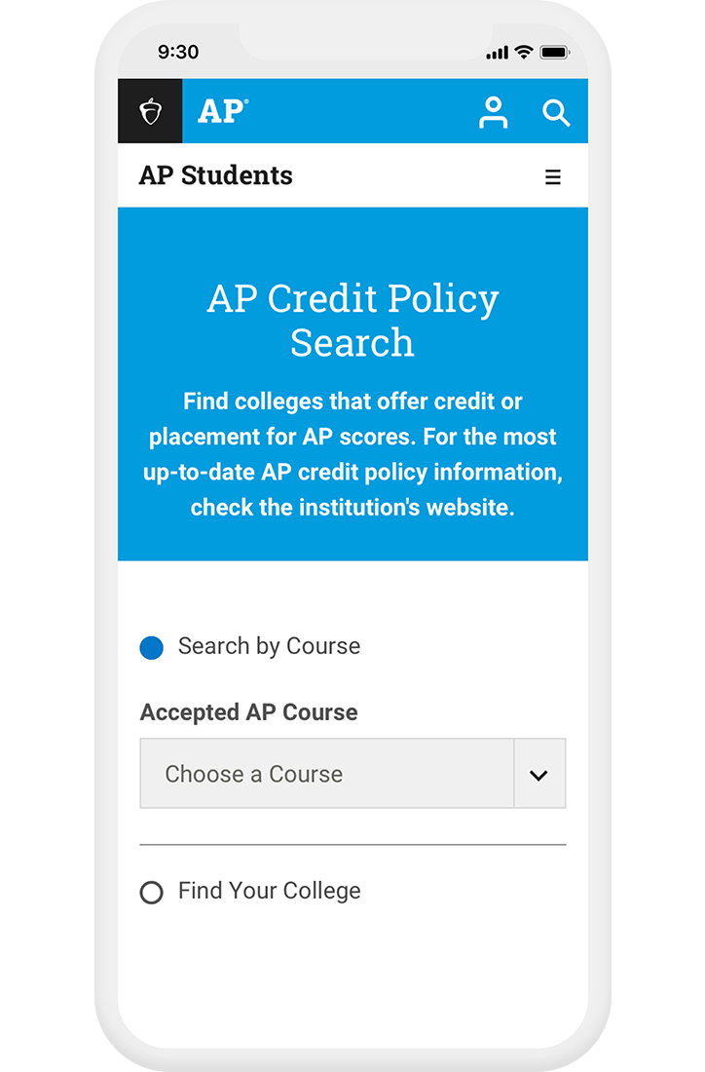
Credit and Placement Opportunities
Each college and university has its own policies regarding AP credit and placement.
Find colleges that grant credit, placement, or both for AP Exam scores at collegeboard.org/apcreditpolicy
  Search by course or college
  Data for each college includes a direct link to that college’s website detailing AP credit and placement policies
  See each college or university’s statement about its AP policy

Slide 15
Credit vs. Placement
Credit
  Many colleges offer credit for AP scores.
  Example—a student earns a 4 on their AP Biology Exam, and the college grants 8 credits for that score. That means the student has earned 8 credits before taking their first class there.
Placement
  Many colleges recognize that AP scores demonstrate knowledge of material in certain courses and let students skip those courses.
  These could be introductory courses required in your major, or core courses the college requires all its students to take.
In some cases, students can get both credit and placement for a qualifying AP score.

Slide 16

Resources and Supports for Student Learning
Resources and Supports for
Student Learning

Slide 17

Sign In to Access AP Resources
myap.collegeboard.org
AP Classroom is an online resource that helps students improve their performance all year long.
It’s mobile friendly, so students can access it anytime, anywhere, once they’ve joined the class online.
AP Classroom includes:
  AP Daily Videos
  Practice Questions
  Personal Progress Checks
  Progress Dashboard

Slide 18

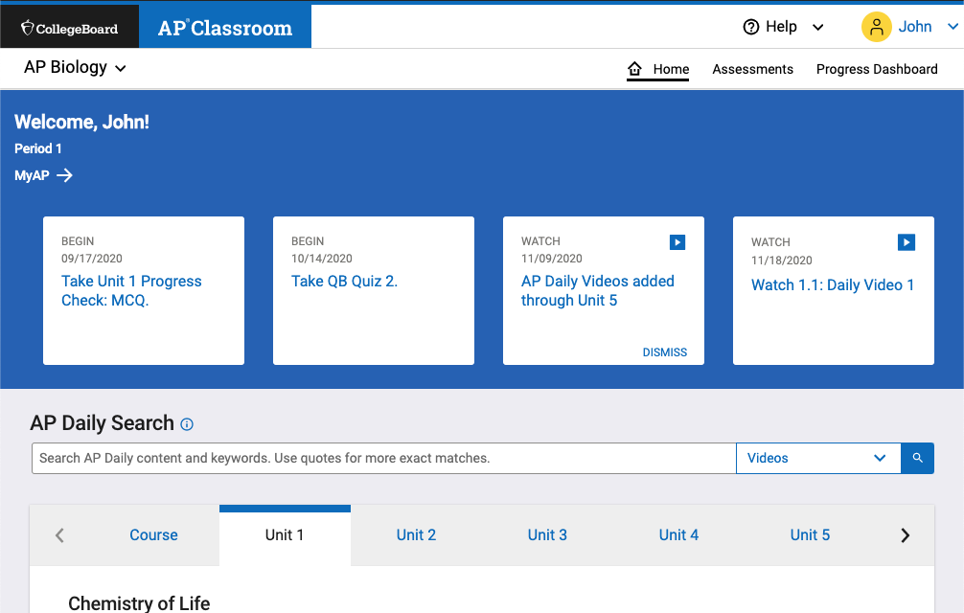
AP Daily Videos
Short learning videos on every topic in every unit for targeted support to help students build knowledge and skills
Roughly 8 minutes long
2 or 3 videos for every topic and skill pairing within a given unit
Led by expert AP teachers
Accessible anytime, anywhere, so students can get answers to questions the moment they have them

Slide 19
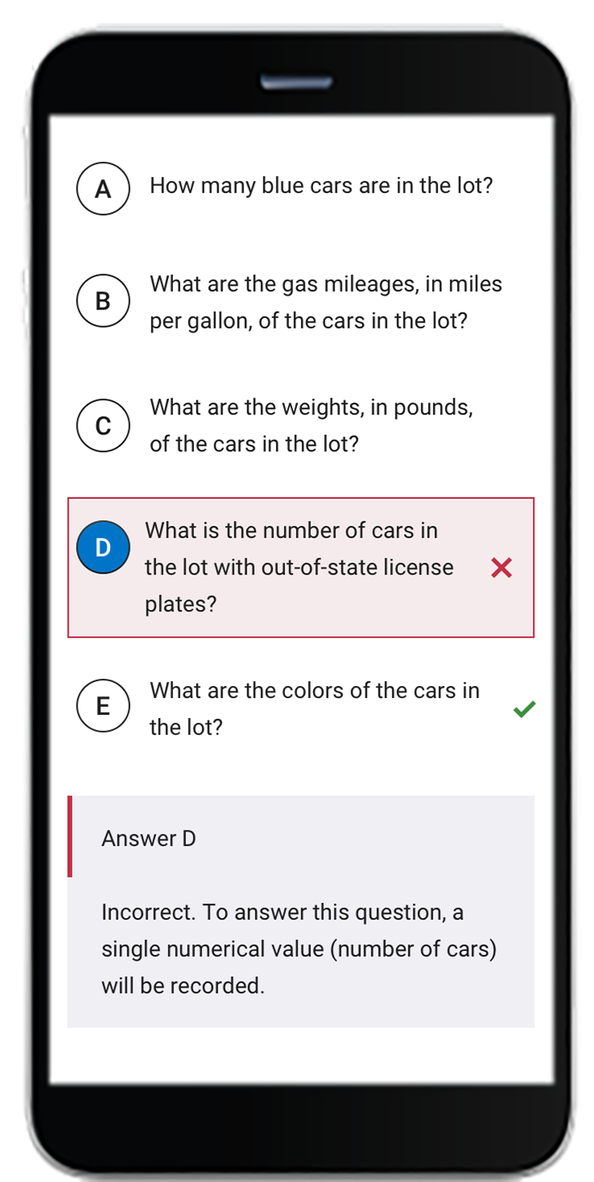
Topic Questions
Topic questions provide students with practice applying the content and skills for each topic within a unit.
Topic questions give teachers and students just-in-time feedback and insights into student misunderstandings.
Students can complete these quick checks for understanding from their cell phone, a tablet, or computer.
Responses give students and their teachers insights into how they’re progressing in the course.

Slide 20
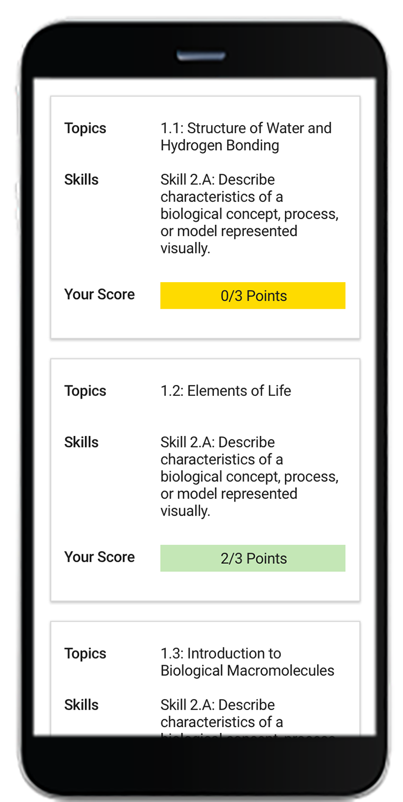
Personal Progress Checks
Real-time feedback on the topics and skills in each unit as the teacher unlocks progress checks
Formative assessments of college-level knowledge and skills designed to:
  gauge student progress over time
  highlight areas of strength
  identify areas students need to work on or get support for
Personal Progress Checks are assigned at the end of each unit, after students have learned the unit’s topics and skills

Slide 21
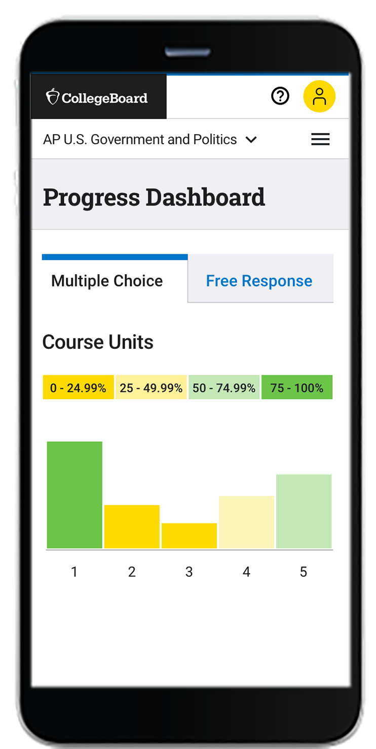
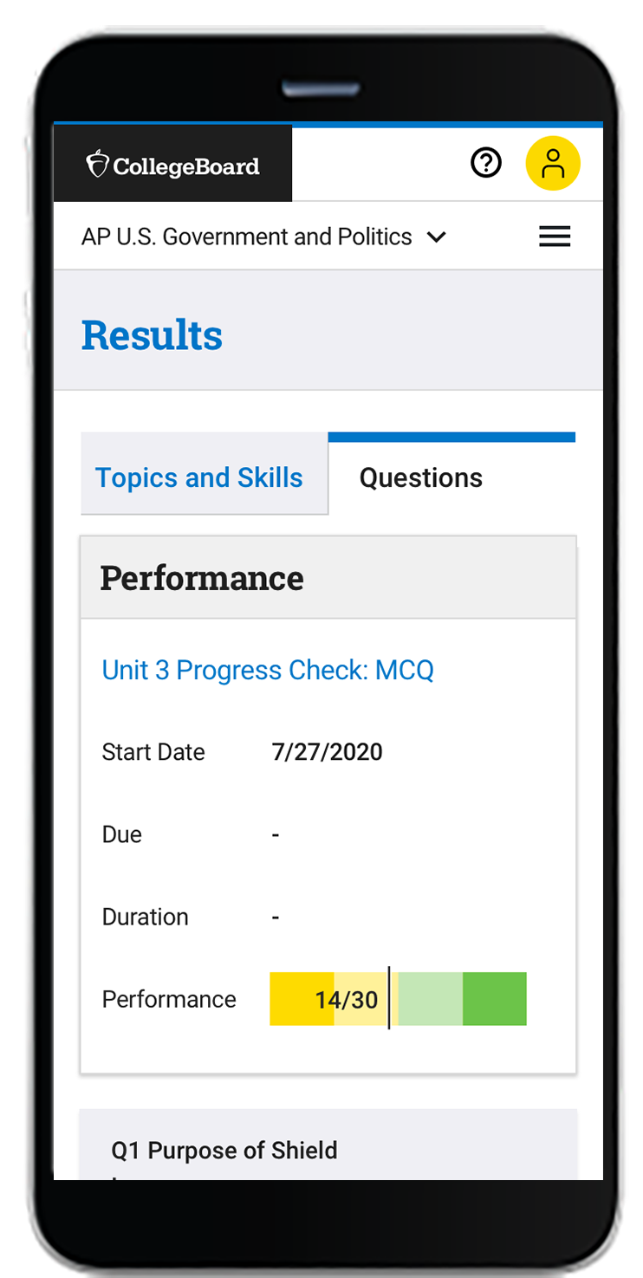
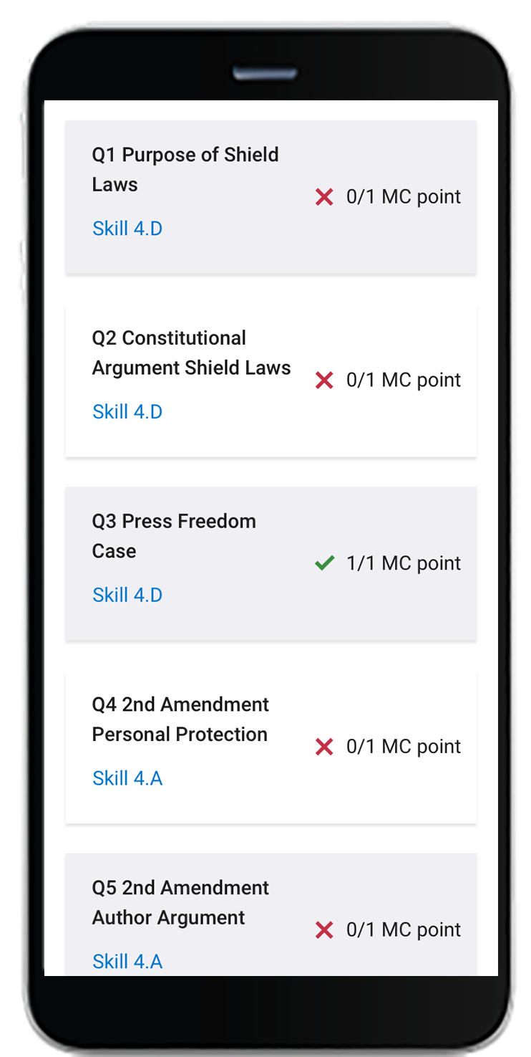
Student Progress Dashboard
Enables students to view their progress unit by unit
Allows students to celebrate successes and focus on areas of growth

Slide 22
AP Exams
AP Exams

Slide 23
About AP Exams
Standardized exams that measure how well students have mastered the content and skills of a specific AP course
Administered by schools worldwide every year in the spring
Most AP courses have an end-of-year paper and pencil exam, but a few courses have different ways to assess what you’ve learned—for example, AP Art and Design students submit a portfolio of work for scoring
Most AP Exams are 2–3 hours long.
  The first part of the exam usually consists of multiple-choice questions.
  The second part of the exam usually consists of free-response questions.
Created and scored by teams of AP teachers and college professors

Slide 24
The Reality of AP
The Reality of AP

Slide 25
Myths and Facts About AP
Myth #1 – AP courses are for students who always get good grades.
Myth #2 – AP courses are too hard and stressful.
Myth #3 – I don’t think I’ll score high enough on the AP Exam to get college credit.
Reality – You don’t need to be top of your class to be an AP student, but you’ll want to be prepared for the AP course you choose. AP courses ask that you come willing to do your best work.
Reality – AP classes can be challenging, but that doesn’t mean you’re not up to the task. If you’re willing to work hard and if you’re prepared academically, you should be able to succeed in an AP course.
Reality – Many colleges grant credit, placement, or both based on a 3 or higher on an AP Exam.
Myth #4 – Taking AP courses could hurt my GPA.
Myth #5 – I’m not sure AP is for me. How do I know if I’m ready?
Myth #6 – The final step in your AP journey is taking the AP Exam.
Reality – <Describe any extra weighting for AP course grades that your school may offer.> Taking AP courses shows colleges that you’re willing to challenge yourself academically.
Reality – If you think you’re ready to take an AP course, then you’re ready to advocate for yourself—talk to a teacher or counselor.
Reality – Every year that you take AP Exams, you can send one score report for free to the college, university, or scholarship organization of your choice. Be sure to take this important last step.

Slide 26
Next Steps
Decide which AP courses are right for you:
  What subjects do you enjoy most?
  Which subjects do you excel in?
  Have you completed the course prerequisites?
Talk to your teachers and counselor.
Talk to other students who have taken AP courses
Deadline to register for AP courses: <Insert your school’s deadline. Include any specific steps students need to take to register.>

Slide 27
Questions and Answers
Questions and Answers

