Slide 1
Advanced Placement® Program

Slide 2
About the Advanced Placement Program
Excellence in Education Since 1955
There are 38 AP® courses in seven subject categories.
Financial assistance for the AP Exam fee is available for students who need it.
No matter their score, taking an AP course and exam helps students stand out to colleges.
More schools than ever before are accepting AP scores for credit and placement. Students should take advantage of their free score sends following the exam administration.
Nearly all colleges offer credit for qualifying scores for the most popular AP courses.
3 out of 4
AP Students
enrolled in
a four-year college
start school with
some AP credit
Notes:
AP offers students the opportunity to take college-level courses and exams in high school and earn college credit, advanced placement, or both at many colleges and universities in the U.S. and around the world.
By earning college credit in high school and skipping introductory courses in college, students can save time and money as they work toward a college degree.
In fact, 3 out of 4 AP students enrolled in a four-year college start school with some AP credit.
There are currently 38 AP courses in seven subject categories, with that number expanding each year. Next year, the number will expand to 39 courses with the addition of AP Precalculus.

Slide 3
About AP Exams
Each AP course concludes with a standardized college-level assessment, or AP Exam, that measures how well students have mastered the content and skills
Administered at authorized schools and test centers each year in May
Most are paper and pencil exam, but a few courses have different ways to assess what students have learned—for example, AP Art and Design students submit a portfolio of work for scoring.
Exams are scored on a scale of 1 to 5
Created and scored by teams of AP teachers and college professors
Notes:
Each AP course concludes with a college-level assessment, or AP Exam
Most AP Exams are paper and pencil, but a few courses have different ways to assess what students have learned – for example, AP Art and Design students submit a portfolio of work to be scored. We also offer select exams to be taken digitally in school.
You’ll see later in this presentation that College Board is starting to incorporate more performance tasks as part of assessing students’ knowledge.
Exams are scored on a scale of 1 to 5 – with 5 being the highest grade and are scored by teams of AP teachers and college professors.

Slide 4
Instructional Supports
Notes:
To ensure both students and teachers make the most of their AP journey, we offer several instructional supports to guide them along the way.

Slide 5
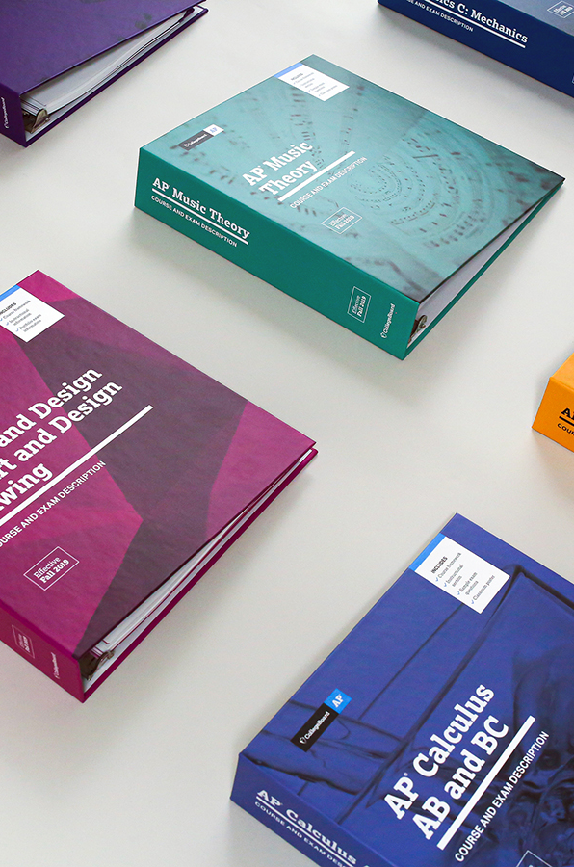
AP Course and Exam Descriptions
Flexible instruction and pacing to reach all students.
AP Course and Exam Descriptions (CEDs) with Unit Guides organize course content and skills in a recommended sequence with suggested pacing.
The units lay out content with sequence and pacing teachers can adopt or modify.
The sequence enables skill practice in progressive complexity from unit to unit.
The pacing is ~140 classes (45 minutes each), accounting for non-instruction days and time to administer formative assessments.
Instructional strategies model how to effectively build knowledge and skills relevant to each unit's content.
Notes:
Each AP course come with Course and Exam Descriptions (CEDs).
The CEDs have Unit Guides that organize course content and skills in a recommended sequence with suggested pacing.
So it’s a great resource for teacher’s to effectively build knowledge and skills relevant to each unit's content.

Slide 6
AP Classroom
Free and flexible instructional resources for AP teachers and students.
Unit Guides provide an outline of the exact content and skills covered on the exam and include Topic Pages, which describe the content for each topic.
Personal Progress Checks (PPCs) assess student understanding of topics and skill within a unit through multiple-choice and free-response questions.
AP Daily is a series of on-demand, short videos that teachers can assign to students*, saving direct class time to focus on areas where students need help.
The Progress Dashboard can help teachers recognize student achievement and prioritize areas for extra support by pinpointing strengths and weaknesses.
Topic Questions are formative questions that teachers can use to check student understanding of content and skills as each topic is taught.
The Question Bank is a searchable database of real AP questions that teachers can use to create customized practice, online or on paper.
* AP Daily videos are always visible and available to all students, including students in Exam Only sections, regardless of whether teachers have assigned them.
Topic Questions, PPCs, and Question Bank assessments are only visible to students if a teacher assigns them.
Notes:
To ensure continued student success throughout the AP program, we offer resources to support teaching and learning through our online platform called AP Classroom.
With just 1 click, teachers can assign all topic questions for any topic and skill in the unit they’re teaching or reviewing.
In just 1 place, teachers can manage all class assignments, including AP Daily videos, practice exams, and their own quizzes.
In just 1 place, teachers get immediate access to student results through the progress dashboard and a new "gradebook-style" view of all their students' work.

Slide 7





Help Your Students Go Farther
These AP Courses Open Access and Opportunity
Notes:
As mentioned earlier, there are currently (2022-23 school year) 38 AP courses and that number is expanding each year.
Now, let’s highlight a few key courses that will help to expand access to AP.

Slide 8
Small Edits,
Big Impacts
Consider adjusting your master schedule to engage more students.
Notes:
Consider adjusting your master schedule to engage more students.

Slide 9
3 Problems
Your Master Schedule Can Fix
Consider
adjusting your master schedule to engage more students
Notes:
There are 3 problems that your master schedule can fix.

Slide 10
3 Problems
Your Master Schedule Can Fix
1
Pursuing STEM Majors
UNDER REPRESENTATION
Asian
White
First
_{Female Black} Hispanic ^{Gen}
Female, Black, Hispanic, and First Generation students are least likely to declare a major in STEM.
Notes:
First, there is an under representation of students pursuing STEM majors.
Female, Black, Hispanic, and First-Generation students are least likely to declare a major in STEM.

Slide 11
3 Problems
1 Pursuing STEM Majors
UNDER REPRESENTATION
Asian
White
First _{Female Black} Hispanic ^{Gen}
Female, Black, Hispanic, and First Generation students are least likely to declare a major in STEM.
2
Staying In College
GIVING UP
Your Master Schedule Can Fix
Not all students who start college finish college. About 1 of every 4 students don’t make it to Year 2.
Notes:
The second problem is retention. Not all students who start college finish college. About 1 of every 4 students don’t make it to their second year.

Slide 12
3 Problems
Your Master Schedule Can Fix
2
Staying In College
3
Achieving STEM Degrees
1 Pursuing STEM Majors
UNDER REPRESENTATION
Asian
White
First _{Female Black} Hispanic ^{Gen}
Female, Black, Hispanic, and First Generation students are least likely to declare a major in STEM.
GIVING
UP
Not all students who start college finish college. About 1 of every 4 students don’t make it to Year 2.
FALLING SHORT
40%
Students who enter college as STEM majors switch to a non-STEM major or fall short of a degree after failing common gateway courses, particularly calculus.
Notes:
And third, 40% of students who enter college as STEM majors switch to a non-STEM major or fall short of a degree after failing common gateway courses, particularly calculus.

Slide 13
How Can AP Help?
Notes:
How can AP help help with these problems?

Slide 14



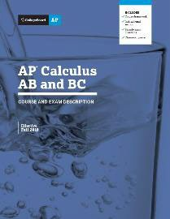
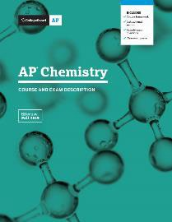

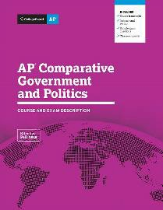
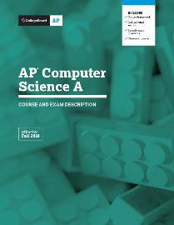
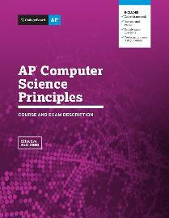
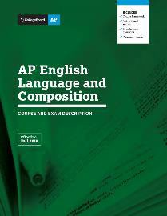

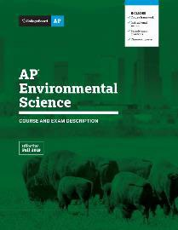

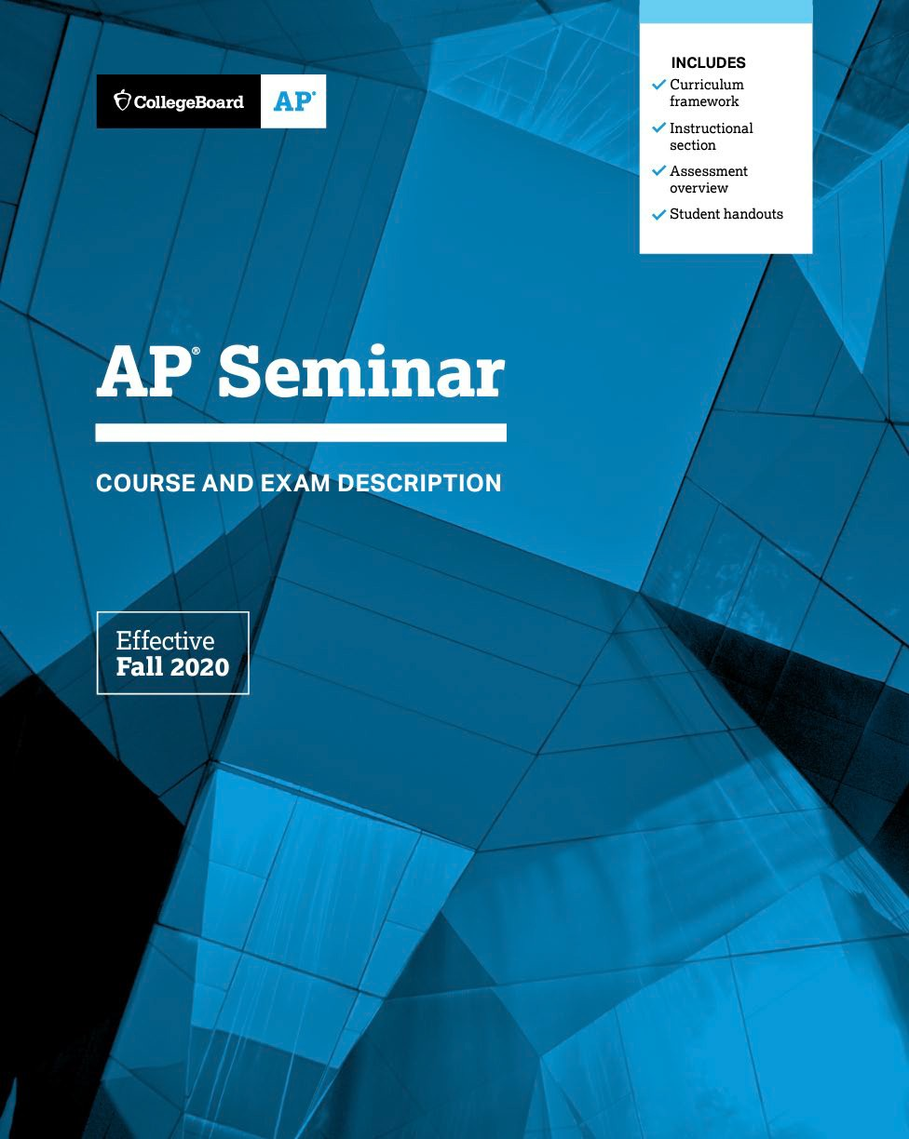
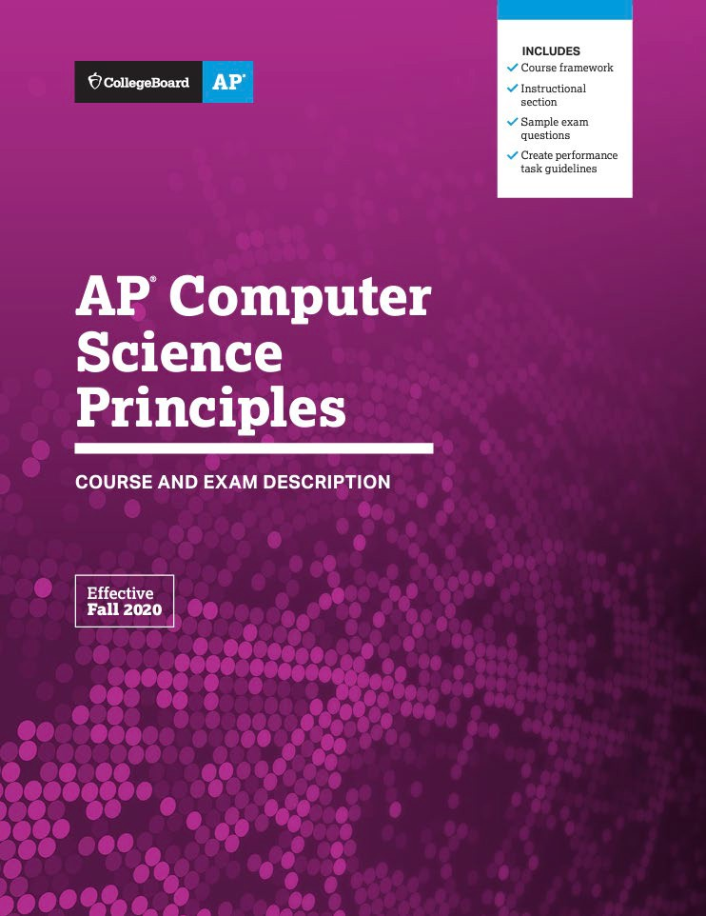



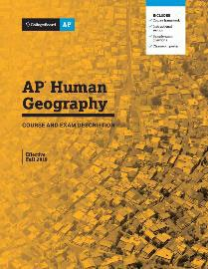


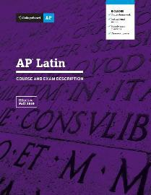
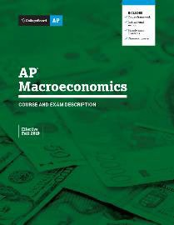
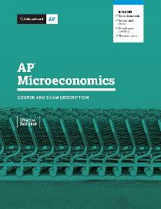
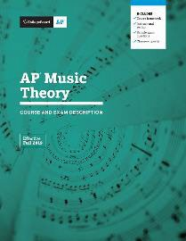
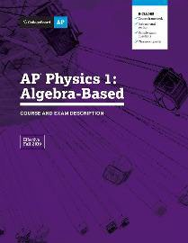
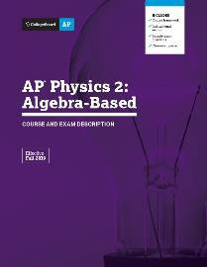
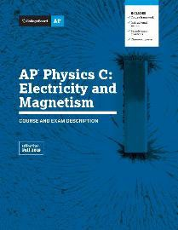
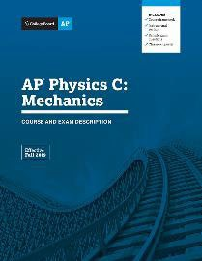

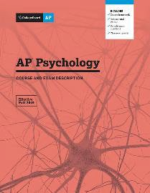
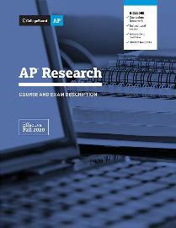
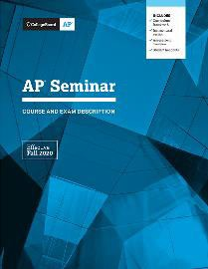
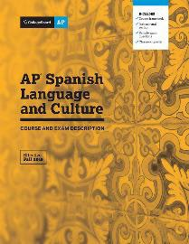

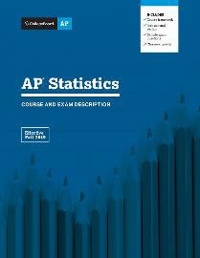
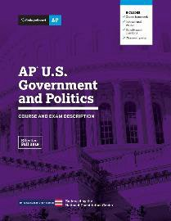
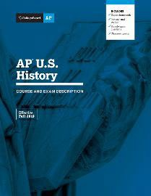

Notes:
These three courses (AP Precalculus, AP Seminar, and AP Computer Science) are all designed to combat these problems. Let me explain how…

Slide 15
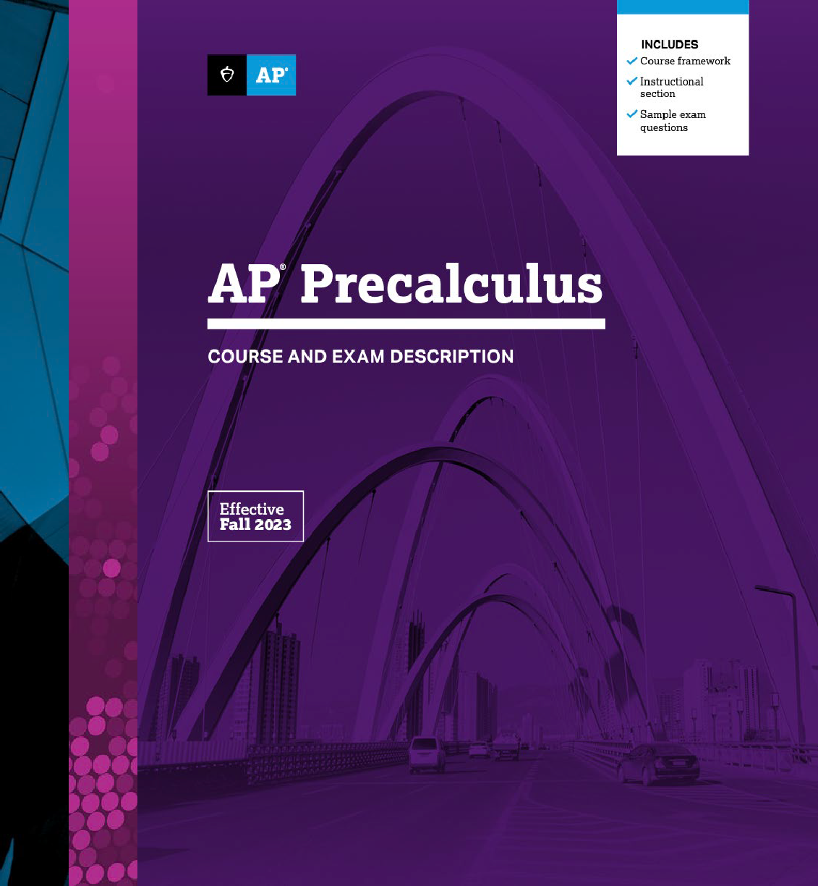
2.5x
Students who take precalculus are nearly 3 times more likely to earn a college degree, more so than students who take Algebra 2, Trigonometry, or Calculus.
Notes:
Students who take precalculus are nearly 3 times more likely to earn a college degree, more so than students who take Algebra 2, Trigonometry, or Calculus

Slide 16
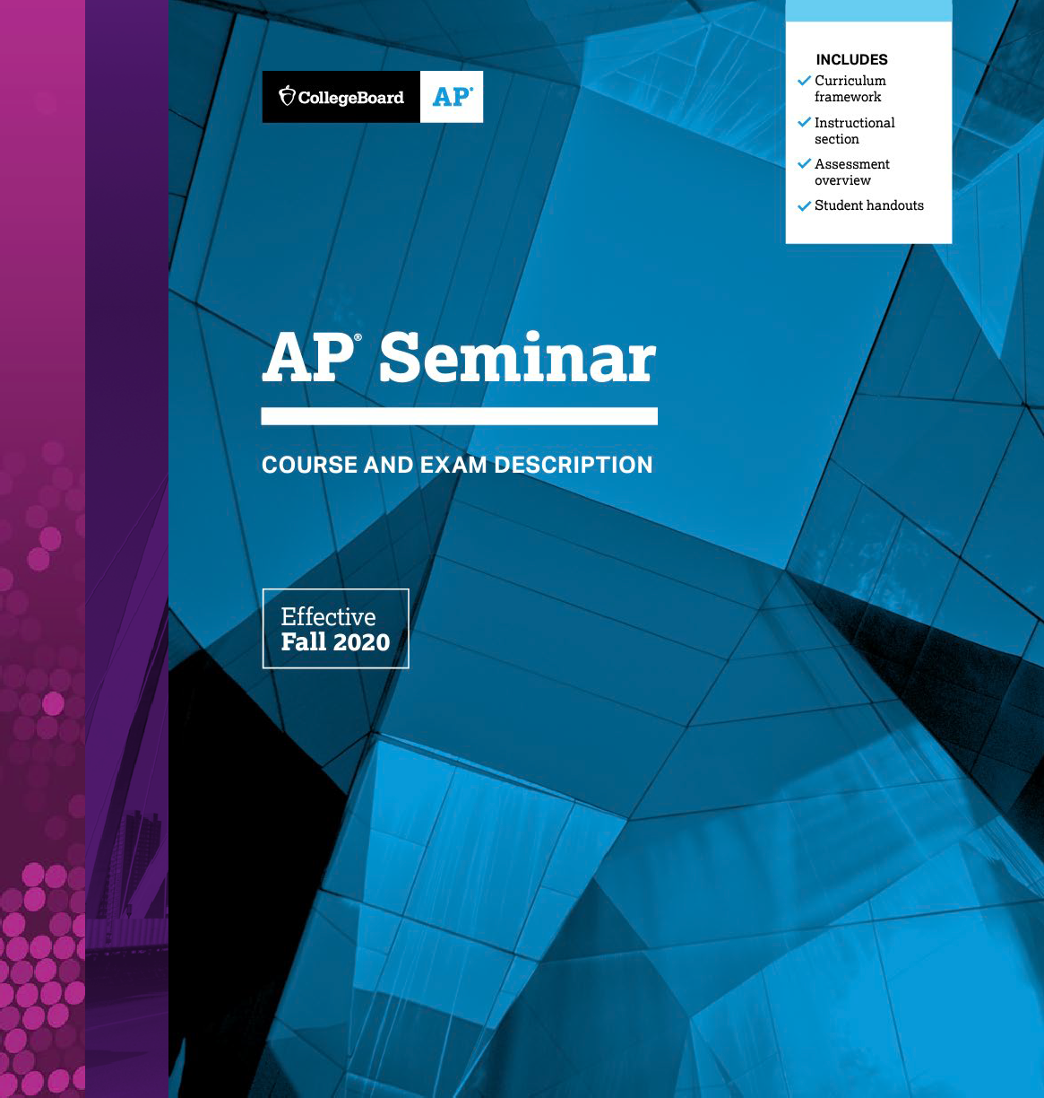
86%
Students who take AP Seminar have higher likelihood of persisting to the second year of higher education than their non-AP peers.
Notes:
Students who take AP Seminar have higher likelihood of persisting to the second year of higher education than their non-AP peers.

Slide 17
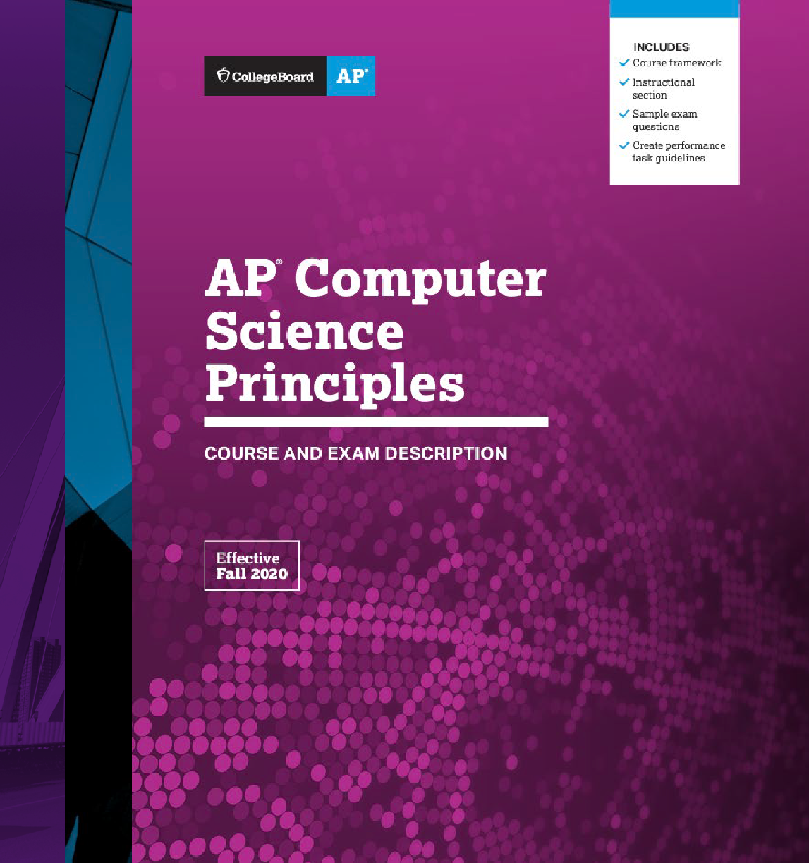
11.6 pp
Students who take AP Computer Science Principles are 11.6 percentage points more likely to declare a STEM major in college than otherwise similar non-CSP students.
Notes:
Students who take AP Computer Science Principles are 11.6 percentage points more likely to declare a STEM major in college than otherwise similar non-CSP students.
So let’s take a look at these courses a little closer…

Slide 18

AP Precalculus: Not Just the Honors Section
Notes:
AP Precalculus is not just for the honors students. AP Precalculus is for any student who takes precalculus.

Slide 19
All Prerequisites Are Taught in Prior Courses
For Success in AP Precalculus
Expected Prior Knowledge and Skills | Algebra 1 | Geometry | Algebra 2
Proficiency with linear functions
Proficiency in polynomial addition and multiplication
Proficiency in factoring quadratic trinomials
Proficiency in using the quadratic formula
Proficiency in solving right triangle problems involving trigonometry
Proficiency in solving linear and quadratic equations and inequalities
Proficiency in algebraic manipulation of linear equations and expressions
Proficiency in solving systems of equations in two and three variables
Familiarity with piecewise-defined functions
Familiarity with exponential functions and rules for exponents
Familiarity with radicals (e.g., square roots, cube roots)
Familiarity with complex numbers
 |  |  | 14
Notes:
That’s because the prerequisites that are necessary are all taught in prior math courses.

Slide 20
Any Precalculus Student Can Be an AP Precalculus Student
No Matter When They Take Algebra 1
Grade 8
Grade 9
Grade 10
Grade 11
Grade 12
Algebra 1
Geometry
Algebra 2
AP Precalculus
AP Calculus AB
AP Calculus BC
Algebra 1
Geometry
Algebra 2
AP Precalculus
AP Precalculus is designed for students who’ve taken Algebra 1, Geometry, and Algebra 2.
That means any precalculus student can be an AP Precalculus student, no matter if they’re finishing high school with AP Precalculus or using AP Precalculus to prepare for AP Calculus AB or BC.
Notes:
Here you will see that any Precalculus student can be an AP Precalculus student.
AP Precalculus is both for:
Students who begin Algebra 1 in 8th grade to prepare for AP Calculus later in HS.
Students who begin Algebra 1 in 9th grade, to ensure they complete Precalculus in HS and are prepared for Calculus when they reach college.

Slide 21
AP Precalculus: More Time, Incentives, and Supports
 | High School Precalculus | College Precalculus | AP Precalculus
Functions Studied: | Polynomial / Rational | Polynomial / Rational | Polynomial / Rational
Functions Studied: | Exponential / Logarithmic | Exponential / Logarithmic | Exponential / Logarithmic
Functions Studied: | Trigonometric / Polar | Trigonometric / Polar | Trigonometric / Polar
Functions Studied: | Parameters / Vectors / Matrices* | Parameters / Vectors / Matrices* | Parameters / Vectors / Matrices
Hours of Instruction: | 140 hours | 48 hours | 140 hours
Class Size: | Small classroom | Large lecture hall | Small classroom
Incentives: |  |  | GPA bonus points
Incentives: |  |  | College credit opportunity
Supports: |  |  | AP Daily Videos
Supports: |  |  | Free AP Online Practice
Supports: |  |  | AP Teacher Workshops
* In Most Courses
Notes:
Just like any Precalculus student can be an AP Precalculus student, any high school Precalculus course can be an AP Precalculus course.
The content studied in Precalculus is advanced math and are studied in any Precalculus course.
The advantage of AP Precalculus is that students can:
Receive GPA bonus points
Earn college credit
Access to AP Daily Videos
Free AP Online Practice
And teachers will the opportunity to attend AP teacher workshops.

Slide 22

AP Seminar: Replacement for English 10
Notes:
Moving on, AP Seminar can be used as a replacement for English 10.

Slide 23
What’s AP Seminar?
A foundational course: Students engage in academic conversations and
analyze divergent perspectives that explore complex, real-world topics.
Why is AP Seminar a great fit for English 10?
READING
Students practice reading and analyzing:
Articles
Research studies
Foundational texts
Literary texts
Philosophical texts
WRITING
Students learn to synthesize information from multiple sources and develop their own perspectives in written essays.
LISTENING
Students practice listening to and viewing:
Speeches
Broadcasts
Personal accounts
Artistic works
Performances
SPEAKING
Students design and deliver oral and visual presentations, both individually and as part of a team.
Notes:
College Board introduced AP Seminar in 2014
Created because college admissions leaders’, wanted a course that would help students develop skills of collaboration, research, writing, and presentation.
Builds Relevant Skills:
Students learn applicable skills to help in college and career such as investigating topics, working in teams, conducting research, and presenting.
Students learn to work in teams to investigate a real-world or academic problem and present an argument for their proposed solution – just as the workplace requires in so many careers.

Slide 24
Exam: How Students Will Be Assessed
The AP Seminar Exam has Performance Tasks throughout the year.
Team Project and Presentation
Individual Research Report (1,200 words)
Team Multimedia Presentation and Defense (8–10 minutes, plus Q&A)
Individual Research Based Essay and Presentation
Individual Written Argument (2,000 words)
Individual Multimedia Presentation (6–8 minutes)
Oral Defense (two questions from the teacher)
End-of-Course Exam
Part A: Analyze an argument using evidence (1 source)
Part B: Build an argument using evidence (4 sources)
20%
35%
45%
Notes:
AP Seminar has Performance Tasks throughout the year that are calculated in their final AP Exam score. This slide shows how students are assessed throughout the year. The AP Exam score is comprised of:
Team Project and Presentation – 20%
Individual Research Based Essay and Presentation – 35%
End-of-Course Exam – 45%

Slide 25
Historically, when schools adopt this course, we see three things happen:
A more diverse group of students take English 10: AP Seminar than any other course and exam scores are more similar across White, Black, and Hispanic students than any other AP course.
10th graders who take English 10: AP Seminar go on
to earn higher scores on AP English, History, and Government exams taken
in grades 11 and 12.
English 10: AP Seminar students outperform non-AP students in first-year college GPA and have a higher likelihood of persisting
to the second year in college than
their non-AP peers.
Expands Access
to Serve More Students
Prepares Students for Future Advanced Courses
Improves Outcomes
Notes:
Expands Access & Engages More Students:
Change the trajectory of students who may not otherwise take AP. Taking even 1 AP course greatly improves students’ first-year college GPA and on-time graduation rates.
Preparation for Future AP Courses:
The skills taught in AP Seminar enhance other AP experiences
AP Seminar students demonstrate stronger AP Exam performance on later AP Exams than their peers who didn’t take AP Seminar.
These results are consistent across race and ethnicity.
Improves Outcomes:
English 10: AP Seminar students outperform non-AP students in first-year college GPA and have a higher likelihood of persisting to the second year in college their non-AP peers.

Slide 26

AP CSP: Offered as Early as Possible
Notes:
Lastly, we’ll discuss the benefit of offering AP Computer Science Principles, as early as possible.

Slide 27

AP CSP Gets Students Interested Early
Students choose a project that’s relevant to their interests.
Why Students Choose AP CSP
Students show what they’ve learned through the Create Performance Task with final program code, often developing an app.
Project Based
Career Relevant
Student Choice
BIG IDEAS
Creative Development
Data
Algorithms and Programming
Computer systems and networking
Impact of Computing
Notes:
AP Computer Science Principles is designed to attract a more diverse group of students by focusing on collaboration, creativity, and student choice in selection of projects.
Students indicate that they select AP CSP because it allows them to apply their learning in a hands-on environment—and it looks like fun.
So why does it matter that students have the opportunity to take AP CSP as early as possible?
AP CSP is the fastest-growing AP course and is attracting a more diverse set of students who are going on to pursue other STEM courses in high school and college.

Slide 28
High School Benefit:
AP CSP Students
Increase in Subsequent AP STEM Participation Associated with AP CSP Participation
Persist in STEM
4.7 pp | 2.7 pp | 2.4 pp | 5.9 pp | 7.2 pp | 5.7 pp | 4.8 pp
Overall | Female | Asian | White | Black (42.6%) | Hispanic (48.9%) | First Gen (53.7%)
(60.0%) | (62.8%) | (76.5%) | (59.1)
AP CSP students are 4.7 percentage points more likely to take AP STEM exams in high school than similar non-AP CSP students.
This is true across all student groups, particularly Black, Hispanic, and first-generation students.
Note: Horizontal axis numbers in parentheses are the percentage of the non-AP CSP students in the subgroup who take AP STEM exams. For example, 60% of non-AP CSP students take AP STEM, while 64.7% of AP CSP students take AP STEM for a 4.7 percentage-point increase associated with AP CSP participation.
23
Notes:
AP CSP students are 4.7 percentage points more likely to take AP STEM exams in high school than similar students
This is true across all student groups, particularly Black, Hispanic, and first-generation students.

Slide 29
College Benefit No. 1:
AP CSP Students
Increase in STEM Major Declaration Associated with AP CSP Participation
Major in STEM
 |  |  |  | 15.2 pp
 |  |  | 13.3 pp |  | 13.4 pp | 12.7 pp
11.6 pp
 | 9.8 pp
 |  | 6.6 pp
Overall | Female | Asian | White | Black (31.6%) | Hispanic (32.4%) | First Gen (35.0%)
(37.3%) | (30.7%) | (47.6%) | (34.0%)
AP CSP students are 11.6 percentage points more likely to declare a STEM major in college than otherwise similar non-AP CSP students.
AP CSP students are more likely to major in a STEM field, particularly Black, Hispanic, and first- generation students.
Note: Horizontal axis numbers in parentheses are the percentage of the non-AP CSP students in the subgroup who declare a STEM major. For example, 37.3% of non-AP CSP students declare a STEM major, while 48.9% of AP CSP students declare a STEM major for a 11.6 percentage-point increase associated with AP CSP participation.
24
Notes:
Then, once they get to college, AP CSP students are 11.6 percentage points more likely to declare a STEM major
This is particularly true of Black, Hispanic, and first-generation students.
This course is diversifying the pipeline of students who are entering STEM fields.

Slide 30
Exam: How Students Will Be Assessed
The AP Computer Science Principles Exam has the Create Performance Task during the year.
Create Performance Task
12 hours or more of dedicated class time
Final program code (often in form of an app)
Video that displays the running of the program and demonstrates its functionality
Written responses to Create Task prompts
End-of-Course Exam
70 MCQ’s
  57 single-select
  5 single-select with reading passage about computing innovation
  8 multiple-select
120 minutes
30%
70%
Notes:
Similar to AP Seminar, the AP CSP Exam has a Create Performance Task which takes place during the year.
The AP Exam score is made up of:
The Create Performance task – 30%
End-of-Course Exam – 70%

Slide 31
Thank you

