Slide 1
Get Ready for College and Career with PSAT™ 8/9
A lesson plan for school counselors
Spring, 2024

Slide 2
PSAT 8/9™ - Scores for Students
Time: 20−30 minutes
Materials:
This PowerPoint presentation
Recommend one or more from list below.
Printed Sample Student Score Report
Printed student PDF score reports provided through K−12 Score Reporting Portal
Additional Resources:
Video: https://satsuite.collegeboard.org/sat-suite-benefits-students-parents/bigfuture-school-mobile-app
ASCA Professional Standards​ for Counselors
Provide appraisal and advisement in large-group, classroom, small group, and individual settings. (B-SS2)​
ASCA Competencies​
Use assessments to help students understand their abilities, values, and career interests. (B-SS2.a)​
​
A lesson plan for school counselors
Objective: Walk students through their score reports. Help them understand their next steps on the path to college and career readiness.
Notes:
Students can see their scores using a printed .pdf score report (available for printing in the K−12 Score Reporting Portal). They can use their College Board student account to see additional insights.
This lesson plan includes screenshots from the PDF score reports. Information is similar in each type of score report.
Each slide includes talking points in the notes to help you guide your students through the information in the score reports.
Notes:
Print .pdf score reports in the K−12 Score Reporting Portal
To print student reports, follow these steps:
Run a Roster Report for a school.
In the roster, check the box next to the name of each student you want to include.
Click Create Score Reports to print score reports.
You can print score reports and score labels for up to 50 students at a time in the Roster Report.
To print score reports for all students who took an assessment, use the Batch Student Report PDFs report.
This report creates score report PDFs for each student who took an assessment in the SAT Suite of Assessments. You can run this report for specific administrations and can include all grades tested or select certain grades. This is a scheduled report and will be delivered within 24 hours of submitting the request in the Reports You Scheduled page in Downloads. You'll receive an email when your PDF score reports are available for download in the reporting portal.

Slide 3
Score Reporting Dates - Spring 2024
Spring 2024 Testing Window | Educator Score Release (online portal) | Student Score Release (online portal)
Window #1 (March 4–15) | Tuesday, April 2, 2024 | Thursday, April 4, 2024
Window #2 (March 16–29) | Tuesday, April 16, 2024 | Thursday, April 18, 2024
Window #3 (March 30–April 12) | Tuesday, April 30, 2024 | Thursday, May 2, 2024
Window #4 (April 13–26) | Tuesday, May 14, 2024 | Thursday, May 16, 2024
Notes:
These score and reporting dates apply for those schools and districts that aren’t under state contracts. If a school chooses to provide an assessment that is not covered by the state, scores will be released according to this timeline.

Slide 4
Student Scores on the SAT Suite of Assessments
Assessment | Total Score | Reading and Writing Section | Math Section
SAT | 400−1600 | 200−800 | 200−800
PSAT™ 10 | 320−1520 | 160−760 | 160−760
PSAT™ 8/9 | 240−1440 | 120−720 | 120−720
Notes:
On each of the assessments, the Total Score is the sum of the Reading and Writing score and the Math score. Ranges for each of the assessments are vertically aligned, meaning the score a student earns on any of the assessments on a given day is the same score they would have earned on the other assessments. For example, if a student earns a 550 on the Math section on the PSAT 8/9, they would have earned that same score on the PSAT 10 and SAT.

Slide 5
PSAT 8/9 Scores
Assessment | Total Score (sum of Section Scores) | Section Scores
PSAT 8/9 | 240−1440 | Reading and Writing 120−720
 |  | Math 120−720
Notes:
The SAT score range for the total score is 240−1440. The total score is the sum of the Reading and Writing section score and the Math section score. Section scores range from 120 to 720.

Slide 6
1. Accessing Scores on the PDF Score Report
Notes:
This section walks students through the .pdf score report. Instructions for printing are in the notes on slide 2.

Slide 7
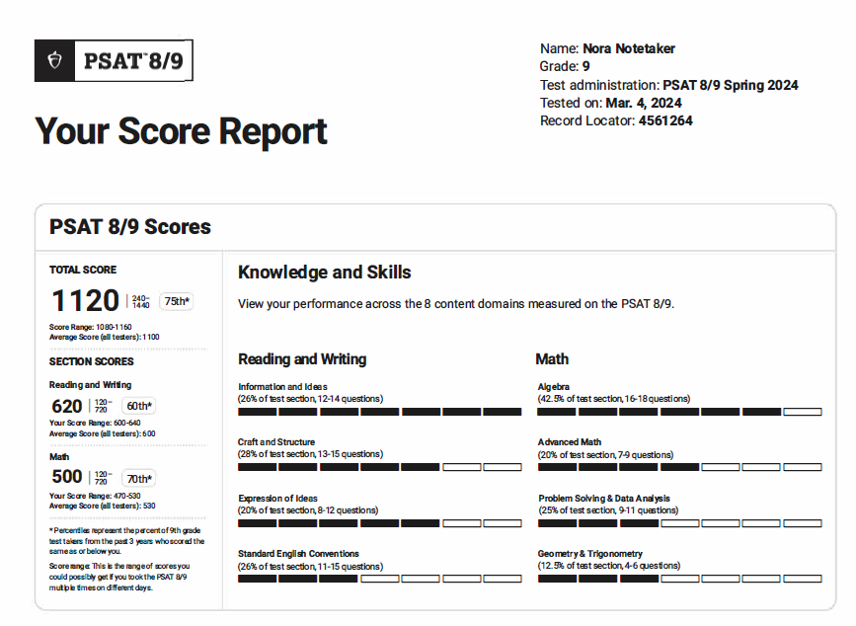
Student Score Report PDF
Notes:
This is a view of the top half of the student score report. Note that the scores are listed on the left-hand side. Next to the scores, students can see how they performed on each of eight content domains measured on the PSAT 8/9.

Slide 8
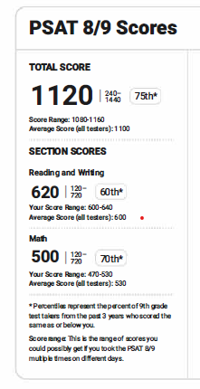
See Your Scores
Total Score
Reading and Writing Score
Math Score
Notes:
Student score information is in the upper left corner of the .pdf score report. They can see their total score, Reading and Writing score, and Math score. The total is the sum of the Reading/Writing and Math scores.

Slide 9
Score Range
Scores should be interpreted as ranges rather than singular points because a student’s score might vary slightly if they had taken different versions of the test under identical conditions.
Notes:
Score range is the range of scores students could possibly get if they took the test on multiple days. Some colleges consider score ranges when reviewing applications.
When students take tests more than once, scores may differ on each testing occasion. Scores should be interpreted as ranges rather than singular points because a student’s score might vary slightly if they had taken different versions of the test under identical conditions. For the example, on the slide, the Reading & Writing score of 620 should be interpreted as 620 ± 20 points, or a range of 600−640.

Slide 10
Score Comparisons and Percentiles
Percentile Rank scores range from 1 to 99 and express student ability relative to the scores of other students in the same grade.
If a student has a percentile rank of 40%, this indicates the student performed at the same level or better than 40% of students at that grade-level on the test.
Notes:
The percentiles compare a student’s scores with those of all students in the same grade around the world who took the PSAT 8/9. The student on the slide scored as well or better in Math than 70% of a globally representative group of 9th-grade students.
Percentiles are based on the actual scores of students in the past three graduating classes who took the PSAT 8/9.

Slide 11
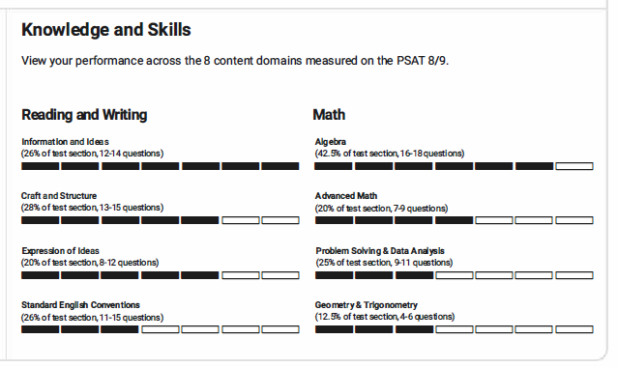
Knowledge and Skills Content Domains
Reading and Writing
Craft and Structure
Explanation of Ideas
Information and Ideas
Standard English Conventions
Math
Algebra
Advanced Math
Problem Solving and Data Analysis
Geometry and Trigonometry
Notes:
The next section of the score report is the content domains for each section. Based on our Skills Insight™ tool, we provide students with a deeper dive into the knowledge and skills measured by the PSAT 8/9.
Students can view a graphic showing their performance on each of the eight content areas measured on the PSAT 8/9. There are four content areas in Reading and Writing, and four in Math. In each content area, students can view:
The approximate number of questions in the content area and what percentage of the section that represents (e.g., 12–14 questions would be about 26% of the Reading and Writing section).
A visual indication of how the student performed in each content area.
Students can use this section to identify content areas they may want to focus on to practice and improve.
.

Slide 12
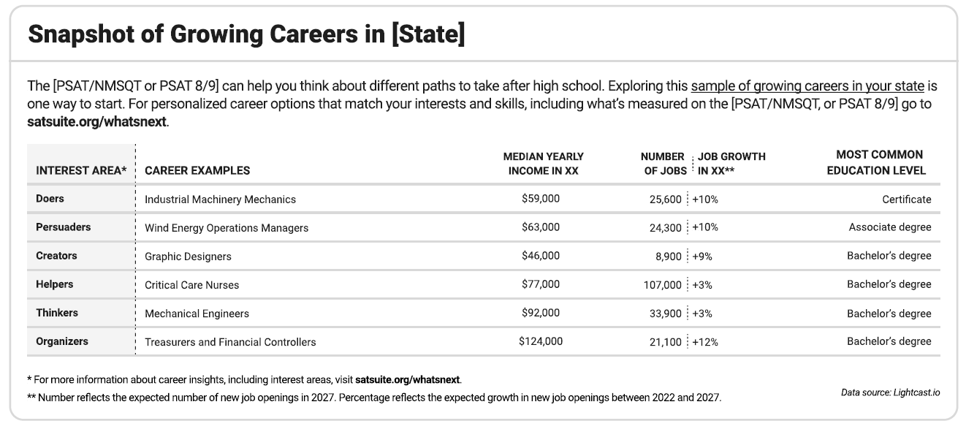
Career Insights Snapshot
Relevant Careers in My State
Notes:
Here’s a view of the bottom portion of the student score report, which provides career insights.
Career is a driving force when students make decisions about their future. Students should know what they like, what they’re good at, the opportunities available to them, and the steps they need to take to reach their goals.
Providing career information directly on the score report provides an opportunity to spark interest in new careers and spur action on charting a career path based on a student's interests, values, and skills.
All students taking a digital PSAT 8/9 receive information about six careers directly on their official PSAT score report, just like you see here.
This is a snapshot of in-demand jobs in each state to get students thinking about what they might like to do in the future. The careers listed aren’t the only ones available in the state or the only ones they should consider, but they can be useful as a starting point to explore what interests students most.
You’ll see that the report offers an interest area, career example, median yearly income, number of jobs, job growth in coming years, and the most common education level required.
Interest areas are from the Holland framework, the most well-known and widely used tool in career advising—which includes 6 dimensions that are mapped to work environments
Median yearly income represents the median salary (middle point) students can expect to earn for each your specific state. All careers shown on the score report have a median yearly income that meets living wage standards.
The number of jobs refers to the expected number of new job openings that will be available in your state ears from now. Job growth refers to the percent by which the job is expected to have new openings in the next 5 years. All the careers shown on your score report are growing in your state.
Most common level of education refers to the education level most often needed to enter an occupation. Some jobs will require a bachelor’s degree while others may require a certificate or an associate degree. The careers on your score report show a variety of different education requirements. We selected jobs that require some form of education after high school as most jobs in the coming years will require some education or skills training beyond high school.
This is a great place to get students talking about their career insights. Ask students to share a career on their report that interests them. Givedetails to the class. Find one student to share each of the RISEC options. Work together as a class. You can also break into small groups for discussion.

Slide 13
Next Steps

Slide 14
What’s Next After Taking the PSAT 8/9?
Start getting ready for college with college and career planning tools in BigFuture.
Begin thinking about paying for college: Search for scholarship information in BigFuture.
Build your college and career readiness skills with Official Digital SAT Prep on Khan Academy.®
Notes:
In this section, students will see how their score report leads to information that will help them plan and prepare for college and careers.

Slide 15
Connect to BigFuture
Notes:
Students can access BigFuture through their score report, either by clicking the link or using the QR code.
BigFuture is College Board’s free online planning guide that helps all students take the right first step after high school.
Students can check out careers they're interested in. They can find colleges based on what's important to them. They can discover ways to pay for college.
When they’re ready to get started, BigFuture offers the information they need to make the right decision for them.
When students look at their scores, it’s a perfect chance for them to think about what their next steps are for school or training, and what careers they might like to explore. BigFuture is a comprehensive tool that helps them investigate what interests them.

Slide 16
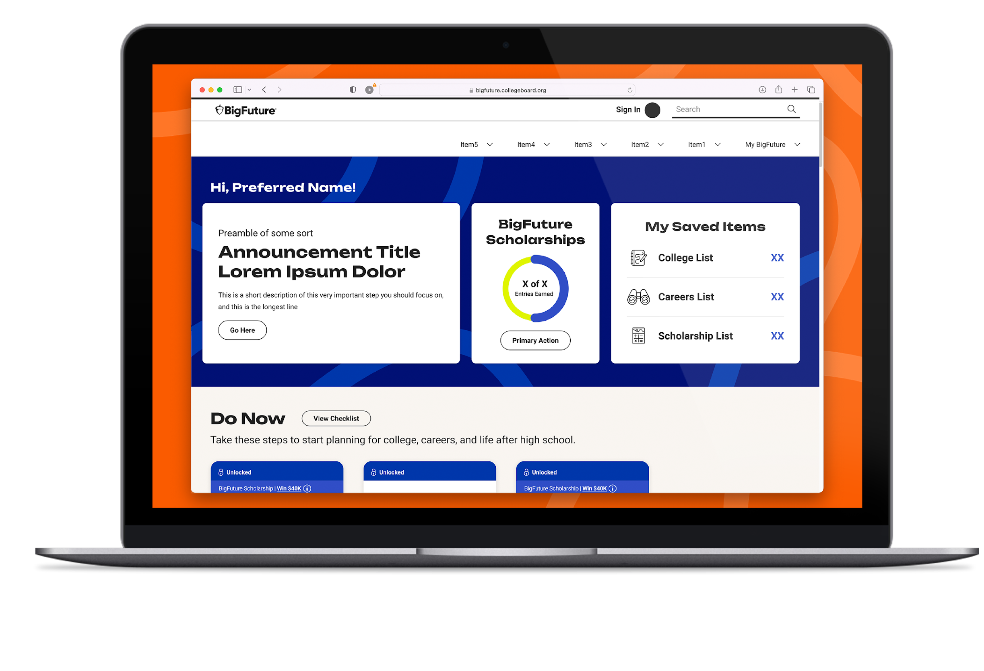
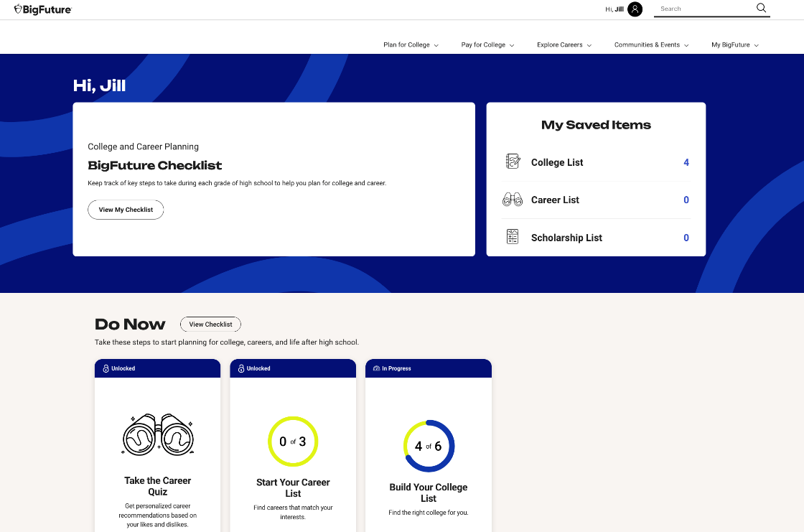
What’s BigFuture?
A free online planning guide to help all students take the right first step after high school.
Bigfuture.org
Notes:
Every student starts somewhere. Every student’s path is unique with its own twists and turns.
This free guide with everything students need is ideal for that right first step after high school.
It’s a new look and a new experience where students have a personalized experience that tracks their progress on college and career planning steps.
They can see what steps they should currently be working on, what’s next, and what’s complete.
They can also track their entries for BigFuture Scholarships from their dashboard.

Slide 17
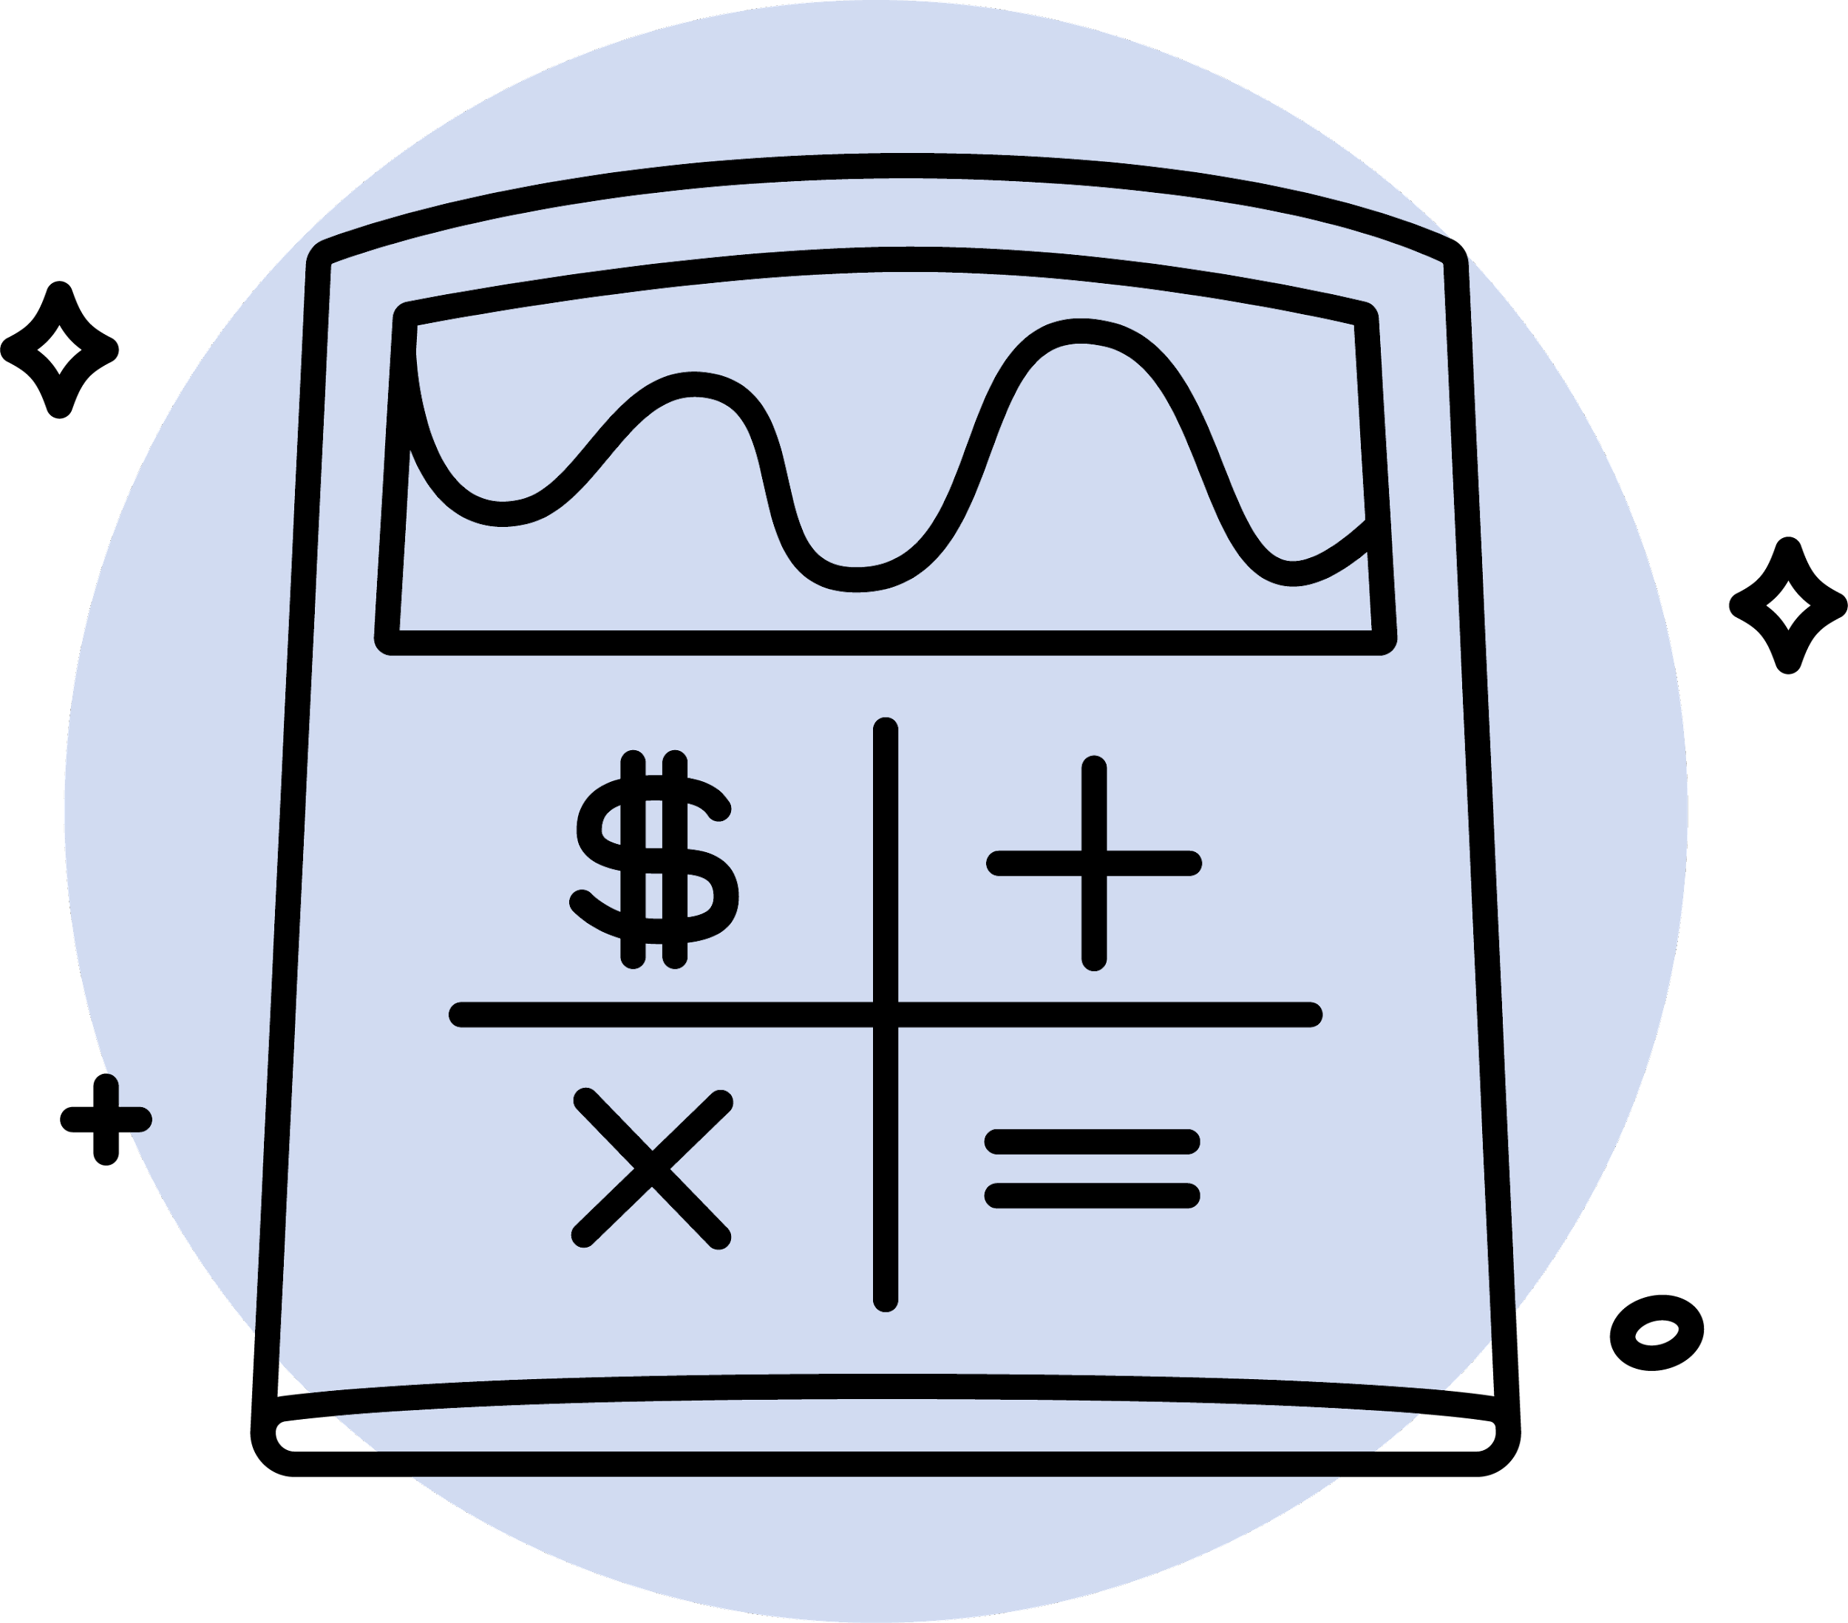
BigFuture
Explore Careers
Plan for College
Pay for
College
Bigfuture.org
Notes:
BigFuture is there for students to explore careers, plan for college, and pay for college.
Whether your students are looking for a four-year university, community college, or technical training, we have what you need to help students start planning their future, their way.
We’ve continually evolved in the last year to better help students. We’ll continue to evolve with feedback from educators like you

Slide 18
BigFuture Scholarships
BigFuture awards hundreds of $500 and 2 $40,000 scholarships monthly!
1
Start Your Career List
4
Strengthen Your College List
Save 3 or more careers on Career Search.
Opens: December of sophomore year
Deadline: By the end of February of senior year
Save 1 safety, 2 match, and 3 reach schools on College Search
Opens: July 1 before senior year
Deadline: By October 31 of senior year
2
Build Your College List
5
Complete the FAFSA
Save 6 or more colleges on College Search
Opens: December of sophomore year
Deadline: By June 30 of junior year
Complete the FAFSA®, submit a state aid form, or be legally ineligible to submit both the FAFSA and a state aid form.
Opens: December 1 of senior year
Deadline: By the end of February of senior year
3
Explore Scholarships
6
Apply to Colleges
Save 3 or more scholarships on Scholarship Search
Opens: July 1 before senior year
Deadline: By the end of February of senior year
Submit applications to at least 2 colleges.
Opens: October 1 of senior year
Deadline: By the end of February of senior year
Bigfuture.org
Notes:
BigFuture Scholarships are open to sophomores, juniors, and seniors. While 8th- and 9th-grade students aren’t eligible to win, they can get started on BigFuture to think about what they’d like to do in the future, and they’ll be ready when they’re old enough for entries.
BigFuture awards hundreds of $500 scholarships and two $40,000 scholarships every month for tasks that you talk to your kids about every day.
Talk with students about each step on the slide so they’ll know that when they’re old enough, they can take these steps to get ready for college, and maybe win some scholarship money for college!

Slide 19
SAT and Khan Academy
Overview videos, articles, and the ability for students test their knowledge with additional, released digital SAT items in partnership with College Board
Digital Assessment Readiness
Test Preview
Full-Length Practice Exams
Correct Answers and Explanations
Notes:
Students can continue to build their skills for college and career using free Official Digital SAT Practice on Khan Academy.
While the Bluebook testing app houses the full-length practice exams, there’s so much more to explore on Khan Academy.
Khan Academy remains an integral partner in our commitment to deliver free, best-in-class, test prep for the digital SAT. As such, Khan Academy released their digital SAT courses for Reading and Writing and Math on their learning platform, which include overviews, videos, articles, worked examples and additional digital SAT questions for students to test their knowledge.

