Slide 1
Get Ready for College and Career with SAT® School Day
A lesson plan for school counselors
Spring, 2024

Slide 2
SAT School Day - Scores for Students
Time: 30 minutes
Materials:
This PowerPoint presentation
Recommend one or more from list below.
Mobile phone access for eligible students with the BigFuture School app installed
Printed Sample Student Score Report
Printed student PDF score reports provided through K−12 Score Reporting Portal
Additional Resources:
Video: https://satsuite.collegeboard.org/sat-suite-benefits-students-parents/bigfuture-school-mobile-app
ASCA Professional Standards​ for Counselors
Provide appraisal and advisement in large-group, classroom, small group, and individual settings. (B-SS2)​
ASCA Competencies​
Use assessments to help students understand their abilities, values, and career interests. (B-SS2.a)​
​
A lesson plan for school counselors
Objective: Walk students through their score reports. Help them understand their next steps on the path to college and career readiness.
Notes:
Students who provided their mobile phone number during exam setup can review their SAT School Day score report on their mobile phones using the BigFuture School app. They can also view a .pdf report.
Those who did not provide their number may receive a printed .pdf score report (available for printing in the K12 Score Reporting Portal). Students age 13 and older may use a personal College Board student account to view additional insights online.
This lesson plan includes screenshots from BigFuture School and the PDF score reports. Information is similar in each type of score report.
Each slide includes talking points in the notes to help you guide your students through the information in the score reports.
Notes:
Print .pdf score reports in the K−12 Score Reporting Portal
To print student reports, follow these steps:
Run a Roster Report for a school.
In the roster, check the box next to the name of each student you want to include.
Click Create Score Reports to print score reports.
You can print score reports and score labels for up to 50 students at a time in the Roster Report.
To print score reports for all students who took an assessment, use the Batch Student Report PDFs report.
This report creates score report PDFs for each student who took an assessment in the SAT Suite of Assessments. You can run this report for specific administrations and can include all grades tested or select certain grades. This is a scheduled report and will be delivered within 24 hours of submitting the request in the Reports You Scheduled page in Downloads. You'll receive an email when your PDF score reports are available for download in the reporting portal.

Slide 3
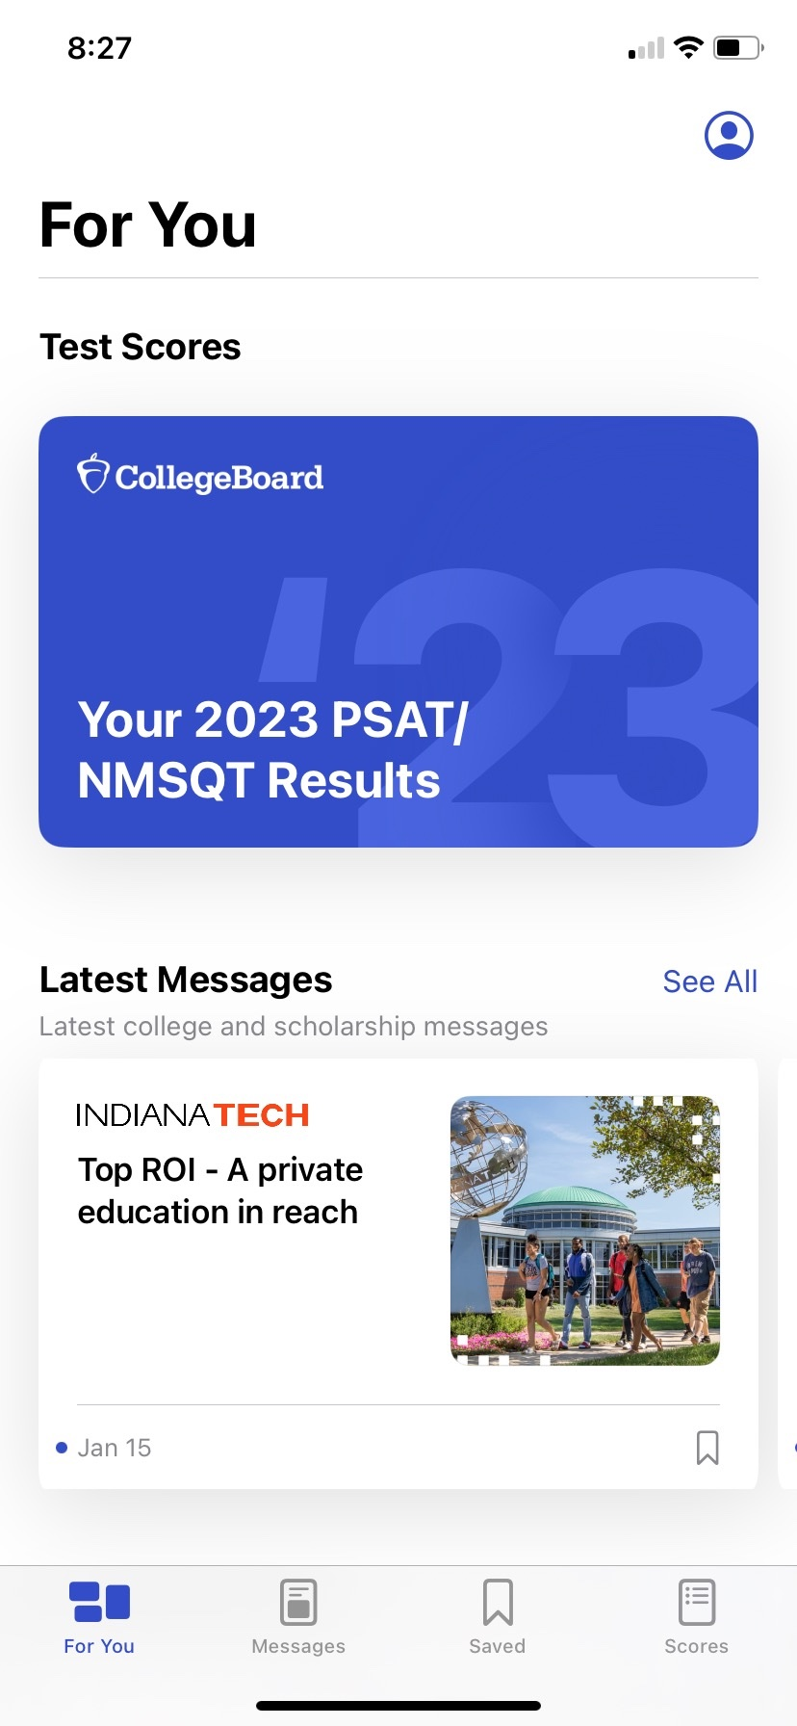
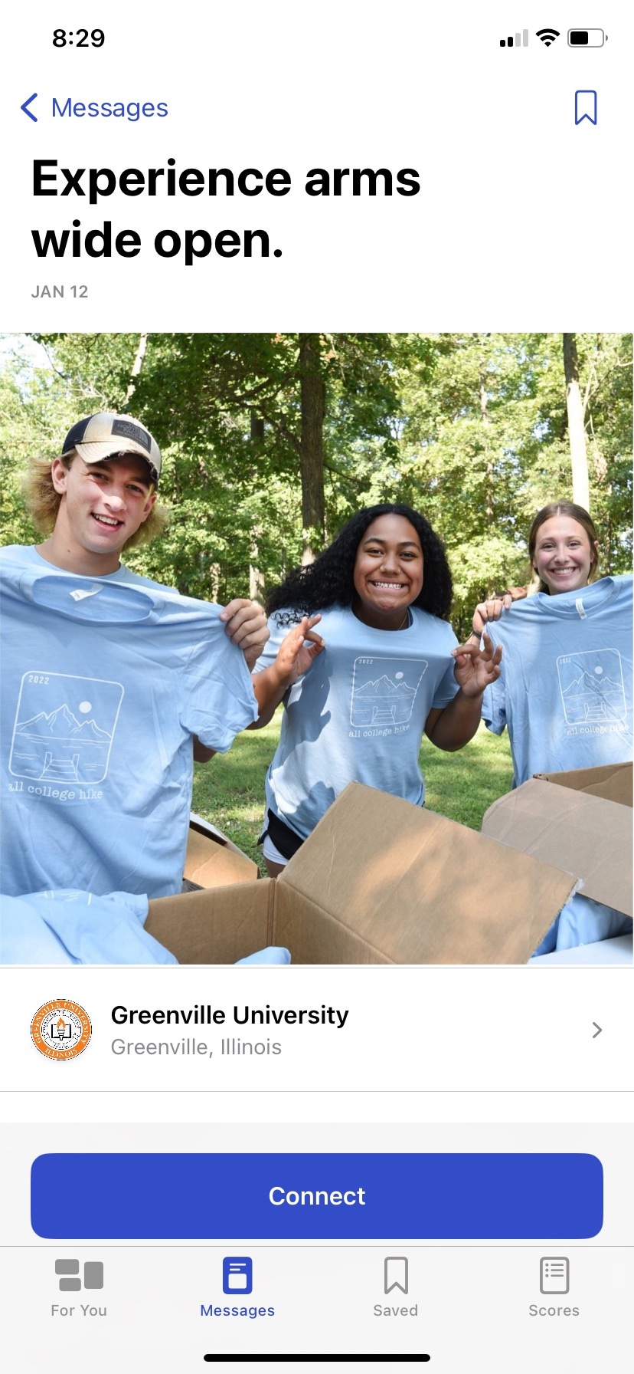
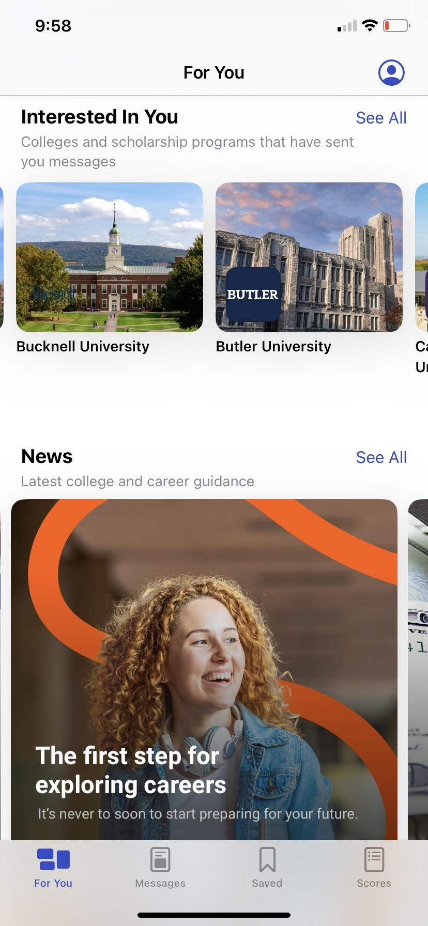
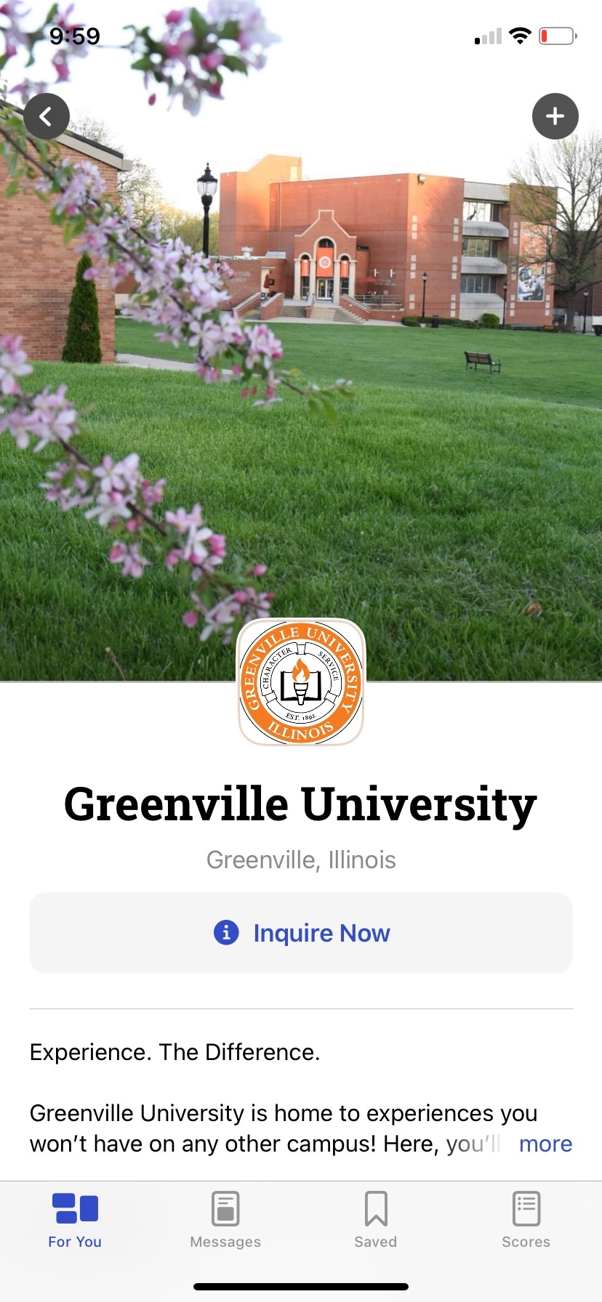
The BigFuture School mobile app:
The power to plan – in the palm of students’ hands
Direct access to digital SAT School Day, PSAT/NMSQT®, and PSAT 10 scores.
Customized career guidance and information about planning and paying for college.
Connections™: A program for school day test takers that allows them to hear from nonprofit colleges and scholarship programs that may be a good match─without sharing personal information.
.
https://satsuite.org/k12bigfutureschool
Notes:
BigFuture School is a new mobile app designed to spark students' interest in planning for the future. Students who took the SAT during the school day can use this app to get college and career guidance the moment they get their scores.
During exam setup in the Bluebook app, students were given the option to provide their mobile phone number to access BigFuture School and get their SAT scores right in the app. In addition to their scores, the app provides information on colleges, careers, and scholarships.
Some students also have the option to join Connections. Connections is a free program exclusively for students who take the PSAT/NMSQT, PSAT 10, and SAT on a school day that lets students hear from nonprofit colleges, scholarships, and educational organizations. It delivers messages in the BigFuture School app and by mail from organizations that are interested in students based on information students, schools, districts, or states provide when taking an in-school assessment—including score range—to make connections that are relevant to students.
With Connections, no personal information is shared with institutions unless a student chooses to connect and share information directly with them. This gives students and their families more control over when, or whether, students raise their hands to be seen. The goal is to create more opportunities for students as they consider their options after high school. With input from students, families, and education professionals, BigFuture School and Connections will expand and improve to help every student plan their path for what's next.
Note: Districts and schools may choose not to provide access to Connections.

Slide 4
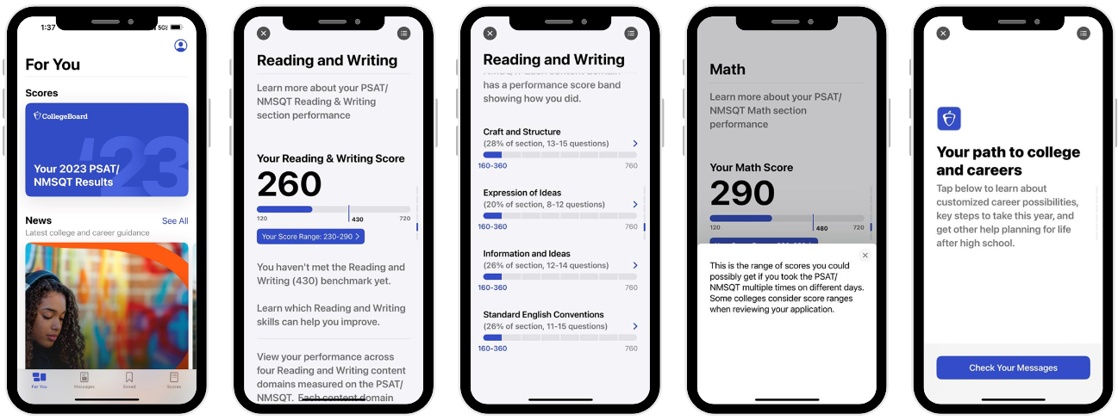
Score Release
Notes:
Students will receive a text message the day before and the day of score release to notify them of the score report availability. Text messages on school days are sent 6–9 p.m. EST.
The same information on the PDF is available in BigFuture School.

Slide 5
Student Score Report PDF Version
Notes:
Another way students can review their scores is through the pdf score report. These can be batch printed from the K−12 reporting portal in the individual reports tab. See slide 2 for instructions.
The walkthrough of the .pdf score report begins on slide 18, if your students aren’t using the BigFuture School app.

Slide 6
Student Scores on the SAT Suite of Assessments
Assessment | Total Score | Reading and Writing | Math
SAT School Day SAT Weekend | 400−1600 | 200−800 | 200−800
PSAT 10 | 320−1520 | 160−760 | 160−760
PSAT 8/9 | 240−1440 | 120−720 | 120−720
Notes:
On each of the assessments, the total score is the sum of the Reading and Writing score and the Math score. Ranges for each of the assessments are vertically aligned, meaning the score a student earns on any of the assessments on a given day is the same score they would have earned on the other assessments. For example, if a student earns a 550 on the Math section on the PSAT 8/9, they would have earned that same score on the PSAT 10 and SAT.

Slide 7
SAT School Day and SAT Weekend Scores
Assessment | Total Score (sum of Section Scores) | Section Scores
SAT | 400−1600 | Reading and Writing 200−800
 |  | Math 200−800
Notes:
The SAT score range for the Total Score is 400−1600. The Total Score is the sum of the Reading and Writing section score and the Math section score. Section scores range from 200 to 800.

Slide 8
1. Accessing Scores Through BigFuture School

Slide 9
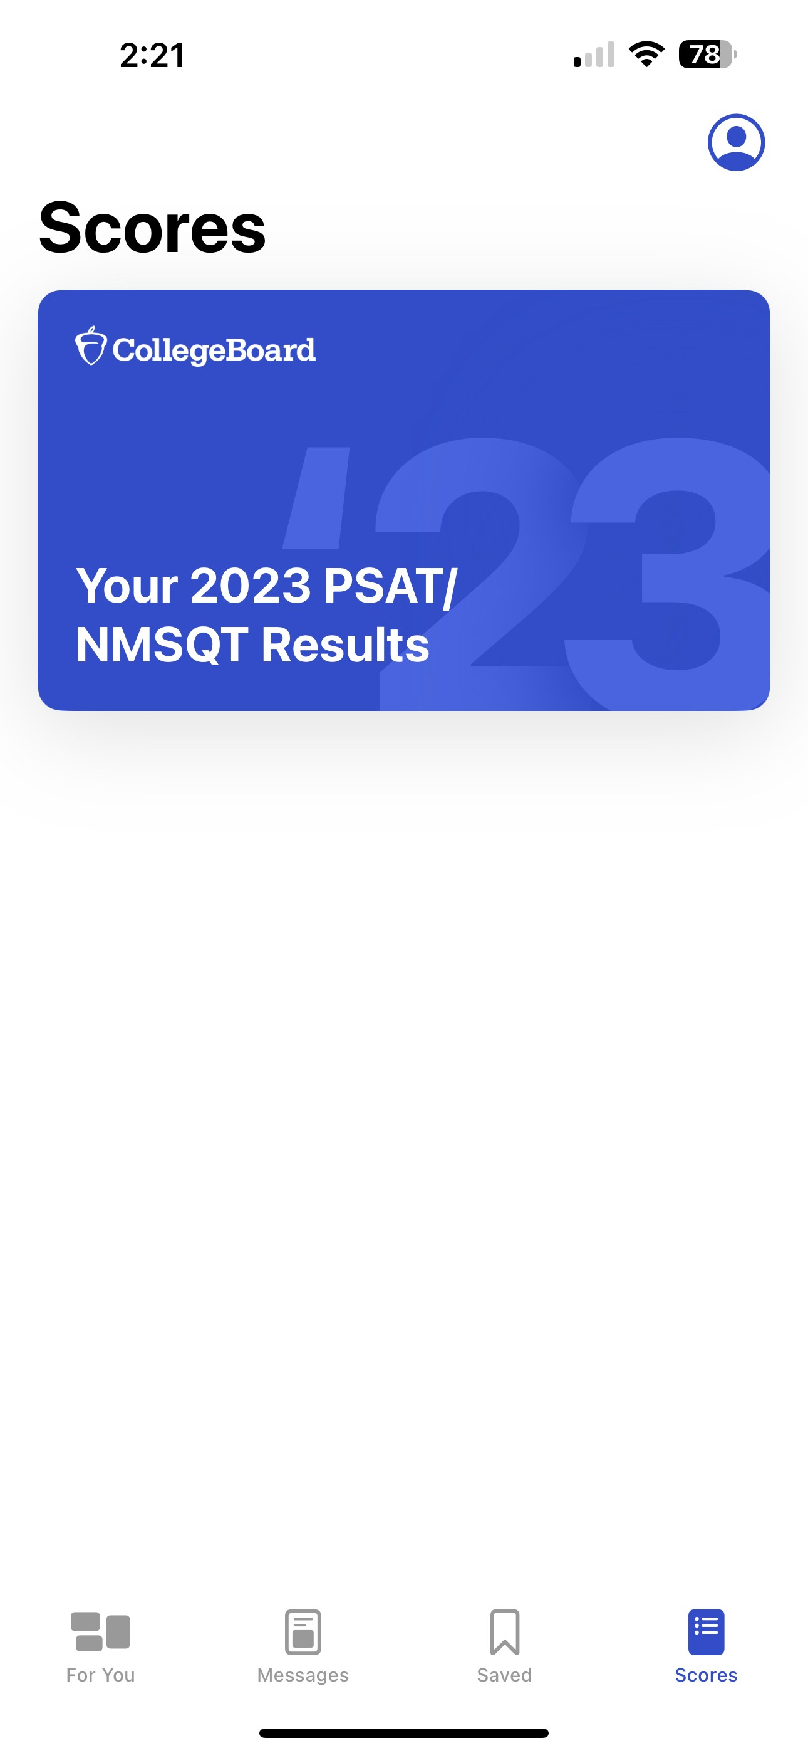
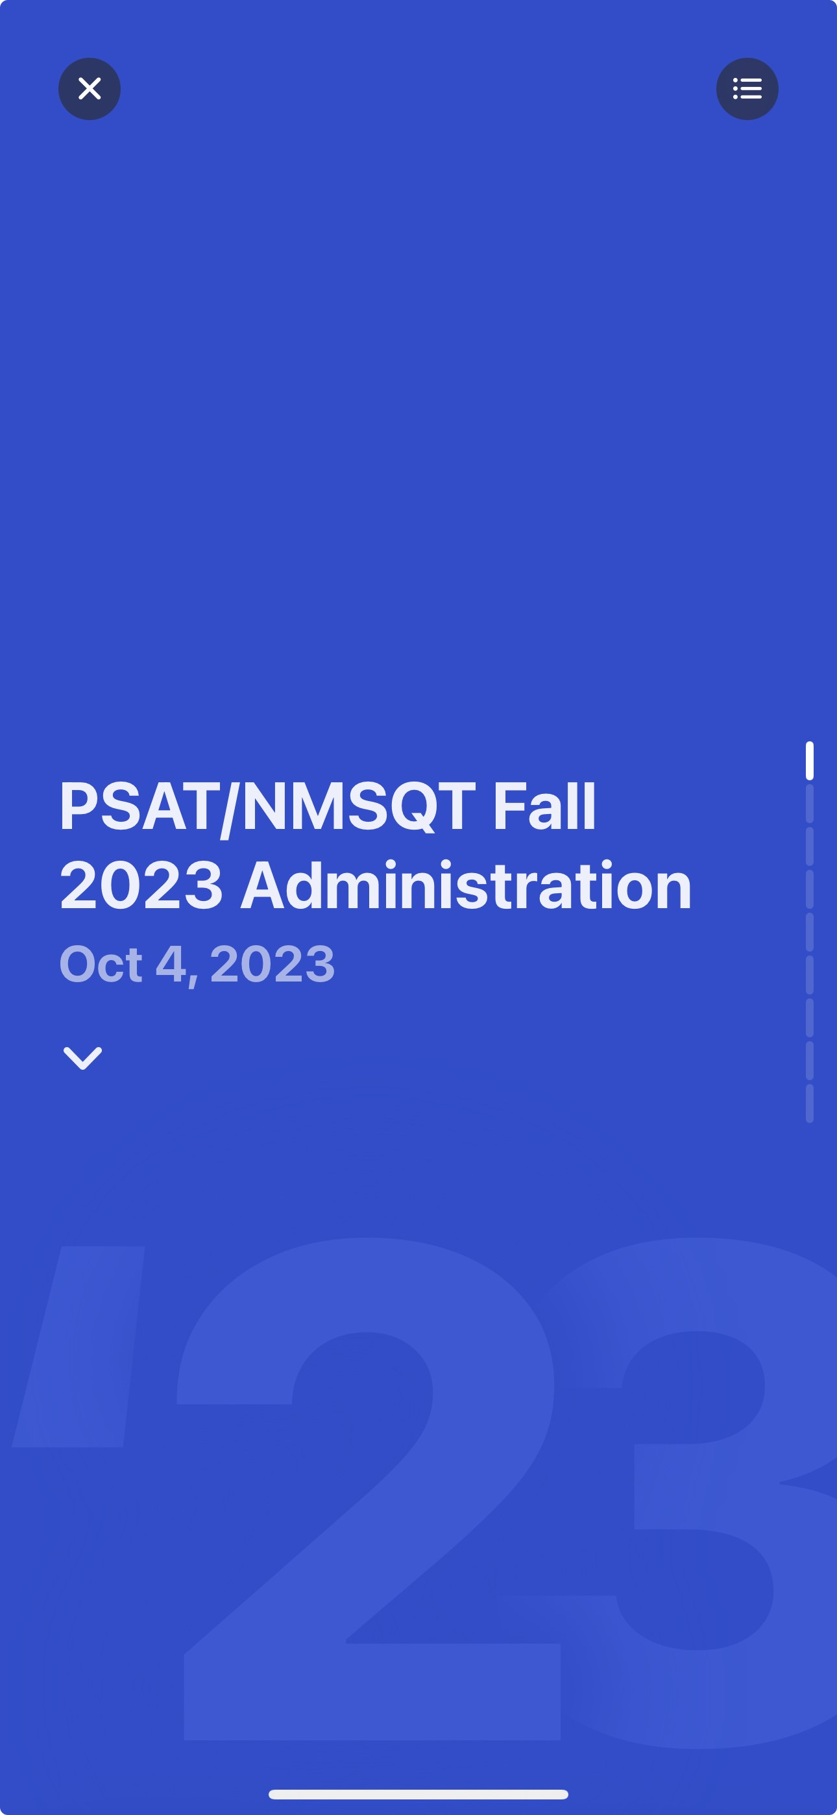
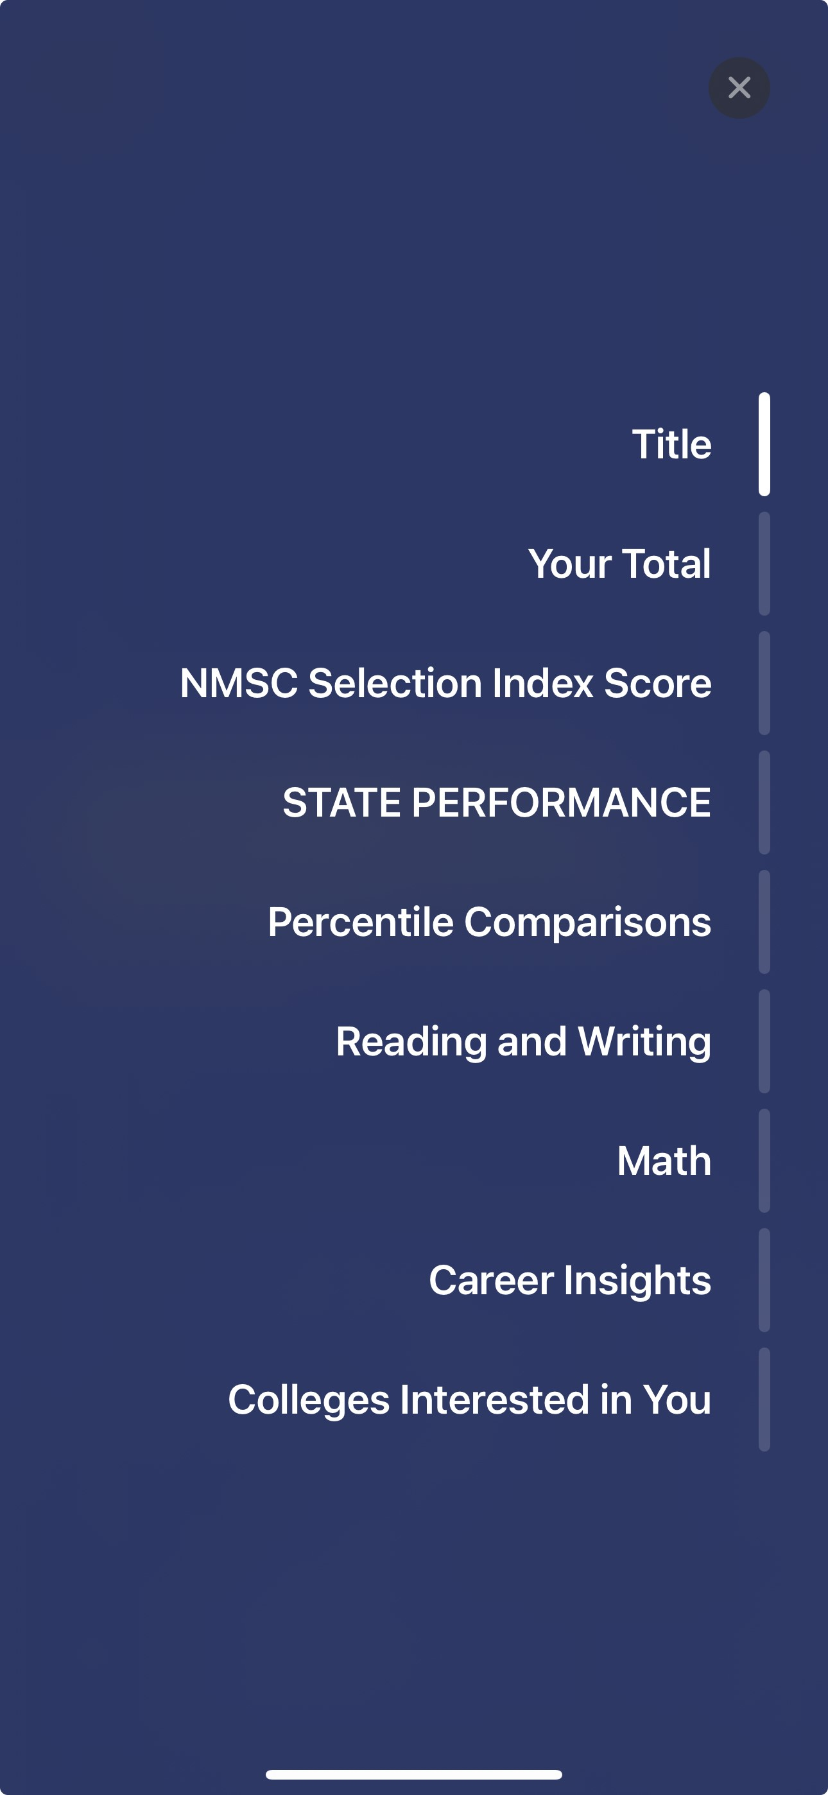
Find Your Score on BigFuture School
Your SAT Results
SAT School Day Spring 2024 Administration
March 4, 2024
Notes:
When students open the BigFuture School app on their phone, they’ll see four icons on the bottom of the screen: For You, Messages, Saved, and Scores. When they select Scores, they’ll see a card that names their test results.
Clicking on the card takes them to the score report. There’s a small icon on the upper right side of the screen. This is menu that takes students directly to the various sections of the score report. Alternatively, they can scroll down.

Slide 10
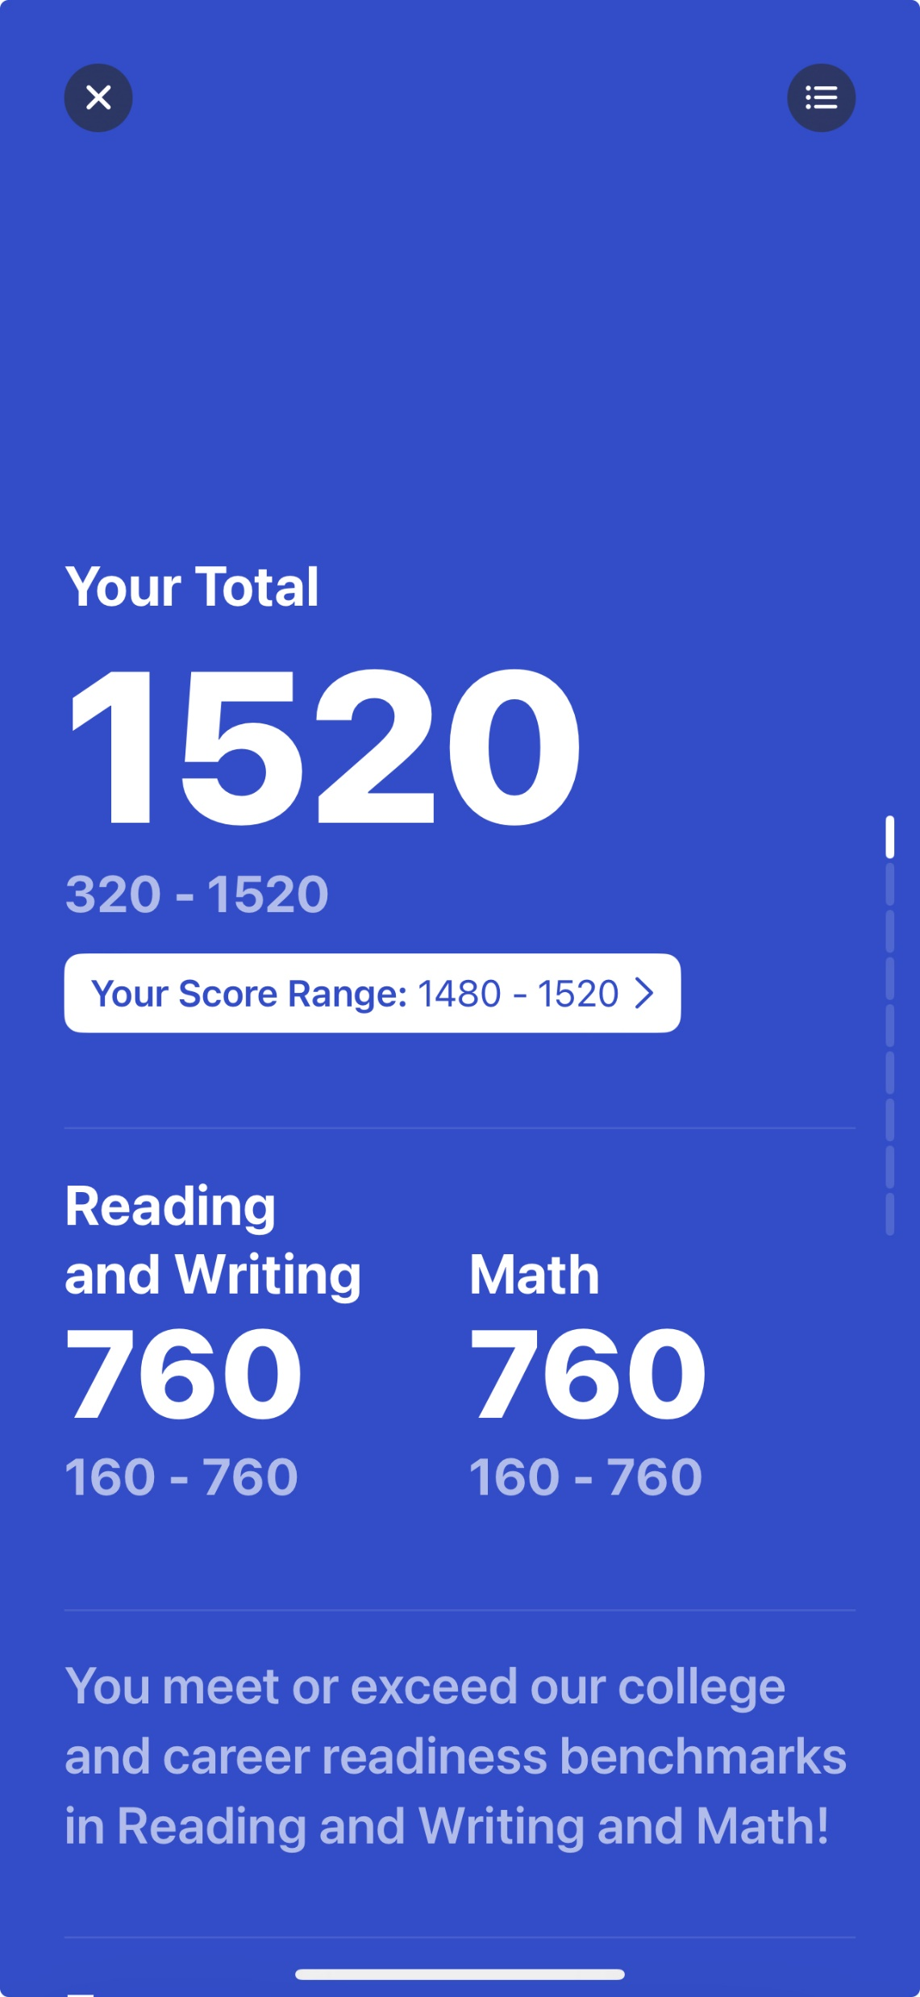
See Your Scores
Total Score
Reading and Writing Score
Math Score
Notes:
Scrolling down, students are shown their total score and their section scores.
The statement on the bottom of the screen lets students know whether they meet the college and career readiness benchmark on each section of the SAT. There’s more information about benchmarks on slide 13.
[In some states, students will see additional scores for their essay and/or Analysis in Science. The essay has three scores: Reading, Analysis, and Writing, each with a score range of 2−8. Students are told if they’re proficient.
The Analysis in Science has a range of 50−70. It’s derived from Reading/Writing and Math questions that are based on science content. Students are informed whether they exceed, meet, or are below state expectations.]

Slide 11
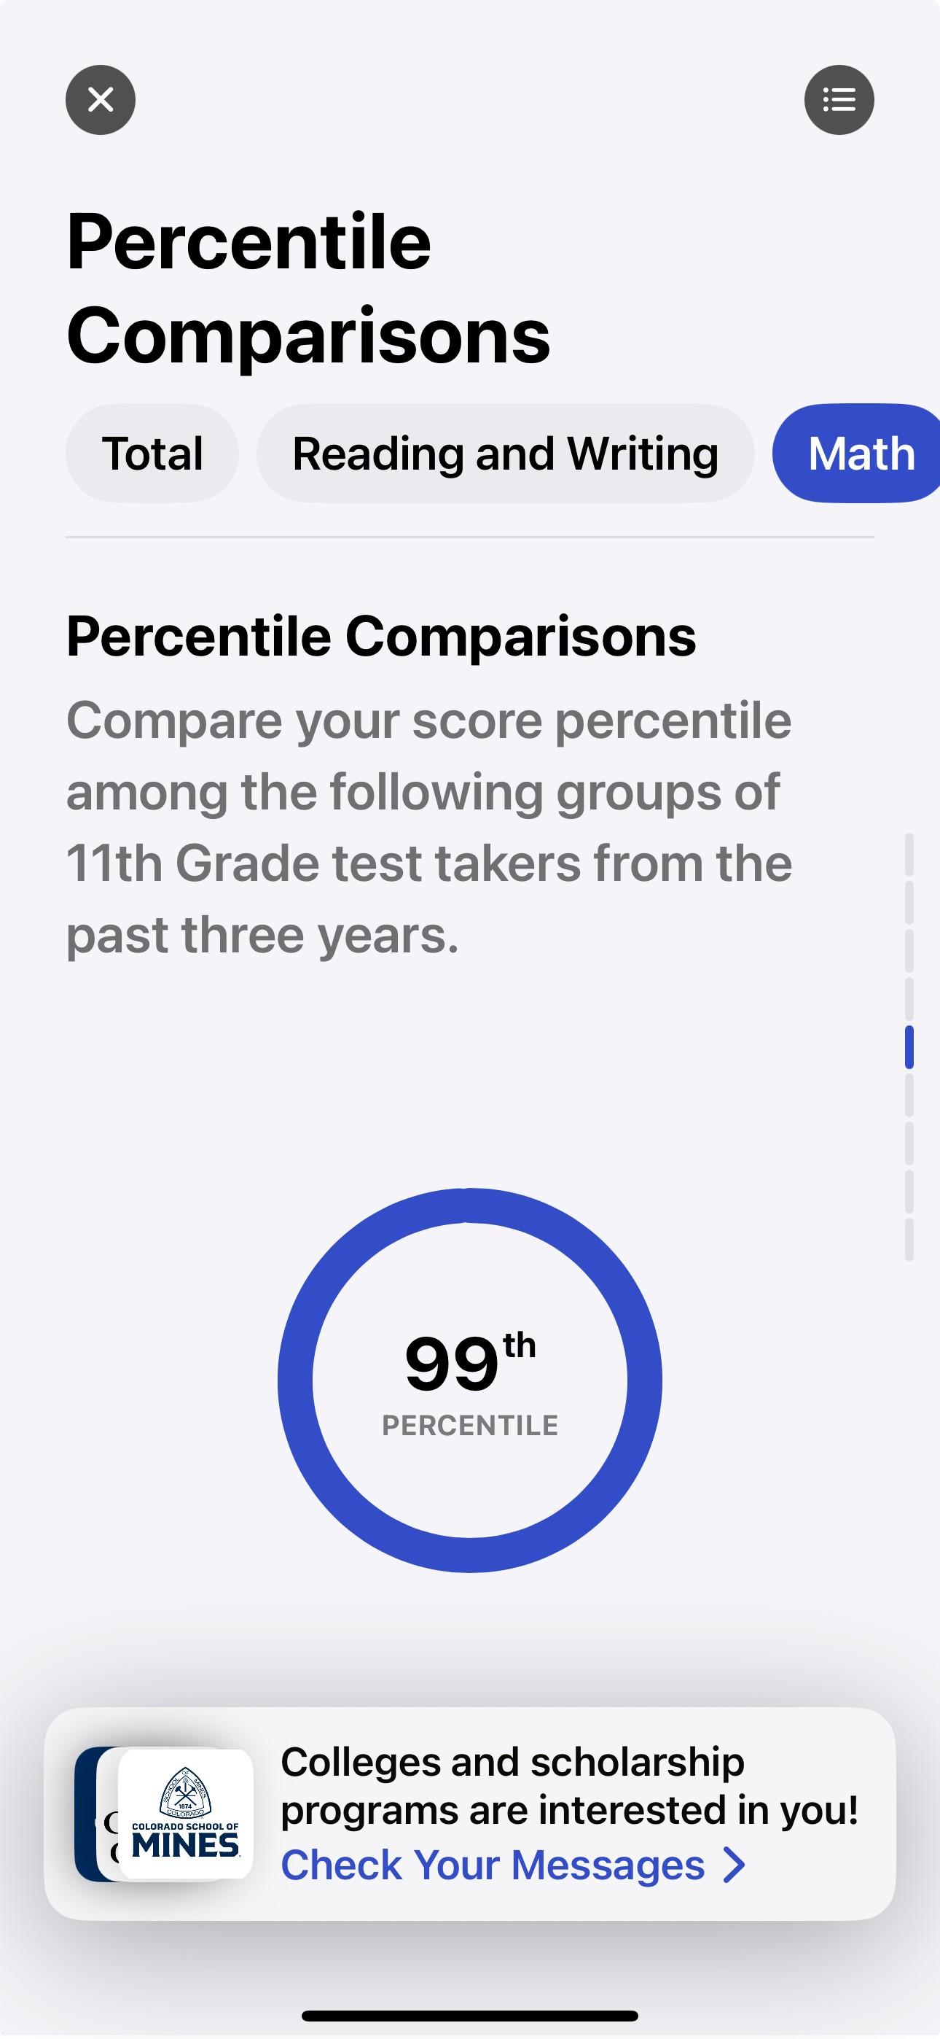
Score Comparisons and Percentiles
Percentile Rank scores range from 1 to 99 and express student ability relative to the scores of other students in the same grade.
If a student has a percentile rank of 40%, this indicates the student performed at the same level or better than 40% of students at that grade-level on the test.
40th
Notes:
When students continue scrolling, they reach the Percentile Comparisons portion of the score report.
Students can select Total, Reading and Writing, and/or Math near the top of the screen to see their score percentile.
The percentiles compare a student’s scores with those of all students in the same grade around the world who took the SAT. The student on the slide scored as well or better in Math than 40% of a globally representative group of 11th-grade students.
Percentiles are based on the actual scores of students in the past three graduating classes who took the SAT during high school.

Slide 12
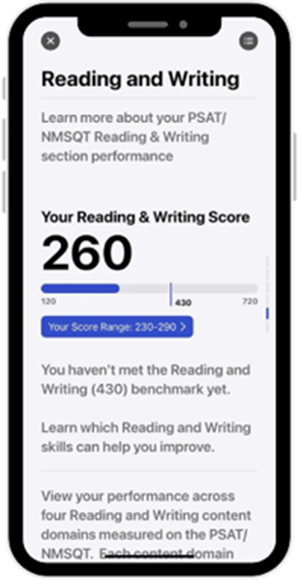
Benchmarks
Assessment – Grade Level | Reading and Writing Benchmark | Math Benchmark
SAT – Grade 12 | 480 | 530
PSAT/NMSQT – Grade 11 | 460 | 510
PSAT 10 – Grade 10 | 430 | 480
PSAT 8/9 – Grade 9 | 410 | 450
PSAT 8/9 – Grade 8 | 390 | 430
The SAT Math benchmark is set to be the minimum score a student can earn on the Math section of the SAT to have a 75% chance of earning at least a C in first-semester, credit-bearing, college-level courses in algebra, statistics, pre-calculus, and/or calculus.
The SAT Reading and Writing benchmark is set to be the minimum score a student can earn on the ERW section of the SAT to have a 75% chance of earning at least a C in first-semester, credit-bearing, college-level courses in history, literature, social science, and/or writing.
Notes:
The SAT Math benchmark is set to be the minimum score a student can earn on the Math section of the SAT to have a 75% chance of earning at least a C in first-semester, credit-bearing, college-level courses in algebra, statistics,
pre-calculus, an/or calculus.
The SAT Reading and Writing benchmark is set to be the minimum score a student can earn on the ERW section of the SAT to have a 75% chance of earning at least a C in first-semester, credit-bearing, college-level courses in history, literature, social science, and/or writing.
The PSAT/NMSQT, PSAT 10, and PSAT 8/9 benchmark scores are based on expected student growth toward the SAT benchmarks at each grade. The new benchmarks are set to reflect typical annual growth from year to year through the 12th grade, where the SAT benchmarks reflect a high probability of successfully earning a passing grade in courses specifically linked to the two SAT section scores.
The benchmarks for all assessments work together as a system, making it easier to evaluate how students are progressing year over year toward college readiness. They provide actionable feedback and detailed information to students and educators in score reports, including areas of academic strength and weakness, as well as action steps for improvement. They also present a more straightforward understanding of college and career readiness by using a definition that’s more familiar to students and educators.

Slide 13
Score Range
Scores should be interpreted as ranges rather than singular points because a student’s score might vary slightly if they had taken different versions of the test under identical conditions.
Your Reading & Writing Score
260
130
430
730
Your Score Range: 230-290
Notes:
Score range is the range of scores students could possibly get if they took the test on multiple days. Some colleges consider score ranges when reviewing applications.
When students take tests more than once, scores may differ on each testing occasion. Scores should be interpreted as ranges rather than singular points because a student’s score might vary slightly if they had taken different versions of the test under identical conditions. For example, on the slide, the Reading & Writing score of 260 should be interpreted as 260 ± 30 points, or a range of 230−290.

Slide 14
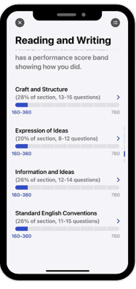
Knowledge and Skills Content Domains
Reading and Writing
Craft and Structure
Explanation of Ideas
Information and Ideas
Standard English Conventions
Math
Algebra
Advanced Math
Problem Solving and Data Analysis
Geometry and Trigonometry
Notes:
The next section of the score report is the content domains for each Reading and Writing, then Math. Based on our Skills Insight™ tool, we provide students with a deeper dive into the knowledge and skills measured by the SAT.
Students can view a graphic showing their performance on each of the eight content areas measured on the SAT. There are four content areas in Reading and Writing, and four in Math. In each content area, students can view:
The approximate number of questions in the content area and what percentage of the section that represents (e.g., 12–14 questions would be about 26% of the Reading and Writing section).
A visual indication of how the student performed in each content area.
Students can use this section to identify content areas they may want to focus on to practice and improve.
.

Slide 15
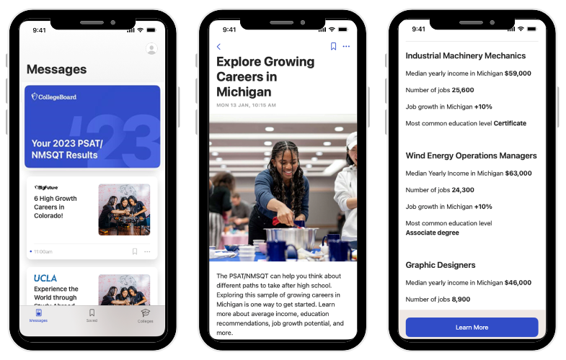
Career Insights
Notes:
Discovering career options is a driving force as students make decisions about their future. And as they think about their career goals and what they’ll do after high school, they’ll begin uncovering what they like, their skills, the opportunities available to them, and the steps they need to take to reach their goals. To help them consider their options, we’ve included Career Insights Snapshots on the SAT score report. The snapshot is a list of growing careers in the state.
Every career has a set of measurable skills, and one way to find a good career fit is to see how a student’s skills, including (but not limited to) how a student’s core math and reading and writing skills demonstrated through the SAT align with the typical skills for a job.
The careers they see are examples, NOT RECOMMENDATIONS or the only careers students can consider. It can show them more about what careers are out there and key aspects of a job like if it requires college.
Each job on the score report:
Is growing in your state meaning there are jobs available.
Requires education after high school, in some cases college but not in all cases.
Pays a living wage because we know salary is important.
Spans a variety of interest areas: Doers, Helpers, Creators, Organizers, Persuaders, Thinkers.
Connects to the math, reading, and writing skills demonstrated on the SAT.
This is a great place to get students talking about their career insights. Ask students to share a career on their report that interests them. Tell them the details to the class. Find one student to share each of the RISEC options. They can work together as a class or break into small groups for discussion.

Slide 16
2. Accessing Scores on the PDF Score Report
Notes:
This section is useful if students are reviewing scores using the .pdf score report, printed from the K−12 Score Reporting Portal. Please skip this portion if your students have reviewed their scores in BigFuture School.

Slide 17
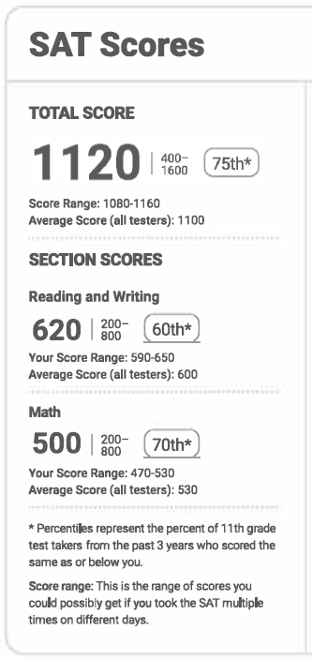
See Your Scores
Total Score
Reading and Writing Score
Math Score
Notes:
Student score information is in the upper left corner of the .pdf score report. They can see their total score, Reading and Writing score and Math score. The total is the sum of the Reading and Writing and Math scores.

Slide 18
Score Range
Scores should be interpreted as ranges rather than singular points because a student’s score might vary slightly if they had taken different versions of the test under identical conditions.
Notes:
Score range is the range of scores students could possibly get if they took the test on multiple days. Some colleges consider score ranges when reviewing applications.
When students take tests more than once, scores may differ on each testing occasion. Scores should be interpreted as ranges rather than singular points because a student’s score might vary slightly if they had taken different versions of the test under identical conditions. In the example on the slide, the Reading & Writing score of 620 should be interpreted as 620 ± 30 points, or a range of 590−650.

Slide 19
Score Comparisons and Percentiles
Percentile Rank scores range from 1 to 99 and express student ability relative to the scores of other students in the same grade.
If a student has a percentile rank of 40%, this indicates the student performed at the same level or better than 40% of students at that grade-level on the test.
Notes:
The percentiles compare a student’s scores with those of all students in the same grade around the world who took the SAT. The student on the slide scored as well or better in Math than 70% of a globally representative group of 11th-grade students.
Percentiles are based on the actual scores of students in the past three graduating classes who took the SAT during high school.

Slide 20
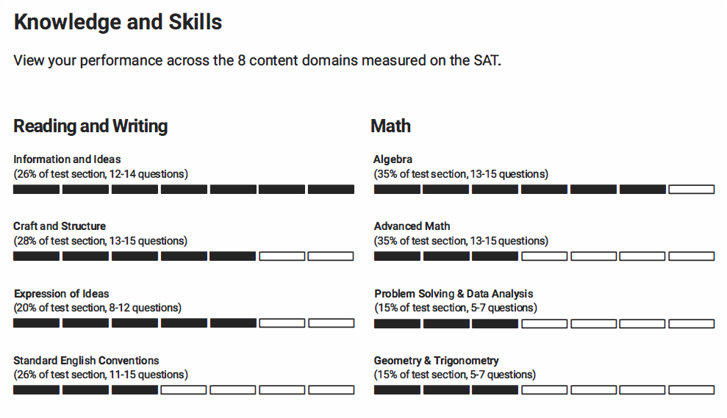
Knowledge and Skills Content Domains
Reading and Writing
Craft and Structure
Explanation of Ideas
Information and Ideas
Standard English Conventions
Math
Algebra
Advanced Math
Problem Solving and Data Analysis
Geometry and Trigonometry
Notes:
The next section of the score report is the content domains for each section. Based on our Skills Insight tool, we provide students with a deeper dive into the knowledge and skills measured by the SAT.
Students can view a graphic showing their performance on each of the eight content areas measured on the SAT. There are four content areas in Reading and Writing, and four in Math. In each content area, students can view:
The approximate number of questions in the content area and what percentage of the section that represents (e.g., 12–14 questions would be about 26% of the Reading and Writing section).
A visual indication of how the student performed in each content area.
Students can use this section to identify content areas they may want to focus on to practice and improve.
.

Slide 21
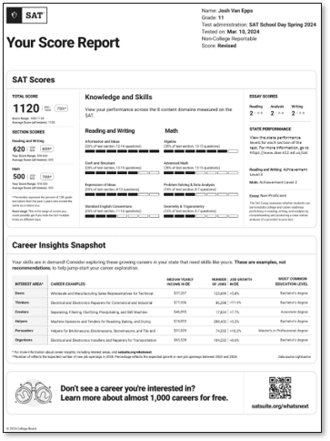
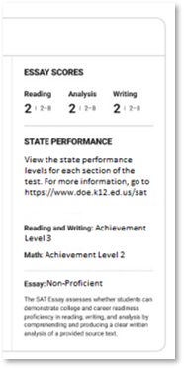
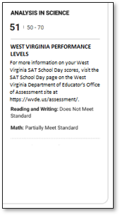
State Score Information
Notes:
Some states have state-specific scores that will print on the score report. This portion of the report is printed in the upper left portion of the score report. If your state doesn’t have this information on the report, please skip this slide.
Some states will have essay information printed in their score report. The essay has three scores: Reading, Analysis, and Writing, each with a score range of 2−8. Students are told if they’re proficient if there’s a state proficiency level set.
West Virginia has the Analysis in Science score ranges of 50−70. It’s derived from Reading/Writing and Math questions that are based on science content. Students are informed whether they exceed, meet, or are below state expectations.

Slide 22
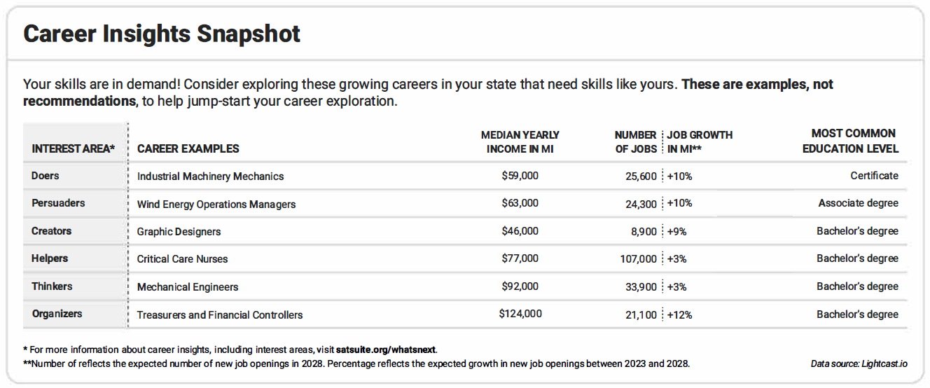
Career Insights Snapshot
Relevant Careers in The State
Notes:
Here’s a view of the bottom portion of the student score report, which provides career insights.
Career is a driving force when students make decisions about their future. Students should know what they like, what they’re good at, the opportunities available to them, and the steps they need to take to reach their goals.
Providing career information directly on the score report provides an opportunity to spark interest in new careers and spur action on charting a career path based on a student's interests, values, and skills.
All students taking a digital SAT Suite assessment will receive information about six careers directly on their official score report.
This is a snapshot of in-demand jobs in each state to get students thinking about what they might like to do in the future. The careers listed aren’t the only ones available in the state or the only ones they should consider, but they can be useful as a starting point to explore what may interest students most.
You’ll see that the report offers an interest area, career example, median yearly income, number of jobs, job growth in coming years, and the most common education level required.
Interest areas are from the Holland framework, the most well-known and widely used tool in career advising—which includes 6 dimensions that are mapped to work environments.
Median yearly income represents the median salary (middle point) students can expect to earn for each your specific state. All careers shown on the score report have a median yearly income that meets living wage standards.
The number of jobs refers to the expected number of new job openings that will be available in your state 5 years from now. Job growth refers to the percent by which the job is expected to have new openings in the next 5 years. All careers shown on your score report are growing in your state.
Most common level of education refers to the education level most often needed to enter an occupation. Some jobs will require a bachelor’s degree while others may require a certificate or an associate degree. The careers on your score report show a variety of different education requirements. We selected jobs that require some form of education after high school as most jobs in the coming years will require some education or skills training beyond high school.
This is a great place to get students talking about their career insights. Ask students to share a career on their report that interests them. Give details to the class. Find one student to share each of the RISEC options. Work together as a class. You can also break into small groups for discussion.

Slide 23
Next Steps
Notes:
This section guides students in using their score report information to increase college and career readiness.

Slide 24
Why Taking the SAT matters
Students who take the SAT demonstrate knowledge and skills research says are most critical for college readiness and success.
The SAT continues to play a vital role in the college admissions process, and it allows you to connect with colleges and scholarships.
When viewed within the context of where you live and learn, test scores can help confirm your grades or can even show your strengths beyond what your high school grades show.
The SAT allows every student—regardless of where you go to high school—to access opportunities that will shape your life and career.
Notes:
In this section, students will see how the SAT helps them get into and pay for college and prepare for their career.

Slide 25
What’s Next After Taking the SAT
Connect with colleges─show them your strengths.
Start getting ready for college with college and career planning tools in BigFuture.
Begin thinking about paying for college: Search for scholarship and financial aid information in BigFuture.
Build your college and career readiness skills with Official Digital SAT Prep on Khan Academy.®
Notes:
In this section, students will see how the SAT helps them get in to and pay for college and prepare for their career.

Slide 26
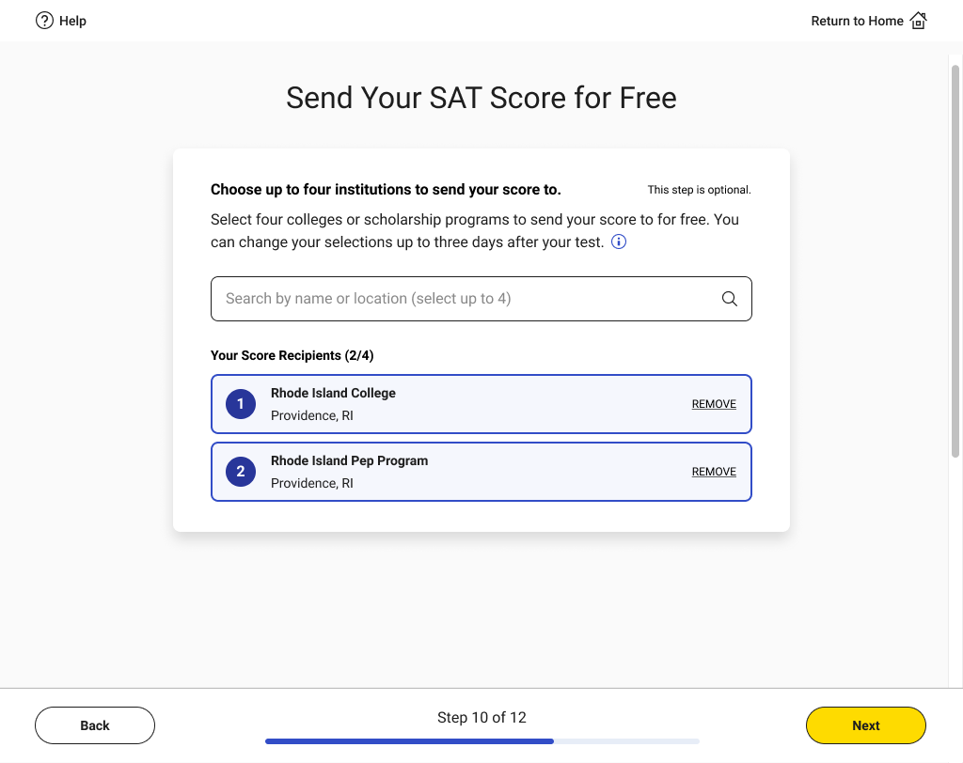
Connect with Colleges by Sending Scores
Notes:
Sending scores an ideal way to connect with a college and let them know of a student’s interest.
Students had the option to send their scores to colleges during exam set up in the Bluebook testing app. If they chose to, they could change those elections up to three days after the test.

Slide 27
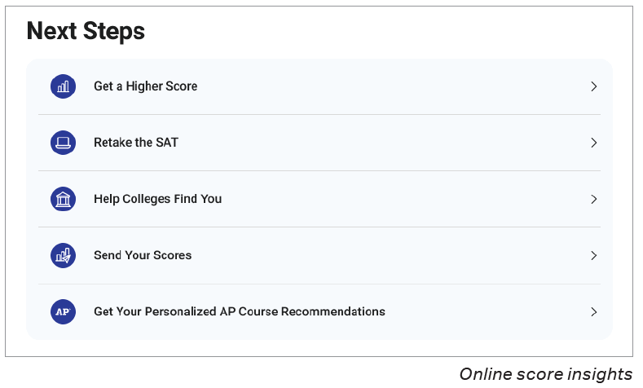
Show Colleges Your Strengths
https://satsuite.collegeboard.org/sat/scores/send-scores-to-colleges/score-choice
Notes:
Students who want to send their scores to additional colleges can log in to their College Board account and select Send Your Scores.
These are the instructions for students:
Sign in to your College Board account. Then go to the Send SAT Scores page.
On the Send SAT Scores page, you might get a prompt about fee waivers. If the message does not apply to you, you can ignore it.
Select institutions to send your scores and information to.
Search for institutions by name or code.
Click one or more institutions to add them to the score recipients list, then click Continue.
For each recipient, send all scores or only some of your scores.
If you've taken the SAT more than once, you can send only your best score. However, the institution you're sending scores to might have a policy that they want to see all your scores. As you select scores to send, you can view the policy requirements of the schools you selected. You can then send what they require.
With Score Choice™, students can put their best foot forward by choosing which scores they send to colleges. Choose by test date for the SAT. Remind students that some colleges and scholarship programs require you to send all their scores.
Share this video about Score Choice to help students understand their options: https://youtu.be/OgMUw5XUJl0?si=p7-d0RwlZXAfaQG9

Slide 28
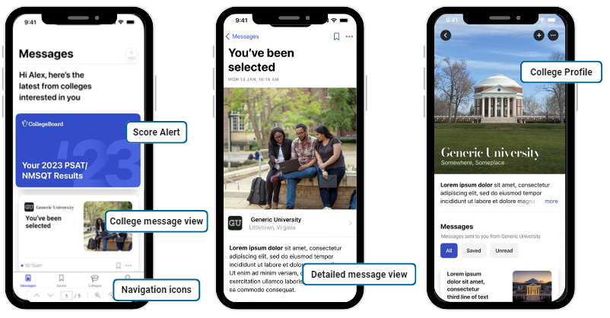
Connect with Colleges using Connections
Notes:
[Note: Some schools and districts don’t have access to Connections. If your students did not have the opportunity to opt into Connections, please skip this slide.]
Students who have downloaded BigFuture School can opt in and out of Connections at any time. When they do, they’ll hear from colleges interested in students like them, based on information the student and the school, district, or state provide when they take an in-school College Board assessment—including the score range—to make connections that are relevant to each student. No personal data will be shared with any institution in the app. Students can reach out to colleges and scholarship organizations outside the app if they choose.
The first screen on the left shows the message feed, the core component of the student app. The purple card up top is an alert from College Board to prompt the student to click to view their scores and score report. The second card is a message from Generic University. If a student clicks on that message card, they’ll be taken to a message detail page.
The second/middle screen show that detail page.
Students can then navigate from messages to college profiles (rightmost screen). They can also search for colleges, access college profiles, and add colleges to their list.
The third screen schools the profile of the college that has messaged the student.
Encourage students to set reminders to check the app often for messages from colleges.

Slide 29
College and Career Planning Tools
Separate, but complementary, resources to help students plan
Start with BigFuture School
Quickly and directly access scores, planning information, and messages from colleges.
Go deeper on BigFuture.org
Go online for additional resources including a career quiz, college search tool, and more.
Notes:
While BigFuture School and the BigFuture and College Board websites are separate resources, they collectively provide students, parents, and schools with the most convenient and comprehensive set of tools to explore colleges, scholarships, and careers as students plan their path after high school.
It’s recommended that students who take in-school assessments download the BigFuture School app for a fast, convenient way to get their scores, receive college and career planning information, and access the exclusive Connections feature, right from their mobile phone.
For students who want to explore more deeply, they can use the BigFuture and College Board websites, alongside the info in the BigFuture School app.

Slide 30
Get College and Career Planning Tools in BigFuture
Notes:
Students can access BigFuture through their score report, either by clicking the link or using the QR code.
BigFuture is College Board’s free online planning guide that helps all students take the right first step after high school.
Students can check out careers they're interested in. They can find colleges based on what's important to them. They can discover ways to pay for college.
When they’re ready to get started, BigFuture offers the information they need to make the right decision.
When students look at their scores, it’s a perfect chance for them to think about what their next steps are for school or training, and what careers they might like to explore. BigFuture is a comprehensive tool that helps them investigate what interests them.

Slide 31
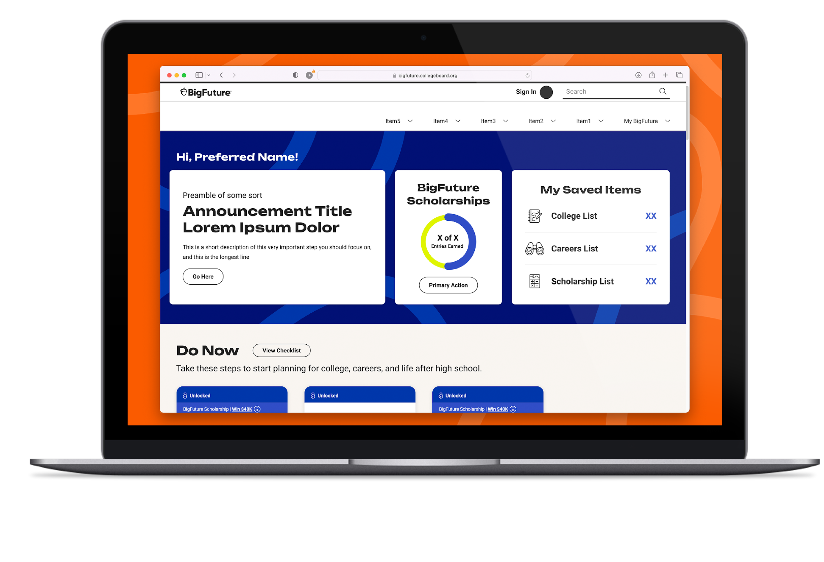
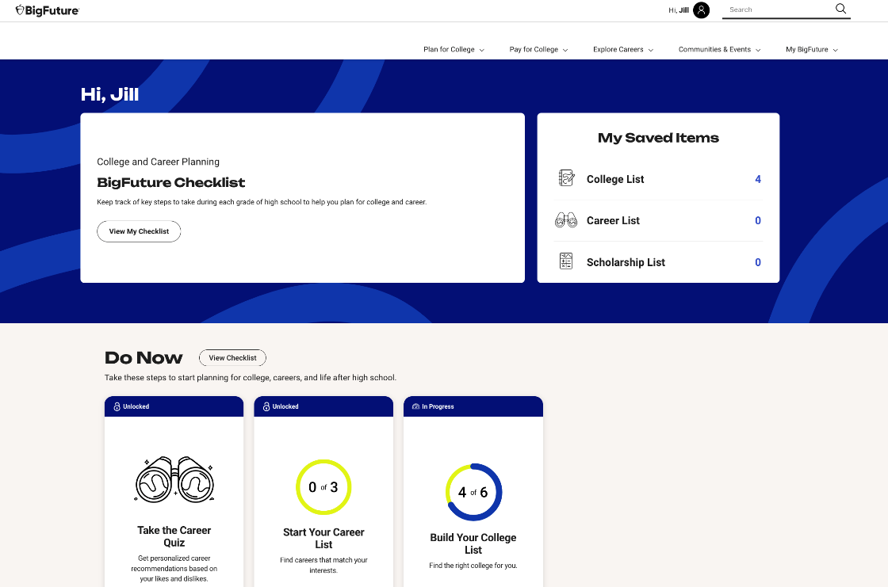
What’s BigFuture?
A free online planning guide to help all students take the right first step after high school.
Bigfuture.org
Notes:
Every student starts somewhere. Every student’s path is unique with its own twists and turns.
This free guide with everything students need is ideal for that right first step after high school.
Students can have a personalized experience that tracks their progress on college and career planning steps.
They can see what steps they should currently be working on, what’s next, and what’s complete.
They can also track their entries for BigFuture Scholarships from their dashboard.

Slide 32
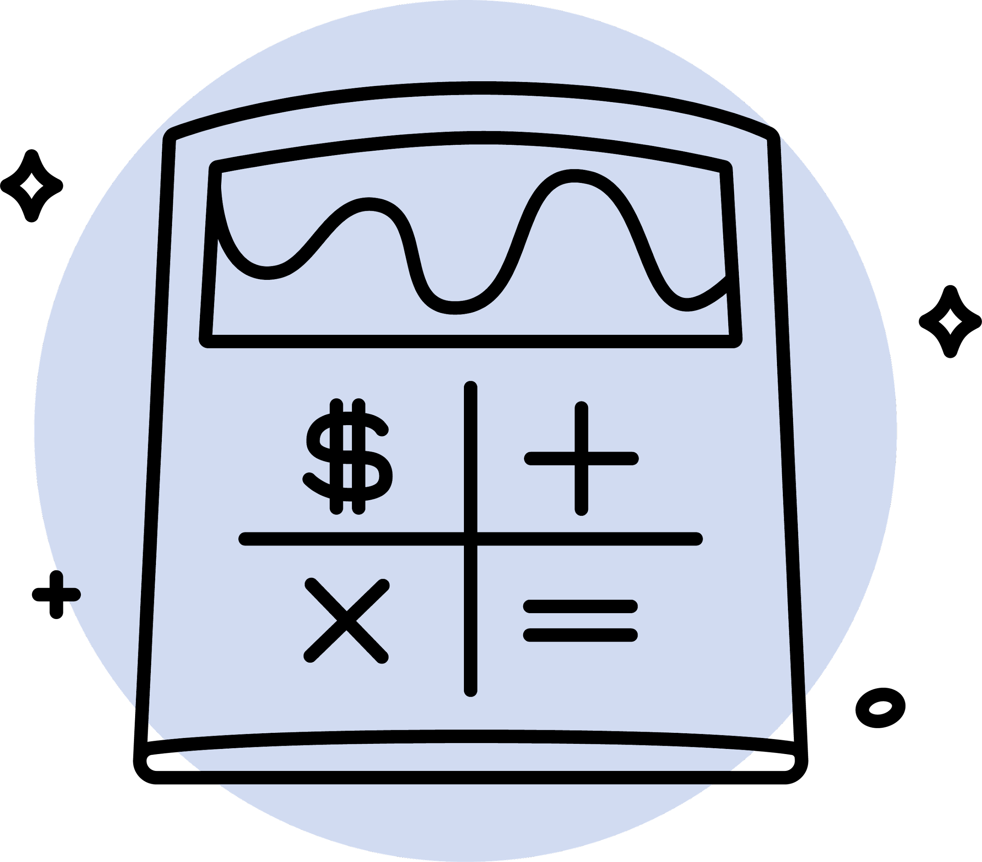
BigFuture
Explore Careers
Plan for College
Pay for
College
Bigfuture.org
Notes:
BigFuture is there for students to explore careers, plan for college, and pay for college.
Whether your students are looking for a four-year university, community college, or technical training, BigFuture has what you need to help students start planning their future the way they want..

Slide 33
BigFuture Scholarships
10th, 11th, and 12th graders can earn entries for completing college and career planning steps on their BigFuture dashboard. Two $40,000 scholarships and hundreds of $500 scholarships are awarded each month!
Bigfuture.org
Notes:
BigFuture Scholarships are open to sophomores, juniors, and seniors.
Students earn entries for taking steps toward college and career planning like building a college list, starting a career list, and exploring careers.
BigFuture awards hundreds of $500 scholarships and two $40,000 scholarships every month for tasks that you talk to your kids about every day.
PLAY VIDEO https://www.youtube.com/watch?v=X054QyER59U

Slide 34
BigFuture Scholarships
BigFuture awards hundreds of $500 and 2 $40,000 scholarships monthly!
1
Start Your Career List
4
Strengthen Your College List
Save 3 or more careers on Career Search.
Opens: December of sophomore year
Deadline: By the end of February of senior year
Save 1 safety, 2 match, and 3 reach schools on College Search
Opens: July 1 before senior year
Deadline: By October 31 of senior year
2
Build Your College List
5
Complete the FAFSA
Save 6 or more colleges on College Search
Opens: December of sophomore year
Deadline: By June 30 of junior year
Complete the FAFSA®, submit a state aid form, or be legally ineligible to submit both the FAFSA and a state aid form.
Opens: December 1 of senior year
Deadline: By the end of February of senior year
3
Explore Scholarships
6
Apply to Colleges
Save 3 or more scholarships on Scholarship Search
Opens: July 1 before senior year
Deadline: By the end of February of senior year
Submit applications to at least 2 colleges.
Opens: October 1 of senior year
Deadline: By the end of February of senior year
Bigfuture.org
Notes:
These are the steps students take to earn entries into the scholarship drawing. These are the steps all students should take to prepare for college and career. Read through the steps on the slide.
When students complete i or more qualifying steps on BigFuture, they'll be automatically entered into drawings for $500 or $40,000
The sooner students complete steps and the more steps they take, the more entries they'll earn.
Their entries for each month will be included in future drawings.
Students whose families earn less than $60,000 per year have extra chances at BigFuture Scholarships and earn double the entries for every drawing.
Students can opt out of monthly scholarship drawings at bigfuture.org/scholarships-opt-out.

Slide 35
College Board
National Recognition Program in 2024
New: National First-Generation Recognition Program
National African American Recognition Program
National Hispanic Recognition Program
National Indigenous Recognition Program
National Rural and Small Town Recognition Program
By Early March: Students are invited to verify their eligibility on BigFuture
June 14: Deadline for students to submit on BigFuture
By September: Awardees access certificates on My Profile on BigFuture
Bigfuture.org/NRP
Notes:
National Recognition Programs help students to be seen by colleges, and they encourage students to take the next step toward college and career.
Like you, we’re committed to elevating all students, especially those who are historically underrepresented on college campuses. Let us help you celebrate the top-performing underrepresented students at your school. Recognition is a signal to colleges that want to recruit awardees. The 2024 submission form is now available. The deadline to submit is June 14, 2024.
Which of Your Students Are Eligible?
Sophomores
Must have a GPA of B+ (equal to at least 3.3 or 87%-89%) or higher at the time they’re submitting. Weighted and unweighted GPAs are considered.
Must have a permanent address in the United States, a U.S. territory or U.S. military base, or attend a Department of Defense Education Activity (DoDEA) school. U.S. citizenship isn’t required.
Must identify as Black/African American, Latino/Hispanic, Indigenous/Native, first-generation college student, or attend high school in a rural area or small town.
Must be in the top 10% among PSAT 10 and PSAT/NMSQT test takers in their state for their award program OR have received a 3+ score on at least 2 distinct AP Exams in 8th or 9th grade.
Juniors
Must have a GPA of B+ (equal to at least 3.3 or 87%-89%) or higher at the time they’re submitting. Weighted and unweighted GPAs are considered.
Must have a permanent address in the United States, a U.S. territory or U.S. military base, or attend a DoDEA school. U.S. citizenship isn’t required.
Must identify as Black/African American, Latino/Hispanic, Indigenous/Native, first-generation college student, or attend high school in a rural area or small town.
Must be in the top 10% among PSAT 10 and PSAT/NMSQT test takers in 11th grade in their state for their award program OR have received a 3+ score on at least 2 distinct AP Exams by the end of 10th grade.
The first-generation programs is new this year. If one or both student’s parents don’t have a bachelor's degree, the student can qualify as first generation. A student’s parents may have some education and still qualify. Learn about the National Recognition Programs.

Slide 36
Build College and Career Readiness Skills
Digital Assessment Readiness
Test Preview
Full-Length Practice Exams
Correct Answers and Explanations
Overview videos, articles, and the ability for students test their knowledge with additional, released digital SAT items in partnership with College Board
Notes:
Students can continue to build their skills for college and career using free Official Digital SAT Practice on Khan Academy.
While the Bluebook testing app houses the full-length practice exams, there’s so much more to explore on Khan Academy.
Khan Academy remains an integral partner in our commitment to deliver free, best-in-class, test prep for the digital SAT. As such, Khan Academy released their digital SAT courses for Reading and Writing and Math on their learning platform, which includes overviews, videos, articles, worked examples and additional digital SAT questions for students to test their knowledge.

Slide 37
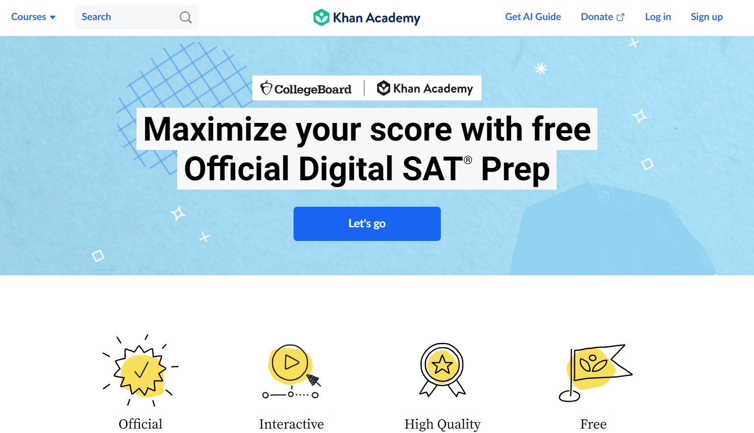
Official Digital SAT Prep on Khan Academy
Students can use this mastery-based course to learn every skill tested on the digital SAT
https://www.khanacademy.org/digital-sat
Notes:
Students can sharpen their skills with Khan Academy’s library of thousands of practice questions, videos, lessons, and hints plus test-taking tips and strategies.
They can prep for every section of the digital SAT with guidance from Khan Academy’s team of math, reading, and writing experts.
All their digital SAT prep materials are free—anytime, anywhere.

Slide 38
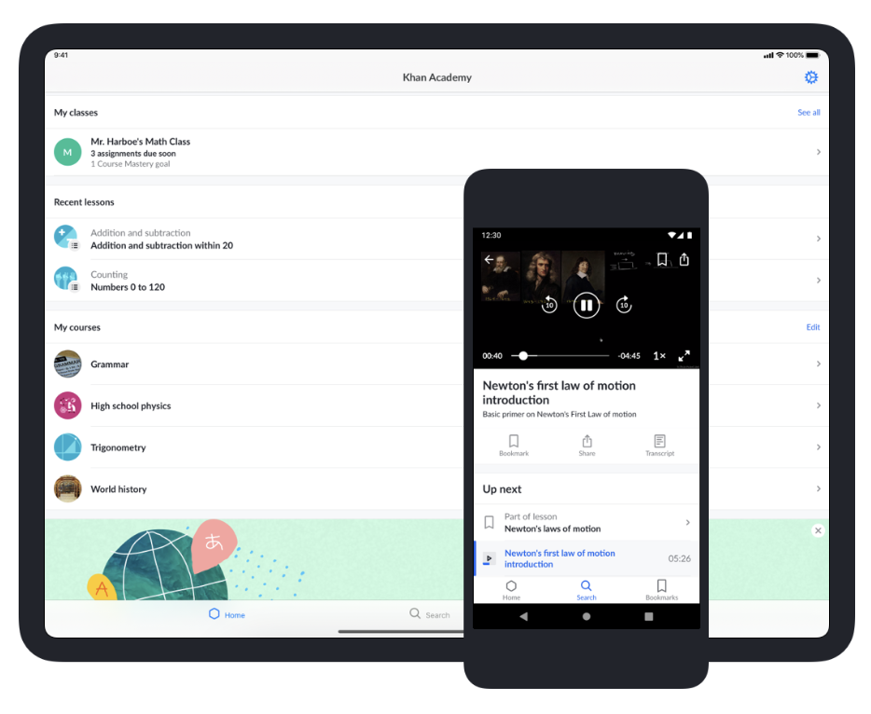
Khan Academy App Puts the Power of Official Digital SAT Prep Directly in the Hands of Students and Parents
Notes:
While Bluebook can’t be accessed on a mobile phone, the Khan Academy App with Official SAT Practice can. This puts the power of practice directly in the hands of students and parents.

Slide 39
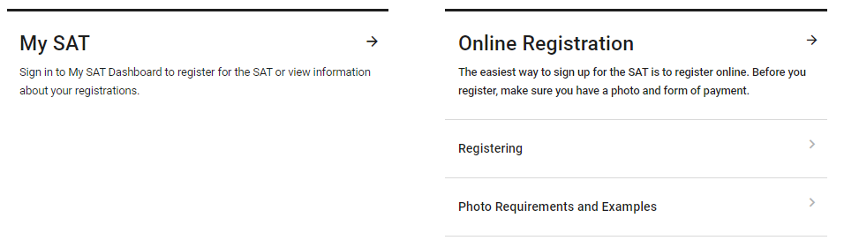
Register for the SAT Weekend
www.sat.org/register
Notes:
Once they’ve sharpened their skills, your students may want to try and improve their SAT score. They can register for SAT on a weekend right through their personal College Board account or by going to sat.org/register.
Students can sign in to My SAT to register. They’ll need to upload a photo and print or save an admission ticket.

