Slide 1
Get Ready for College and Career with SAT® School Day
Fall 2026
A lesson plan for school counselors

Slide 2
SAT® - Scores for Students
Time: 30 minutes
Materials:
This PowerPoint presentation
Recommend one or more from list below.
Mobile phone access for eligible students with the BigFuture School app installed
Printed Sample Student Score Report
Printed student PDF score reports provided through K−12 Score Reporting Portal
Additional Resources:
Video: https://satsuite.collegeboard.org/sat-suite-benefits-students-parents/bigfuture-school-mobile-app
ASCA Professional Standards​ for Counselors
Provide appraisal and advisement in large-group, classroom, small group, and individual settings. (B-SS2)​
ASCA Competencies​
Use assessments to help students understand their abilities, values, and career interests. (B-SS2.a)​
​
A lesson plan for school counselors
Objective: Walk students through their score reports. Help them understand their next steps on the path to college and career readiness.
Notes:
Students who provided their mobile phone number during exam setup can review their SAT School Day score report on their mobile phones using the BigFuture School app. They can also view a .pdf report that you print and provide to them.
Those who did not provide their number may receive a printed .pdf score report (available for printing in the K-12 Score Reporting Portal). Students age 13 and older may use a personal College Board student account to view additional insights online.
This lesson plan includes screenshots from BigFuture School and the PDF score reports. Information is similar in each type of score report.
Each slide includes talking points in the notes to help you guide your students through the information in the score reports.
Notes:
Note to counselor:
Thanks for downloading Get Ready for College and Career with SAT School Day! We hope this PowerPoint will help you inform your students about their scores and opportunities for next steps.
There are multiple ways for students to view their scores. They can download the BigFuture School mobile app. They can look at a .pdf score report that you’ve shared with them. And/Or they can log into their College Board account. The screenshots you’ll see in this presentation are from the BigFuture School app and the .pdf score reports. You can choose to share one or the other, or both, but they provide the same information for students.
If you choose, you can print .pdf score reports in the K−12 Score Reporting Portal
To print student reports, follow these steps:
Run a Roster Report for a school.
In the roster, check the box next to the name of each student you want to include.
Click Create Score Reports to print score reports.
You can print score reports and score labels for up to 50 students at a time in the Roster Report.
To print score reports for all students who took an assessment, use the Batch Student Report PDFs report.
This report creates score report PDFs for each student who took an assessment in the SAT Suite of Assessments. You can run this report for specific administrations and can include all grades tested or select certain grades. This is a scheduled report and will be delivered within 24 hours of submitting the request in the Reports You Scheduled page in Downloads. You'll receive an email when your PDF score reports are available for download in the reporting portal.

Slide 3
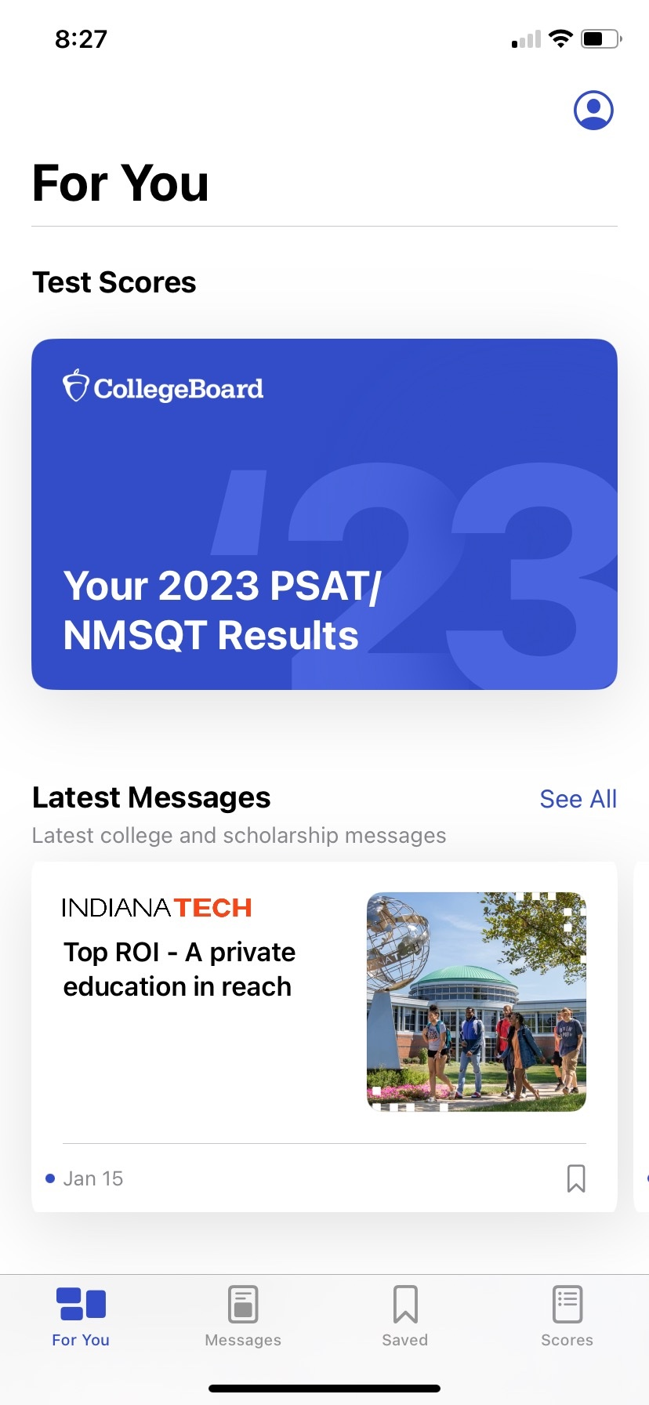
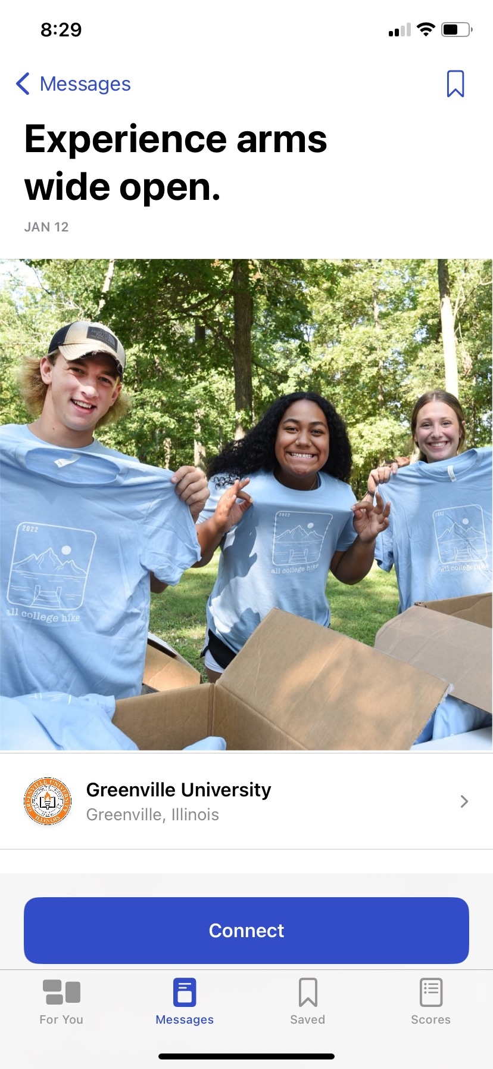
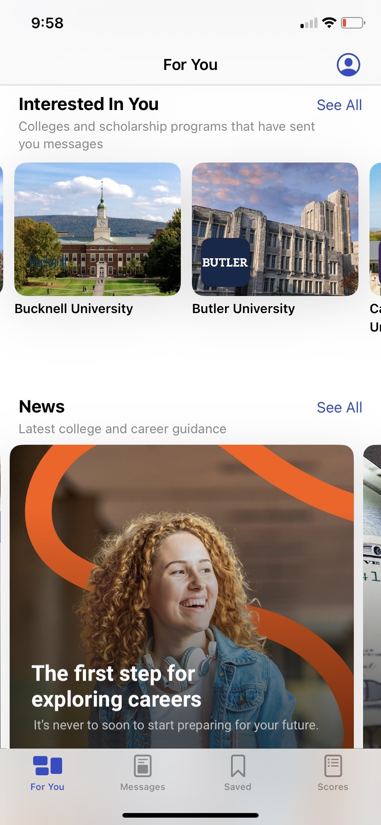
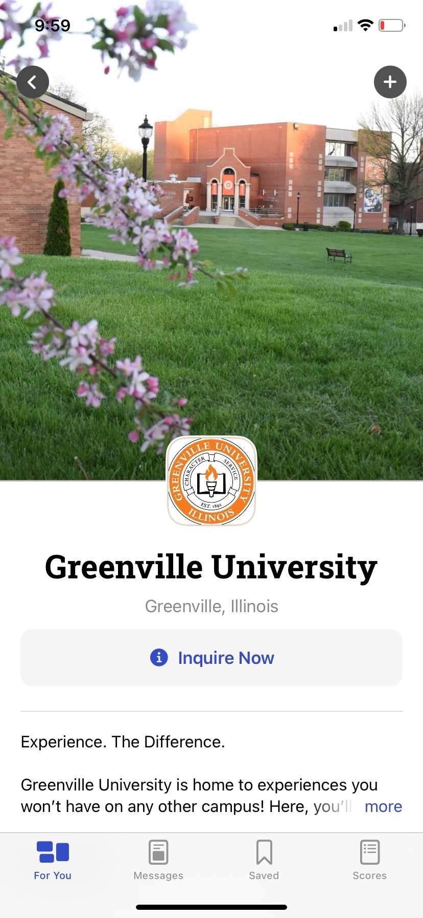
The BigFuture® School mobile app:
The power to plan – in the palm of students’ hands
Direct access to digital SAT School Day, PSAT/NMSQT®, and PSAT 8/9™ scores.
Customized career guidance and information about planning and paying for college.
Connections™: A program for school day test takers that allows them to hear from nonprofit colleges and scholarship programs that may be a good match without sharing personal information.
.
https://satsuite.org/k12bigfutureschool
Notes:
Note to counselor: We created the BigFuture School mobile app several years ago. If you and your students are familiar with the app, no need to share it here.
BigFuture School is a mobile app designed to spark students' interest in planning for the future. Students age of 13 and older who took the SAT School Day, PSAT/NMSQT®, PSAT 10, and PSAT 8/9 can use this app to get college and career guidance the moment they get their scores.

Slide 4
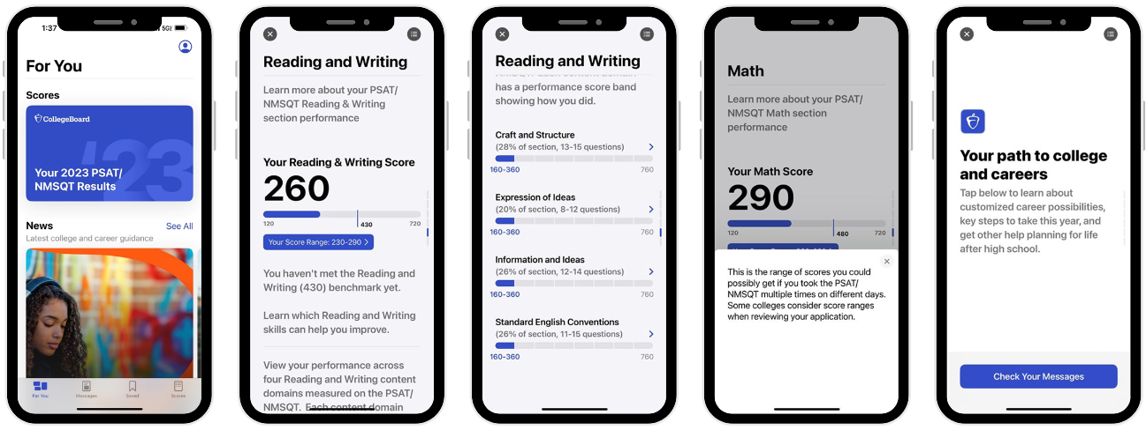
Score Release
Notes:
Note to counselor: Students who have opted in to BigFuture School can see their scores in the app. During exam setup in the Bluebook app, students were given the option to provide their mobile phone number to access BigFuture School and get their scores right in the app. In addition to their scores, the app provides information on colleges, careers, and scholarships. When the score release date nears, students will receive a text message the day before and the day of score release to notify them of the score report availability. Text messages on school days are sent 6 –9 p.m. EST.
The same information on the PDF is available in BigFuture School.

Slide 5
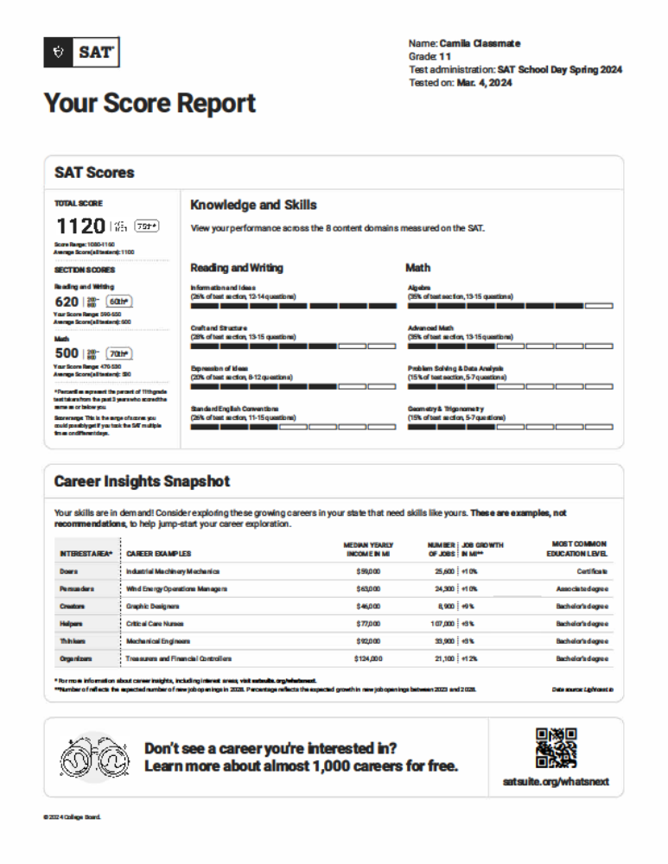
Student Score Report
PDF Version
Notes:
Note to counselors: Another way students can review their scores is through the pdf score report. These can be batch printed from the home screen in the K−12 score reporting portal.
This PPT offers slides with screenshots from BigFuture School, and slides with screen shots from the .PDF version. You can choose the slides that work for your students.
The walkthrough of the .pdf score report begins on slide 17, if your students are not using the BigFuture School app.

Slide 6
SAT School Day and SAT Weekend Scores
Assessment | Total Score (sum of Section Scores) | Section Scores
SAT | 400−1600 | Reading and Writing 200−800
 |  | Math 200−800
Notes:
The SAT score range for the Total Score is 400−1600. The Total Score is the sum of the Reading and Writing section score and the Math section score. Section scores range from 200 to 800.

Slide 7
Student Scores on the SAT Suite of Assessments
Assessment | Total Score | Reading and Writing | Math
SAT School Day SAT Weekend | 400−1600 | 200−800 | 200−800
PSAT/NMSQT | 320−1520 | 160−760 | 160−760
PSAT 8/9™ | 240−1440 | 120−720 | 120−720
Notes:
Note to counselor: This information is for you, and your students may be interested as well.
On each of the assessments, the total score is the sum of the Reading and Writing score and the Math score. Ranges for each of the assessments are vertically aligned, meaning the score a student earns on any of the assessments on a given day is the same score they would have earned on the other assessments. For example, if a student earns a 550 on the Math section on the PSAT 10, they would have earned that same score on the SAT.
Scores ranges are different for each of the assessments due to the relative complexity of each. SAT questions are more complex than PSAT/NMSQT, which has questions that are more complex than PSAT 8/9,

Slide 8
Accessing Scores Through BigFuture School
Notes:
Use this section if your students will access their scores through the BigFuture School mobile app. If you’re reviewing .pdf score reports, advance to slide 17.

Slide 9
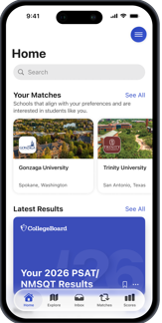
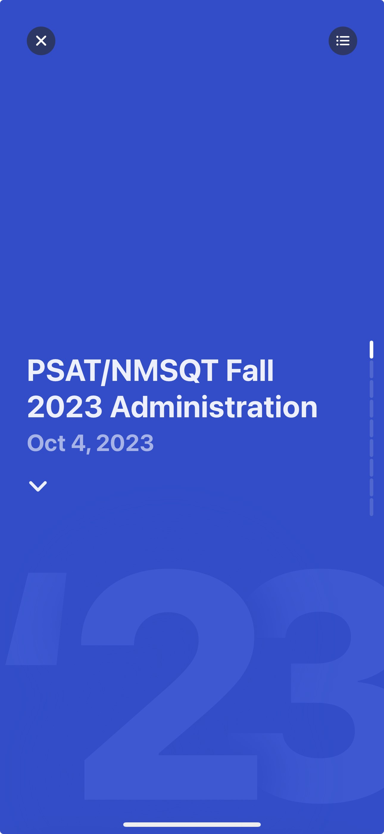
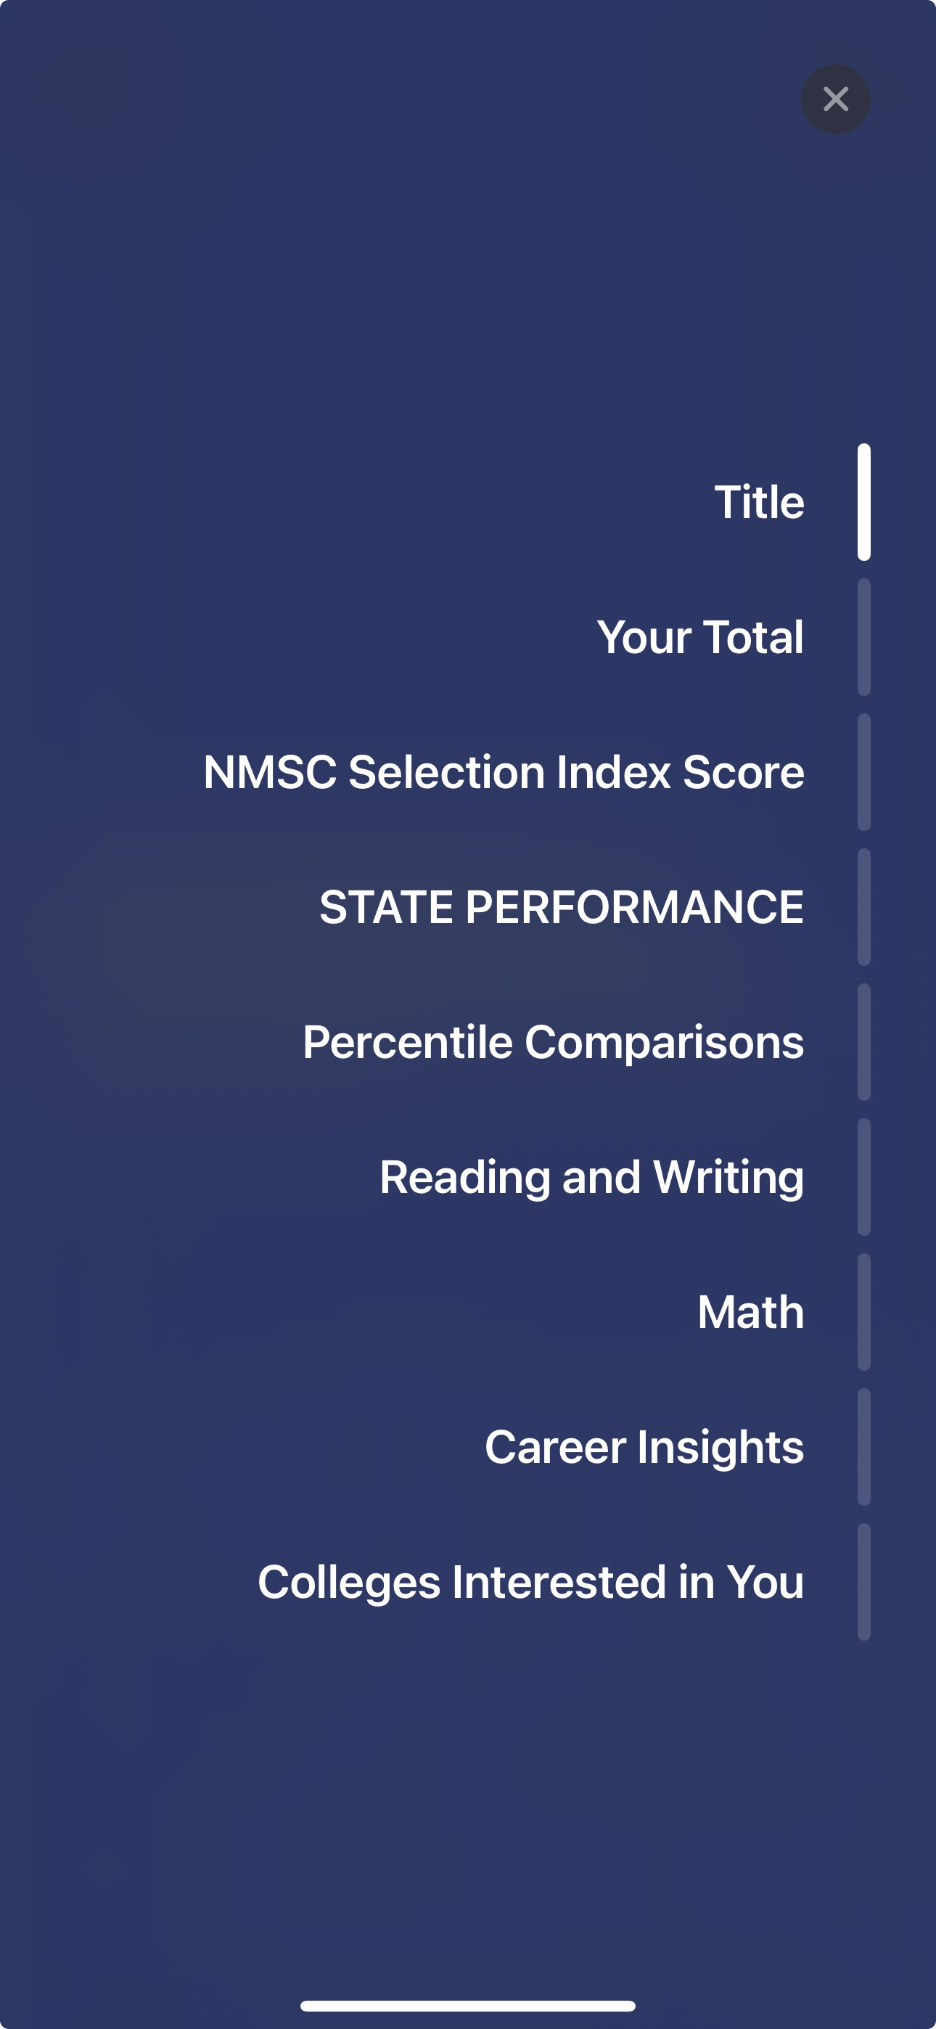


Find Your Score on BigFuture School
Your SAT Results
SAT School Day Spring 2024 Administration
March 4, 2024
Notes:
Note to counselors: going forward, the notes in the slides will be written as if you were reading them to the students.
When you open the BigFuture School app on your phone, you’ll see several icons on the bottom of the screen: For You, Messages, Saved, and Scores. When you select Scores, you’ll see a card that names your test results.
Clicking on the card takes you to the score report. There’s a small icon on the upper right side of the screen. This is menu that takes you directly to the various sections of the score report. Alternatively, you can scroll down.

Slide 10
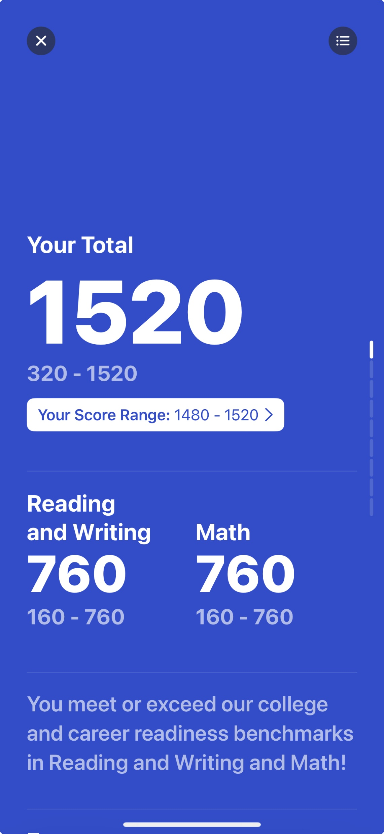
See Your Scores
Total Score
Reading and Writing Score
Math Score
Notes:
Scrolling down, you’ll see your total score and your section scores.
The statement on the bottom of the screen lets you know whether you meet the college and career readiness benchmark on each section of the SAT. There’s more information about benchmarks on slide 12.
[In some states, you’ll see additional scores for your essay and/or Analysis in Science. The essay has three scores: Reading, Analysis, and Writing, each with a score range of 2−8. You’ll be told if you’re proficient.
The Analysis in Science has a range of 50−70. It’s derived from Reading/Writing and Math questions that are based on science content. You’ll be informed whether you exceed, meet, or are below state expectations.]

Slide 11
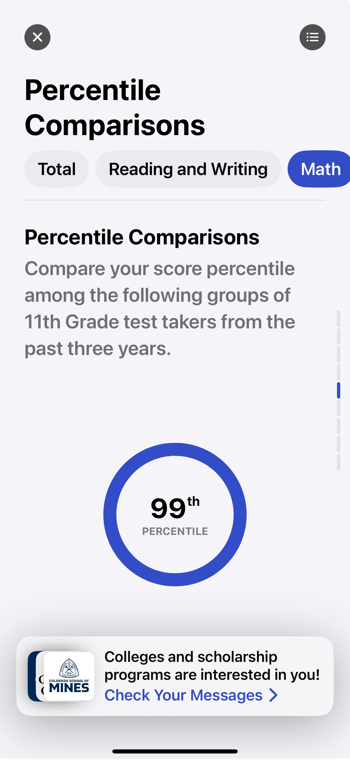
Score Comparisons and Percentiles
Percentile Rank scores range from 1 to 99 and express student ability relative to the scores of other students in the same grade.
If a student has a percentile rank of 40%, this indicates the student performed at the same level or better than 40% of students at that grade-level on the test.
40th
Notes:
When you continue scrolling, you reach the Percentile Comparisons portion of the score report.
You can select Total, Reading and Writing, and/or Math near the top of the screen to see your score percentile.
The percentiles compare your scores with those of all students in the same grade around the world who took the SAT. The student on the slide scored as well or better in Math than 40% of a globally representative group of 11th-grade students.
Percentiles are based on the actual scores of students in the past three graduating classes who took the SAT during high school.

Slide 12
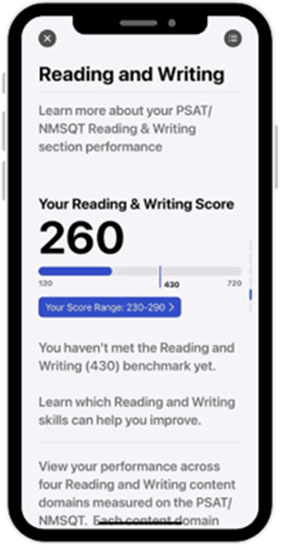
Benchmarks
Assessment – Grade Level | Reading and Writing Benchmark | Math Benchmark
SAT – Grade 12 | 480 | 530
PSAT/NMSQT – Grade 11 | 460 | 510
PSAT 10 – Grade 10 | 430 | 480
PSAT 8/9 – Grade 9 | 410 | 450
PSAT 8/9 – Grade 8 | 390 | 430
The SAT Math benchmark is set to be the minimum score a student can earn on the Math section of the SAT to have a 75% chance of earning at least a C in first-semester, credit-bearing, college-level courses in algebra, statistics, pre-calculus, and/or calculus.
The SAT Reading and Writing benchmark is set to be the minimum score a student can earn on the Reading and Writing section of the SAT to have a 75% chance of earning at least a C in first-semester, credit-bearing, college-level courses in history, literature, social science, and/or writing.
Notes:
A benchmark is a standard you can measure your progress against — like a marker showing where you stand and how close you are to where you want to be.
The SAT Math benchmark is set to be the minimum score you can earn on the Math section of the SAT to have a 75% chance of earning at least a C in first-semester, credit-bearing, college-level courses in algebra, statistics, pre-calculus, and/or calculus.
The SAT Reading and Writing benchmark is set to be the minimum score you can earn on the Reading and Writing section of the SAT to have a 75% chance of earning at least a C in first-semester, credit-bearing, college-level courses in history, literature, social science, and/or writing.
The PSAT/NMSQT, PSAT 10, and PSAT 8/9 benchmark scores are based on expected student growth toward the SAT benchmarks at each grade. The new benchmarks are set to reflect typical annual growth from year to year through the 12th grade, where the SAT benchmarks reflect a high probability of successfully earning a passing grade in courses specifically linked to the two SAT section scores.
The benchmarks for all assessments work together as a system, making it easier to evaluate how you are progressing year over year toward college readiness. They provide you and your teachers with actionable feedback and detailed information, including areas of academic strength and weakness, as well as action steps for improvement.

Slide 13
Score Range
Scores should be interpreted as ranges rather than singular points because a student’s score might vary slightly if they had taken different versions of the test under identical conditions.
Your Reading & Writing Score
260
130
430
730
Your Score Range: 230-290
Notes:
Score range is the range of scores you could possibly get if you took the test on multiple days. Some colleges consider score ranges when reviewing applications.
When students take tests more than once, scores may differ on each testing occasion. Scores should be interpreted as ranges rather than singular points because a student’s score might vary slightly if they had taken different versions of the test under identical conditions. For example, on the slide, the Reading & Writing score of 260 should be interpreted as 260 ± 30 points, or a range of 230−290.

Slide 14
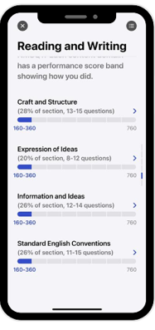
Knowledge and Skills Content Domains
Reading and Writing
  Craft and Structure
  Explanation of Ideas
  Information and Ideas
  Standard English Conventions
Math
  Algebra
  Advanced Math
  Problem Solving and Data Analysis
  Geometry and Trigonometry
Notes:
The next section of the score report includes the content domains for each Reading and Writing, then Math. Based on our Skills Insight™ tool, we provide you with a deeper dive into the knowledge and skills measured by the SAT.
You can view a graphic showing your performance on each of the eight content areas measured on the SAT. There are four content areas in Reading and Writing, and four in Math. In each content area, you can view:
The approximate number of questions in the content area and what percentage of the section that represents (e.g., 12–14 questions would be about 26% of the Reading and Writing section).
A visual indication of how you performed in each content area. More bars indicates a higher performance.
You can use this section to identify content areas you may want to focus on to practice and improve.

Slide 15

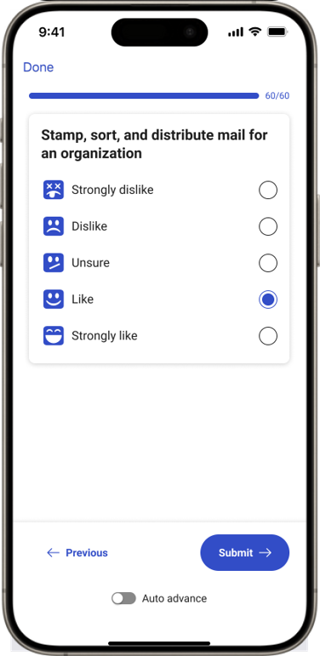
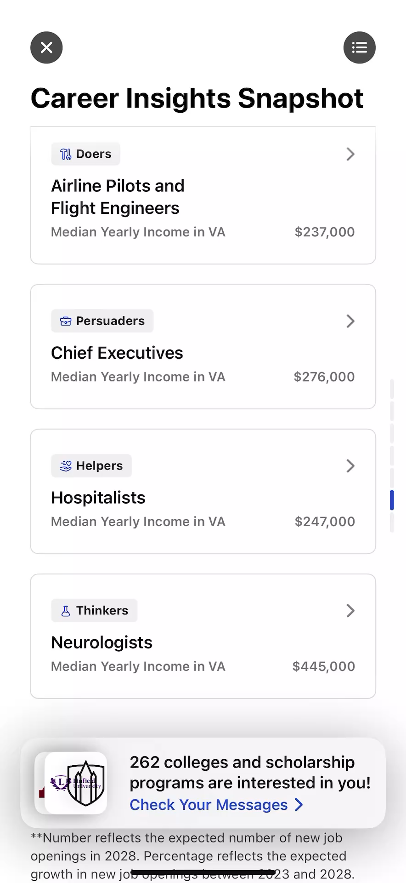
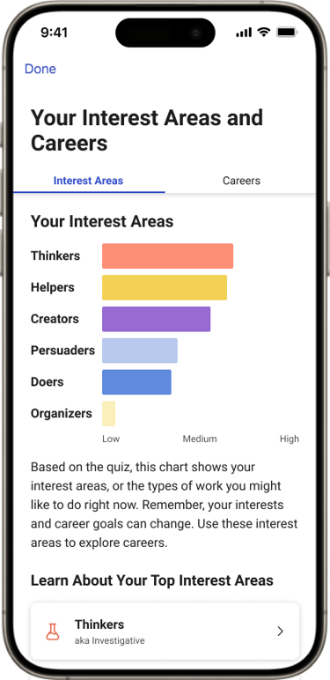
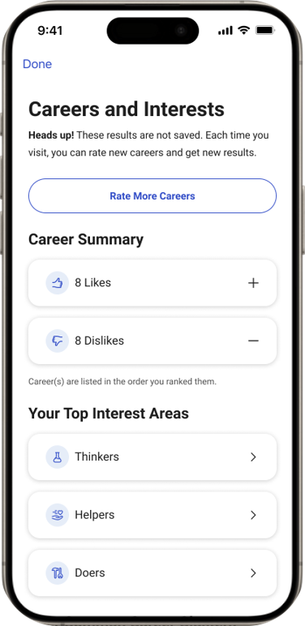
Career Exploration in BigFuture School
Career Quiz: In under 15 minutes, students can get a list of 30 possible careers to explore that align with their interests.
Career Exploration: Students can freely explore a range of careers with expected earnings, job growth, and education levels needed for each.
Notes:
(Hit play on the phone’s video to show what career exploration could look like for students)
You’ll also see your Career Insights Snapshot. The Career Insights Snapshot is part of the score report and maps the math, reading, and writing skills measured by the SAT Suite of Assessments to the skills needed for 1,000 careers.​
​
The Career Insights Snapshot provides a list of six growing careers in your state that align with your current skills. If you have 15 minutes to spare, complete the Career Quiz in the app! This quiz shows career options based on your skills and interests, helping you identify areas you might want to explore further.​
​
The career examples shown aren’t recommendations or the only career options for you but can serve as a possible starting point for your exploration. Each of the six careers shown to you is growing in your state, meaning these are jobs that are expected to be available and pay a living wage. You can also learn more about each career and the level of education required.
You can also look at additional careers that fit your interests by navigating to Career Explorer in the app to discover even more possibilities.

Slide 16
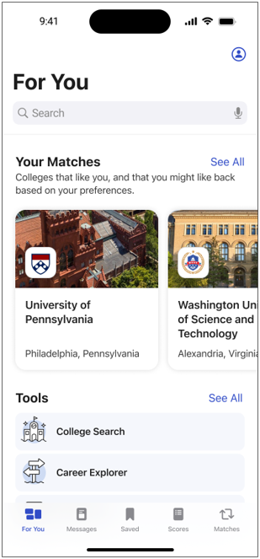
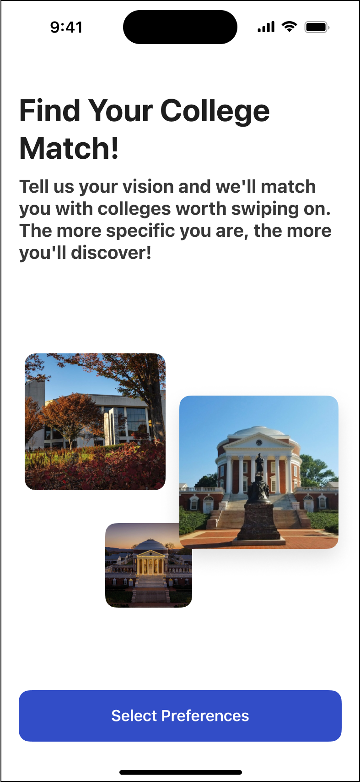
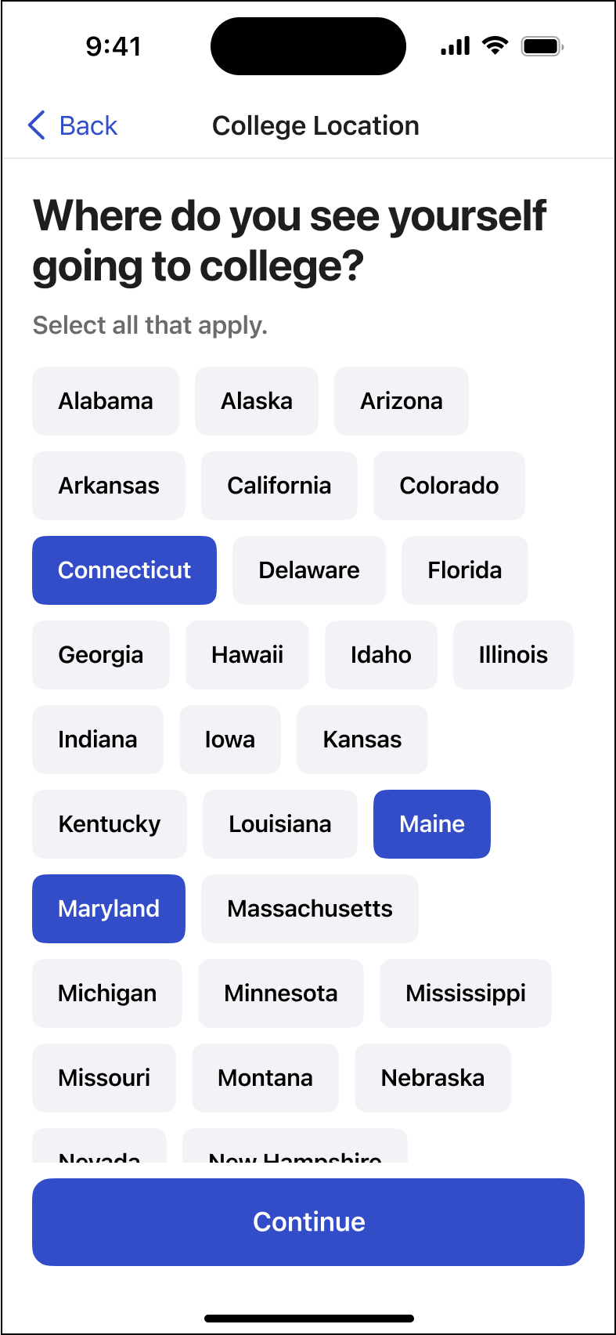
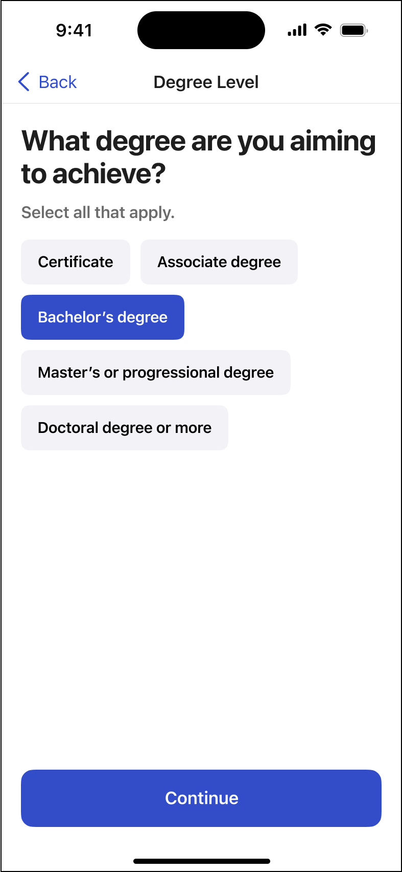
College Search in BigFuture School
Students can update their preferences in the app’s settings to curate a college search experience tailored to their interests.
Indicating preferences such as size and location allows students to narrow their search and discover more relevant options faster.
Notes:
If you’re just starting out or are unsure of your path, the college search function offers a way to explore freely with helpful filters like location, size, setting, degree level, acceptance rates, and SAT ranges.
If you know where and what type of school you want to go to, being able to update preferences and view schools that meet your criteria make discovering college options even easier.
You can check out detailed profiles of schools and programs with information like acceptance rates and cost and save favorites for later. You can update your preferences at any time, which keeps this tool flexible and adaptive to your wants and needs.

Slide 17
Accessing Scores on the PDF Score Report
Notes:
Note to counselor: This section is useful if students are reviewing scores using the .pdf score report, printed from the K−12 Score Reporting Portal. Please skip this portion if your students have reviewed their scores in BigFuture School. Go to slide 24.

Slide 18
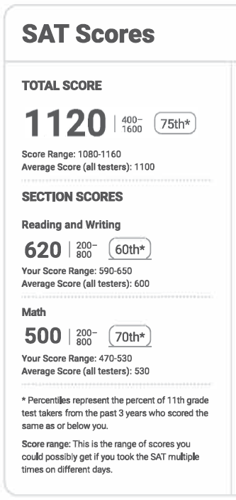
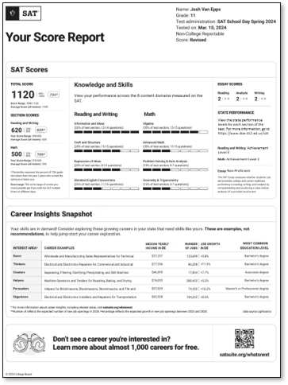
See Your Scores
Total Score
Reading and Writing Score
Math Score
Notes:
Note to counselor: The rest of this section is written as if you are reading the notes to your students.
Your score information is in the upper left corner of the .pdf score report. You can see your total score, Reading and Writing score and Math score. The total is the sum of the Reading and Writing and Math scores.

Slide 19
Score Range
Scores should be interpreted as ranges rather than singular points because a student’s score might vary slightly if they had taken different versions of the test under identical conditions.
Notes:
Score range is the range of scores you could possibly get if you took the test on multiple days. Some colleges consider score ranges when reviewing applications.
When students take tests more than once, scores may differ on each testing occasion. Scores should be interpreted as ranges rather than singular points because a student’s score might vary slightly if they had taken different versions of the test under identical conditions. In the example on the slide, the Reading & Writing score of 620 should be interpreted as 620 ± 30 points, or a range of 590−650.

Slide 20
Score Comparisons and Percentiles
Percentile Rank scores range from 1 to 99 and express student ability relative to the scores of other students in the same grade.
If a student has a percentile rank of 40%, this indicates the student performed at the same level or better than 40% of students at that grade-level on the test.
Notes:
The percentiles compare your scores with those of all students in the same grade around the world who took the SAT. The student on the slide scored as well or better in Math than 70% of a globally representative group of 11th-grade students.
Percentiles are based on the actual scores of students in the past three graduating classes who took the SAT during high school.

Slide 21
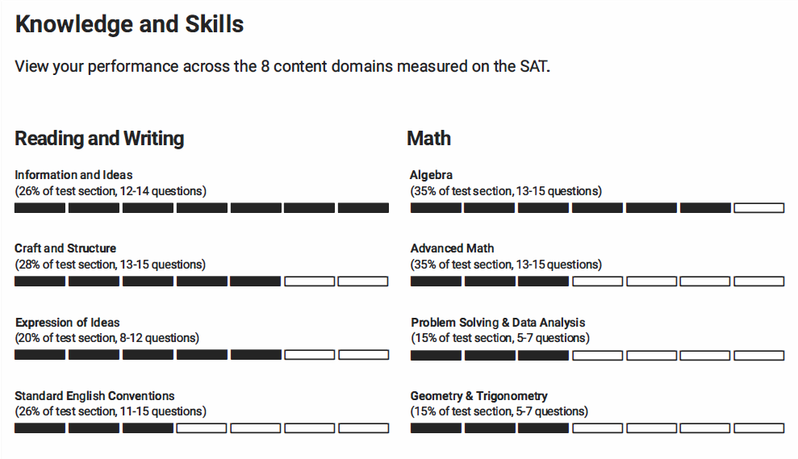
Knowledge and Skills Content Domains
Reading and Writing
  Craft and Structure
  Explanation of Ideas
  Information and Ideas
  Standard English Conventions
Math
  Algebra
  Advanced Math
  Problem Solving and Data Analysis
  Geometry and Trigonometry
Notes:
The next section of the score report is the content domains for each section. Based on our Skills Insight tool, you’ll get a deeper dive into the knowledge and skills measured by the SAT.
You can view a graphic showing your performance on each of the eight content areas measured on the SAT. There are four content areas in Reading and Writing, and four in Math. In each content area, you can view:
The approximate number of questions in the content area and what percentage of the section that represents (e.g., 12–14 questions would be about 26% of the Reading and Writing section).
A visual indication of how you performed in each content area. More bars indicates a higher performance.
You can use this section to identify content areas you may want to focus on to practice and improve.

Slide 22
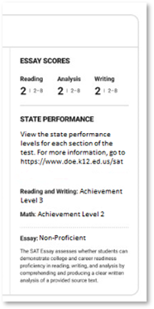
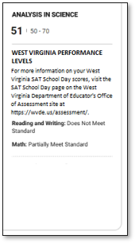
State Score Information
Notes:
Note to counselor: Some states have state-specific scores that will print on the score report. This portion of the report is printed in the upper left portion of the score report. If your state doesn’t have this information on the report, please skip this slide.
Some states will have essay information printed in their score report. The essay has three scores: Reading, Analysis, and Writing, each with a score range of 2−8. You’ll be told if you’re proficient if there’s a state proficiency level set.
West Virginia has the Analysis in Science score ranges of 50−70. It’s derived from Reading/Writing and Math questions that are based on science content. You’ll be informed whether you exceed, meet, or are below state expectations.

Slide 23
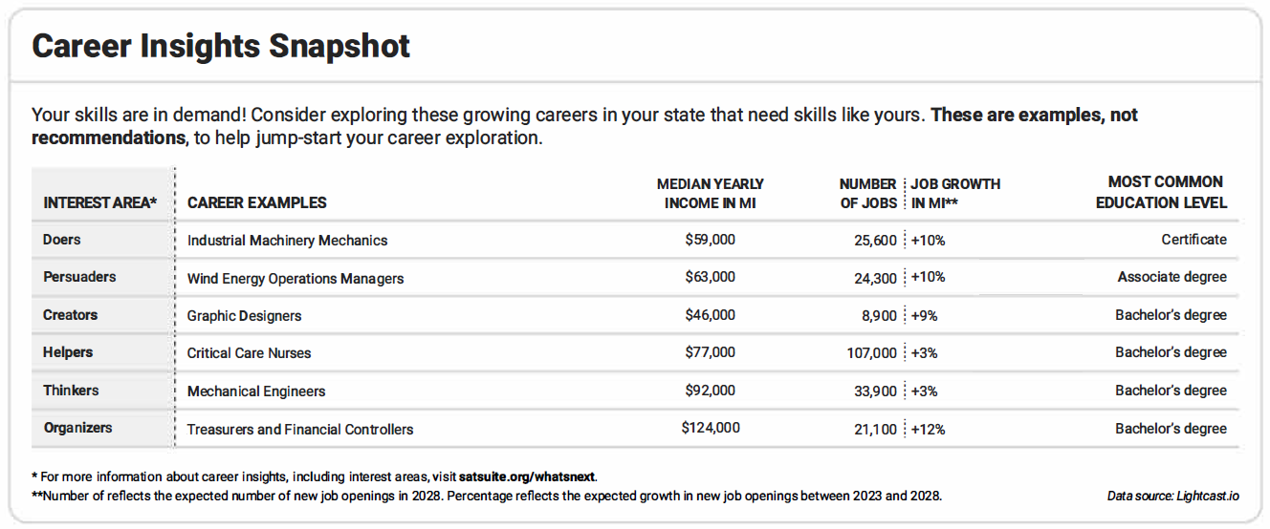
Career Insights Snapshot
Relevant Careers in Your State
Notes:
Here’s a view of the bottom portion of your score report, which provides career insights.
This is a snapshot of in-demand jobs in your state to get you thinking about what you might like to do in the future. The careers listed aren’t the only ones available in your state or the only ones you should consider, but they can be useful as a starting point to explore what may interest you most.
You’ll see that the report offers an interest area, career example, median yearly income, number of jobs, job growth in coming years, and the most common education level required.
Interest areas are from the Holland framework, the most well-known and widely used tool in career advising—which includes 6 dimensions that are mapped to work environments.
Median yearly income represents the median salary (middle point) you can expect to earn for your specific state. All careers shown on your score report have a median yearly income that meets living wage standards.
The number of jobs refers to the expected number of new job openings that will be available in your state 5 years from now. Job growth refers to the percent by which the job is expected to have new openings in the next 5 years. All careers shown on your score report are growing in your state.
Most common level of education refers to the education level most often needed to enter an occupation. Some jobs will require a bachelor’s degree while others may require a certificate or an associate degree. The careers on your score report show a variety of different education requirements. We selected jobs that require some form of education after high school as most jobs in the coming years will require some education or skills training beyond high school.
Note to counselor: This is a great place to get students talking about their career insights. Ask students to share a career on their report that interests them. Give details to the class. Find one student to share each of the RISEC options. Work together as a class. You can also break into small groups for discussion.

Slide 24
Next Steps
Notes:
Note to counselor: This section guides students in using their score report information to increase college and career readiness.

Slide 25
Why Taking the SAT matters
Taking the SAT can help you demonstrate knowledge and skills research says are most critical for college readiness and success.
The SAT continues to play a vital role in the college admissions process, is accepted widely, and it allows you to connect with colleges and scholarships.
When viewed within the context of where you live and learn, test scores can help confirm your grades or can even show your strengths beyond what your high school grades show.
The SAT allows every student—regardless of where you go to high school—to access opportunities that will shape your life and career.
Notes:
In this section, you will see how the SAT helps you get into and pay for college and prepare for your career.

Slide 26
What’s Next After Taking the SAT
Connect with colleges─show them your strengths.
Start getting ready for college with college and career planning tools in BigFuture.
Begin thinking about paying for college: Search for scholarship and financial aid information in BigFuture.
Build your college and career readiness skills with SAT practice tools, including Official SAT Prep on Khan Academy®.
Notes:
In this section, you will see how the SAT helps you get in to and pay for college and prepare for your career.

Slide 27
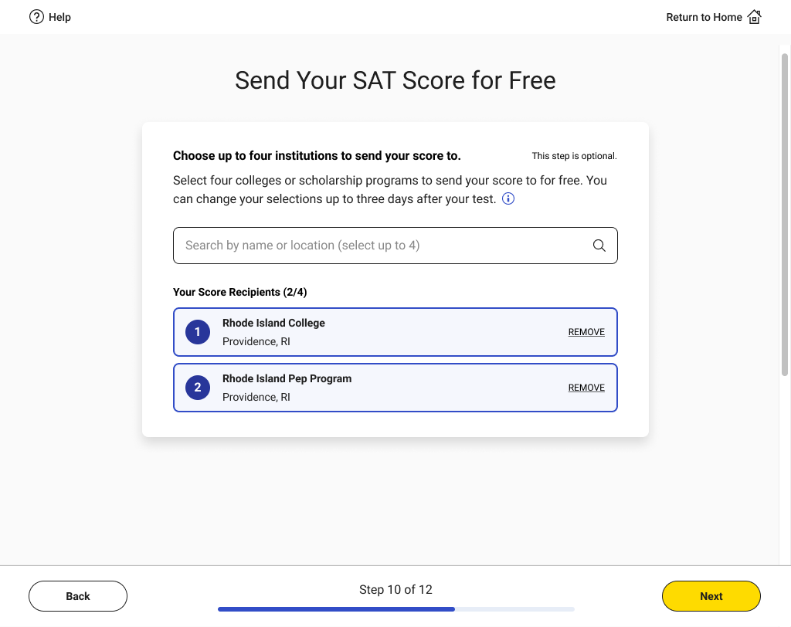
Connect with Colleges by Sending Scores
Notes:
Sending your scores is an ideal way to connect with a college and let them know of your interest.
You had the option to send your scores to colleges during exam set up in the Bluebook testing app. If you chose to, you could change those elections up to three days after the test.

Slide 28
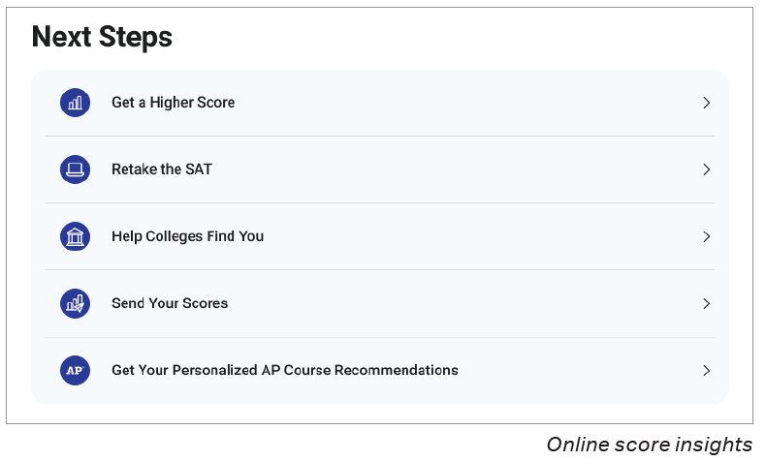
Show Colleges Your Strengths
https://satsuite.collegeboard.org/sat/scores/send-scores-to-colleges/score-choice
Notes:
If you want to send your scores to additional colleges, you can log in to your College Board account and select Send Your Scores.
Here’s how:
Sign in to your College Board account. Then go to the Send SAT Scores page.
On the Send SAT Scores page, you might get a prompt about fee waivers. If the message does not apply to you, you can ignore it.
Select institutions to send your scores and information to.
Search for institutions by name or code.
Click one or more institutions to add them to the score recipients list, then click Continue.
For each recipient, send all scores or only some of your scores.
If you've taken the SAT more than once, you can send only your best score. However, the institution you're sending scores to might have a policy that they want to see all your scores. As you select scores to send, you can view the policy requirements of the schools you selected. You can then send what they require.
With Score Choice™, you can put your best foot forward by choosing which scores you send to colleges. Choose by test date for the SAT. Note to counselor: Remind students that some colleges and scholarship programs require you to send all your scores.
Note to counselor: Share this video about Score Choice to help students understand their options: https://youtu.be/OgMUw5XUJl0?si=p7-d0RwlZXAfaQG9

Slide 29
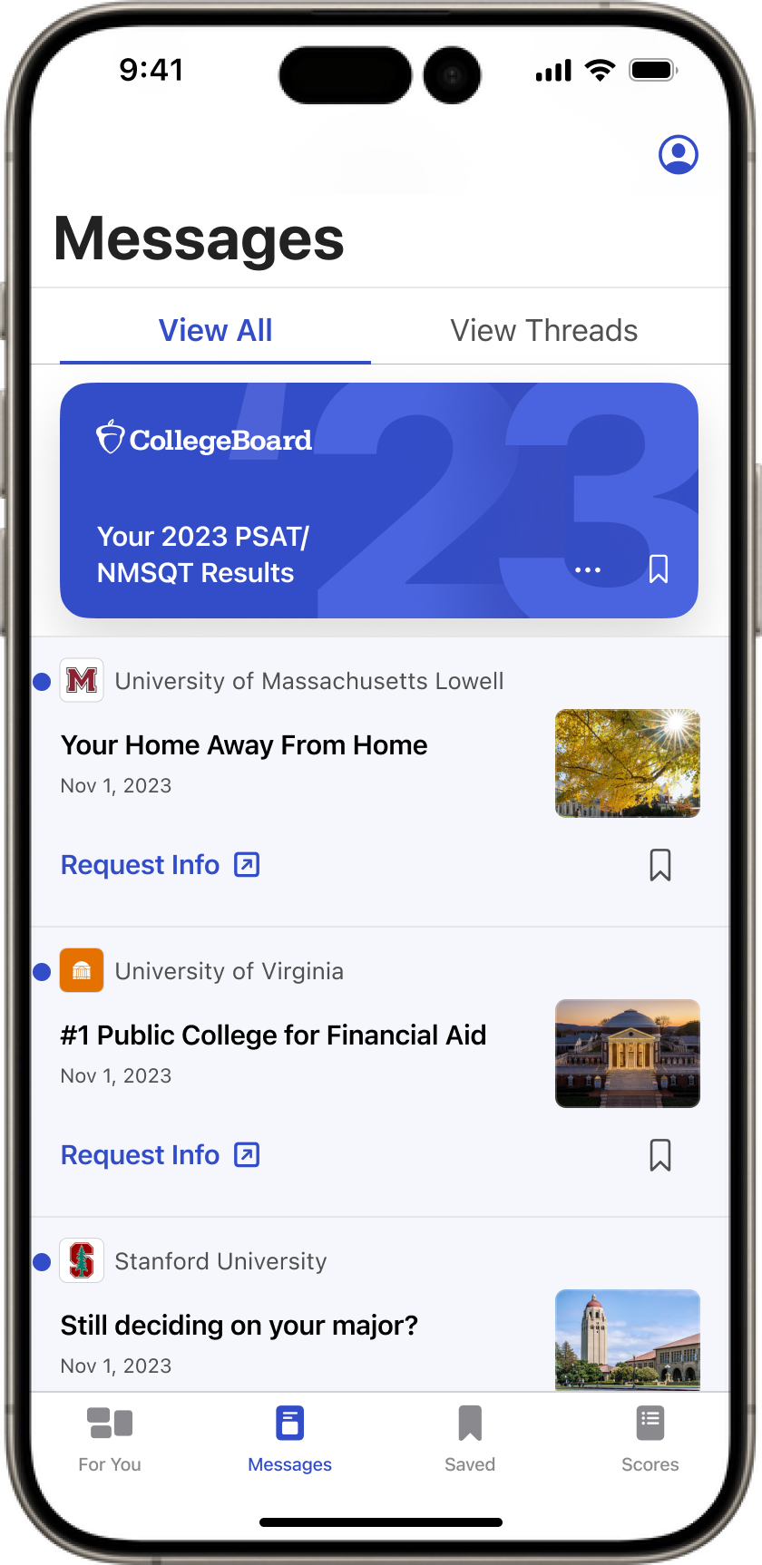

What Is Connections?
Along with BigFuture School, students can opt in to Connections.
Unlock future possibilities. With Connections™, you can discover nonprofit colleges, scholarship providers, and government agencies providing educational programs that may be a good fit and are looking for students like you in BigFuture School.
Receive messages from colleges and programs. College Board shares messages from nonprofit organizations based on information you and your school, district, or state provide as part of the eligible test.
Take control. You decide if and when to share your information with interested institutions.
Notes:
Note to counselor: Some schools and districts don’t have access to Connections. If your students did not have the opportunity to opt into Connections, please skip this slide.
In addition to sending your scores, you can also connect with colleges through Connections in BigFuture School.
You can opt in to Connections in the BigFuture School mobile app.
Connections is the primary way for you to receive messages from nonprofit colleges and universities, scholarship providers, and government agencies offering education programs.
You choose if and when to connect and share information directly with these institutions.
There are currently over 700 institutions in Connections.

Slide 30
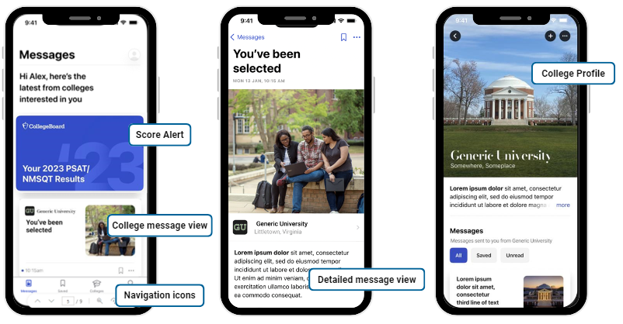
Connect with Colleges using Connections
Notes:
Note to counselor: Some schools and districts don’t have access to Connections. If your students did not have the opportunity to opt into Connections, please skip this slide.
If you’ve downloaded BigFuture School, you can opt in and out of Connections at any time. When you do, you’ll hear from colleges interested in students like you, based on information you and your school, district, or state provide when you take an in-school College Board assessment—including your score range—to make connections that are relevant to you. No personal data will be shared with any institution in the app. You can reach out to colleges and scholarship organizations outside the app if you choose.
The first screen on the left shows the message feed, the core component of the app. The purple card up top is an alert from College Board to prompt you to click to view your scores and score report. The second card is a message from Generic University. If you click on that message card, you’ll be taken to a message detail page.
The second/middle screen shows that detail page.
You can then navigate from messages to college profiles (rightmost screen). You can also search for colleges, access college profiles, and add colleges to your list.
The third screen shows the profile of the college that has messaged you.
Note to counselor: Encourage students to set reminders to check the app often for messages from colleges.

Slide 31
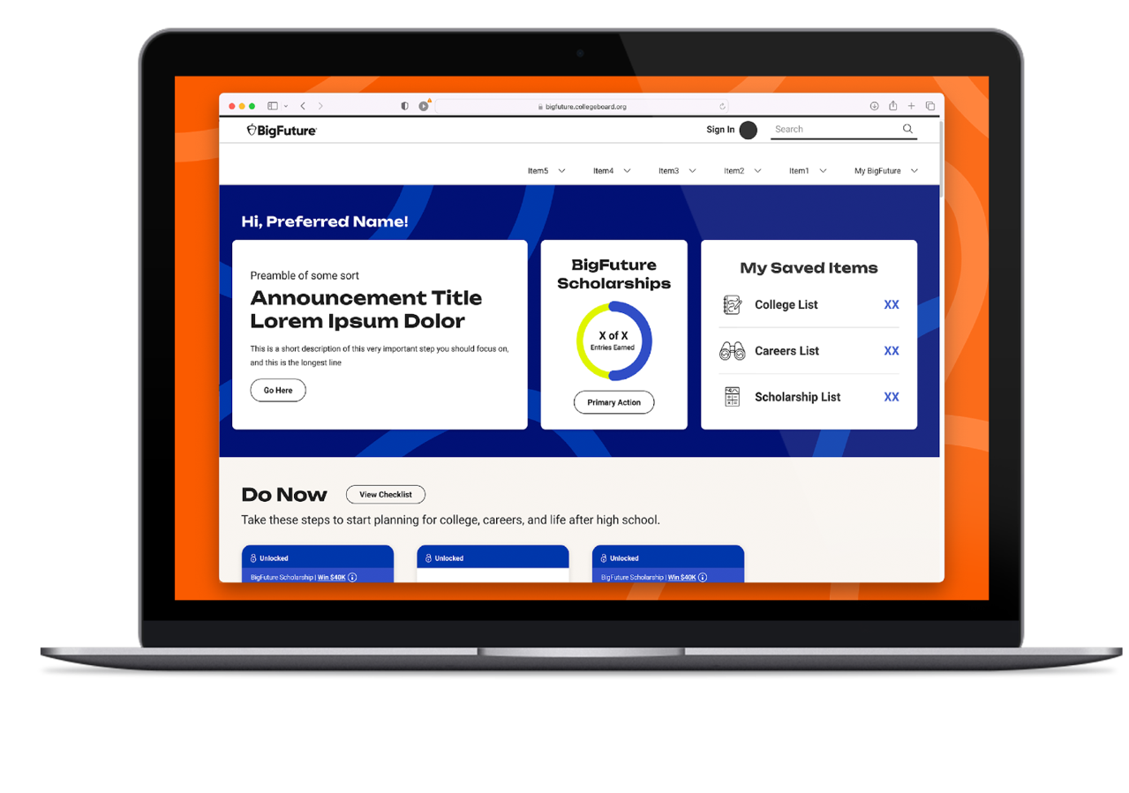
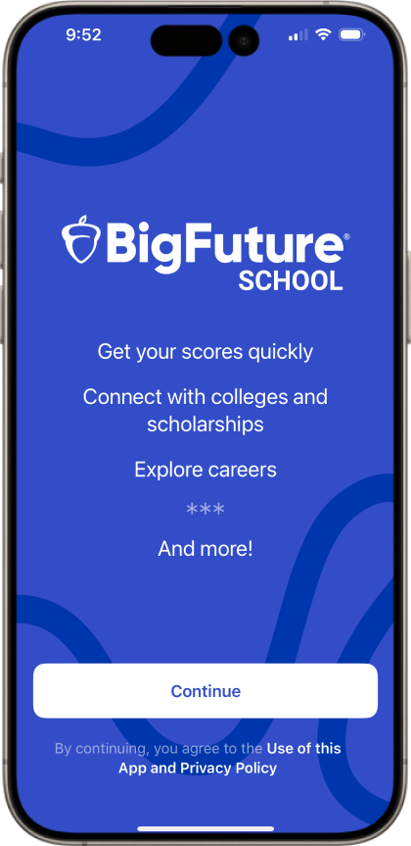
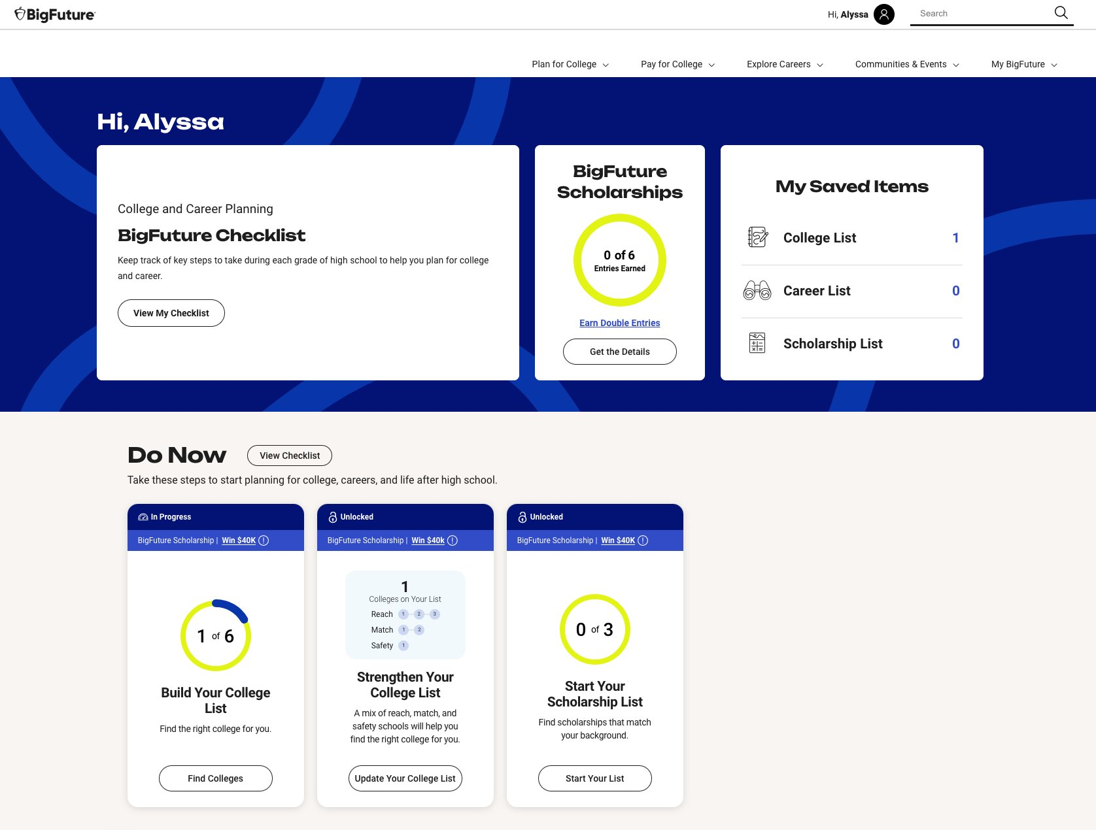
Using BigFuture
BigFuture brings together a trusted community to help each and every learner own their future.
BigFuture provides two complementary tools to help students explore their college and career options and plan for what comes next.
BigFuture.org
BigFuture School
(Available to all students)
(Available to in-school SAT Suite of Assessments test takers 13 or older)
Notes:
Once you have your scores, you can use BigFuture to look for schools that are a good fit, for careers that interest you, and for scholarship opportunities that will help you pay for school.
Within BigFuture there are two free, complementary solutions: BigFuture.org and BigFuture School mobile app.
Both tools work to help you discover what comes next after graduation.
​BigFuture.org is a free website for all students to explore careers, plan and pay for college, and access scholarships and recognition.
BigFuture School is a mobile app for students 13+ who take in-school SAT Suite assessments. It connects test-takers with their scores and timely college and career guidance.
Each platform is built with privacy and student choice at the core. Whether you are planning college, career, or still figuring it out—BigFuture and its tools are designed to meet you where you are.

Slide 32

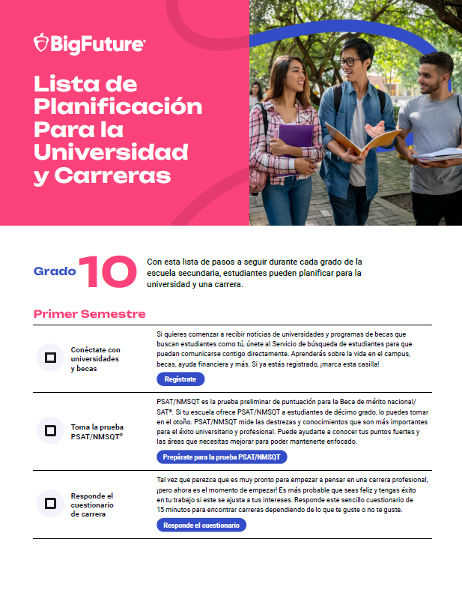
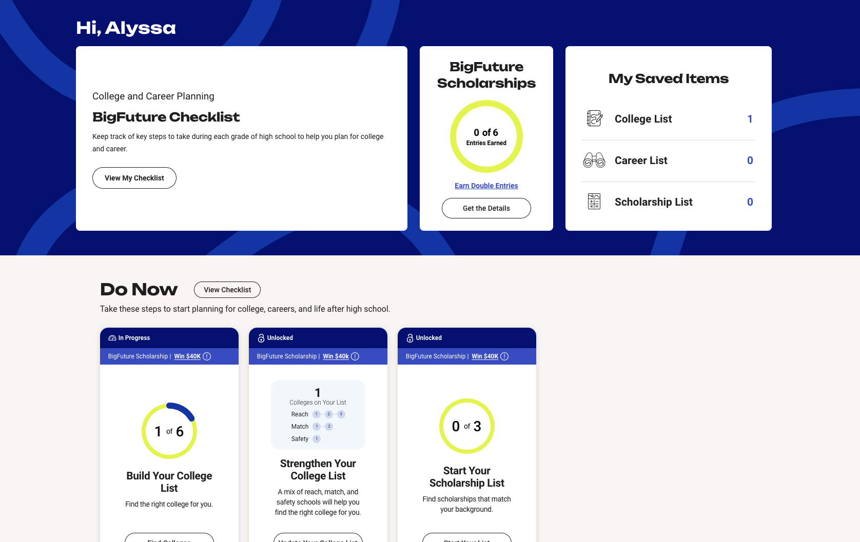
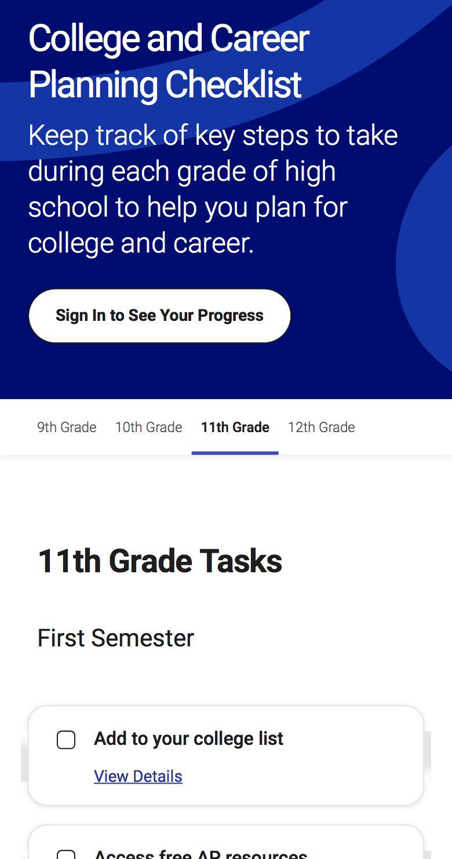
BigFuture.org
With BigFuture.org, all students can envision a future that’s bigger.
Notes:
BigFuture.org is a free, student-friendly platform that helps make postsecondary planning feel possible and personalized.
This is where any student—regardless of their path after high school—can explore careers, build a college list, find scholarships, and plan for how to pay for college.
When you create a free account, you get a personalized dashboard that guides you step-by-step through key actions, and even tracks your progress along the way.
BigFuture also includes easy-to-follow planning checklists, organized by grade and semester—available in both English and Spanish. These checklists help you stay on track from 9th to 12th grade.
And it’s widely used: over 15 million students engage with BigFuture every year.
Ultimately, it’s all about helping you see yourself in the planning process—so you feel confident taking the next step toward college, a career, or both.

Slide 33
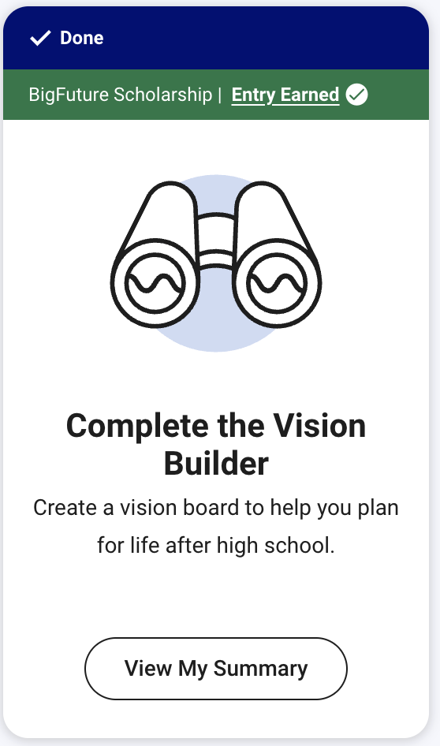

BigFuture Scholarships reward action.
$26M+
has been awarded to more than 31,000 students nationwide since 2019.
Students whose families earn less than $60,000 per year have double the chances of winning.
The earlier they start and the more steps they complete, the more chances they have to win.
Steps to Qualify for the Class of 2029:
Build Your Vision | Take the College Quiz | Start Your College List
Start Your Career List | Find Your College Fit | Start Your Scholarship List
bigfuture.org/scholarships
Notes:
BigFuture Scholarships are open to sophomores, juniors and seniors.
You earn entries for taking steps toward college and career planning like building a college list, starting a career list, and starting a scholarship list.
.
BigFuture awards hundreds of $500 scholarships and two $40,000 scholarships every month for tasks that you do every day.
PLAY VIDEO https://www.youtube.com/watch?v=X054QyER59U

Slide 34
BigFuture Scholarships (classes of 2027 and 2028)
BigFuture awards hundreds of $500 and 2 $40,000 scholarships monthly!
Start your Career List
Build Your College List
Explore Scholarships
Save 3 or more careers on Career Search
Save 3 or more colleges on College Search
Save 3 or more scholarships on Scholarship Search
Strengthen Your College List
Complete the FAFSA
Apply to Colleges
Submit applications to at least 2 colleges.
Save 1 safety, 2 match, and 3 reach schools on College Search
Complete the FAFSA®, submit a state aid form, or be legally ineligible to submit both the FAFSA and a state aid form.
Notes:
Note to counselor: These are the steps students take to earn entries into the scholarship drawing. These are the steps all students should take to prepare for college and career. Read through the steps on the slide.
When you complete 1 or more qualifying steps on BigFuture, you’ll be automatically entered into drawings for $500 or $40,000, awarded monthly
The sooner you complete steps and the more steps you take, the more entries you’ll earn.
Your entries for each month will be included in future drawings.
If your family earns less than $60,000 per year, you have extra chances at BigFuture Scholarships and earn double the entries for every drawing.
You can opt out of monthly scholarship drawings at bigfuture.org/scholarships-opt-out.

Slide 35
National Recognition Programs
Three Award Designations:
School Recognition Award
First-Generation Recognition Award
Rural and Small-Town Recognition Award
Program Cycle (Dates Coming in Early 2027):
Academic honors that help high-performing students stand out to colleges and celebrate their hard work.
Spring
Late June
Early Fall
Eligible students claim awards.
Deadline to claim awards.
Awardee certificates available.
Notes:
College Board’s National Recognition Program is an academic honors that helps high-performing students stand out to colleges and celebrates hard work.
The program offers 3 award designations. You can qualify for more than one award. You can only earn each award once in high school.
The 3 award categories are:
First-Generation Recognition Award
Rural and Small Town Recognition Award
School Recognition Award.
The awardee certificates will be available by September to eligible students who have claimed their awards.
How you qualify:
Achievement on assessments
Top 10% of PSAT/NMSQT or PSAT 10 test takers
In your high school OR
Among first-generation students in your state OR
Among rural and small-town students in your state
Scored 3+ on 2+ AP distinct exams in 8th, 9th and/or 10th grade (Based on scores in 2024 or before)
Cumulative GPA of B+ or higher (at least 3.3 or 87-89%)

Slide 36

SAT Suite Practice Resources
College Board and our partner resources are free and accessible to all students, with proven results.
Bluebook Practice
Tests & My Practice
Build confidence and
target improvement with
11 full-length, adaptive Bluebook practice tests.
Review questions, answer explanations and get tailored questions in My Practice.
Student Question
Bank
Access and filter thousands of real SAT questions by skill and level for even more tailored practice.
Question
of the Day
Stay sharp with new daily questions. Earn badges, build streaks and have fun!
Khan
Academy
Grow skills with Official
SAT Prep, built in partnership with College Board. Available direct to students and for states, districts, and schools.
Schoolhouse.world
Get free, live Official SAT tutoring through virtual small-group sessions led by trained peer volunteers. Build skills, ask questions, and learn alongside peers.
satsuite.collegeboard.org/practice
Notes:
Some of you may want to begin to build your skills for the SAT. If you want to practice, College Board offers multiple free practice tools, including full length practice tests on Bluebook, tailored practice quizzes in My Practice, the student question bank that allows you to practice thousands of questions in the areas you want to focus on, SAT Question of the Day, Official SAT Test Prep on Khan Academy, and live tutoring sessions through Schoolhouse.world.
Students who tested on a school day and again on a weekend have a mean score of 1166. Students who tested on a school day alone have a mean score of 906.

Slide 37
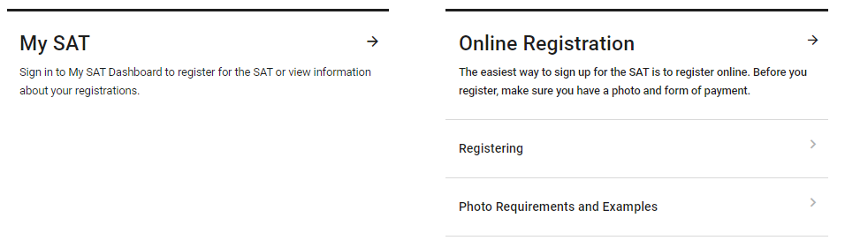
Register for the SAT Weekend
www.sat.org/register
Notes:
Once you’ve sharpened your skills, you may want to try and improve your SAT score. You can register for SAT on a weekend right through your personal College Board account or by going to sat.org/register.
You can sign in to My SAT to register. You’ll need to upload a photo and print or save an admission ticket.

